Slide 1
Key Words
River
Erosion
Deposition
River banks
Sediment
Oxbow lake
Formation of meanders and oxbow lakes
Learning Objectives:
To be able to explain how a meander is formed and changes over time
To be able to create a diagram of the formation of meanders and oxbow lakes
Do Now
Name as many major rivers as you can from around the world

Slide 2
Name as many major rivers as you can from around the world

Slide 3
Name as many major rivers as you can from around the world

Slide 4
4
Erosion
Deposition
Outside bank
Inside bank
Shallow
Deep
Fastest flow
Slowest flow
Re-cap
2
3
1
8
6
5
7
1
2
8
5
7
3
6
4

Slide 5
Why do rivers meanders change shape?
Key Words
River
Erosion
Deposition
River banks
Sediment
Oxbow lake
Write one sentence that explains why you think rivers meanders change shape.
Meanders are constantly changing their shape and position. This is a result of lateral (sideways) erosion and deposition in the river channel.
Extension
Guess how long you think it takes for a rivers meander to move or change shape.

Slide 7
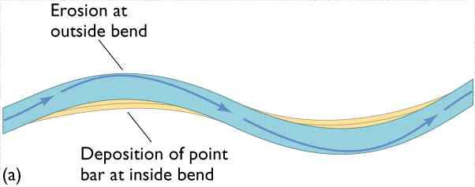
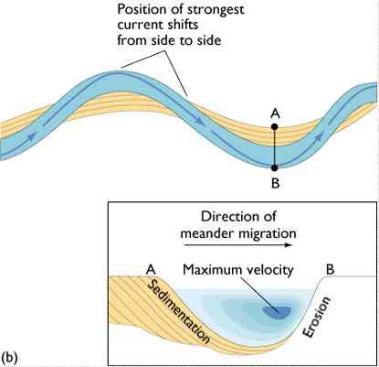
Key Words
River
Erosion
Deposition
River banks
Sediment
Oxbow lake
1) Why does erosion take place at the outside of the river bend? 2) Why does deposition occur on the inside of the bend?

Slide 8
1
2
3
4
https://www.youtube.com/watch?v=WGiX3VT2vTM
Deposition
Erosion

Slide 9
Key Words
River
Erosion
Deposition
River banks
Sediment
Oxbow lake

Slide 10
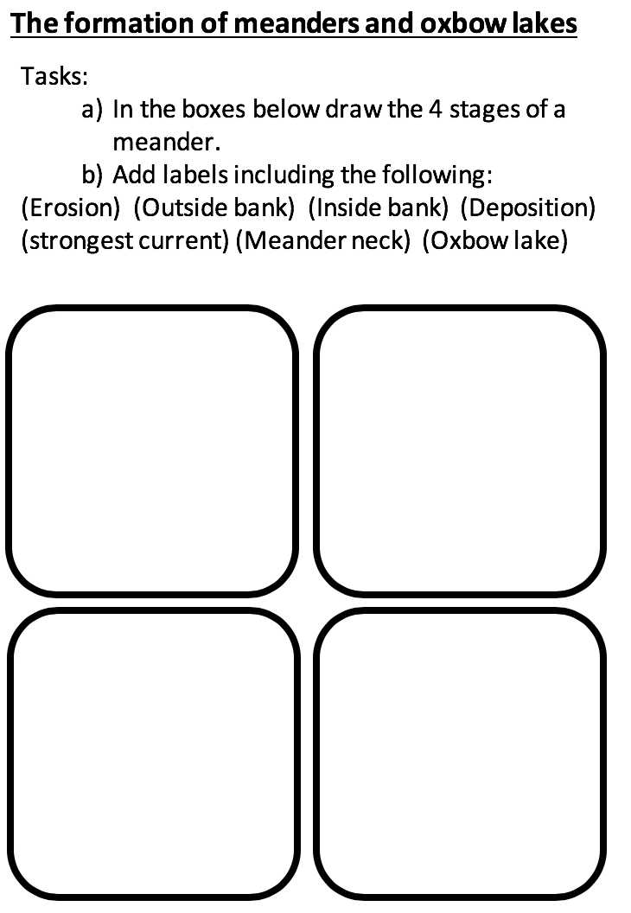

Slide 11
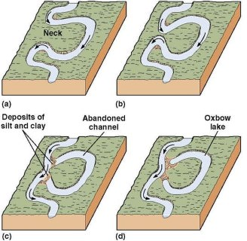
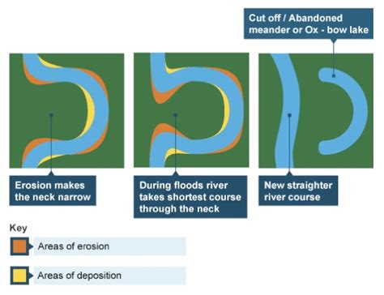
Task:
1) Follow the instructions on top of your worksheet.
2) In your book explain what is happening in each stage of your diagram. This must be done in full sentences.

Slide 12
Key Words
River
Erosion
Deposition
River banks
Sediment
Oxbow lake
Sort the statements into the correct order
2
The river is eroding laterally (from side to side).
3
The river erodes the outside bank and deposits on the inside bank so the river shape changes.
1
The river is meandering across the valley.
New deposition seals off the old meander and the cut-off section becomes an ox-bow lake.
7
5
Often during a flood the river will cut through the neck.
The river continues down its new course and the meander is abandoned.
6
4
This erosion narrows the neck of the meander.

Slide 13
Key Words
River
Erosion
Deposition
River banks
Sediment
Oxbow lake
Sort the statements into the correct order
The river is meandering across the valley.
The river is eroding laterally (from side to side).
The river erodes the outside bank and deposits on the inside bank so the river shape changes.
This erosion narrows the neck of the meander.
Often during a flood the river will cut through the neck.
The river continues down its new course and the meander is abandoned.
New deposition seals off the old meander and the cut-off section becomes an ox-bow lake.

