Slide 1
Where are these places in the World?
Can you guess?

Slide 2
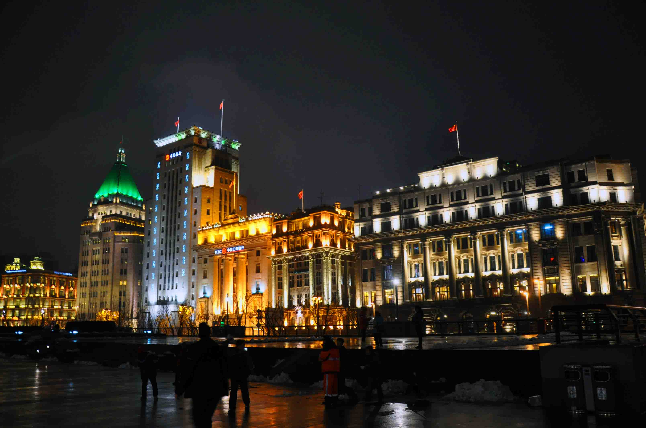

Slide 3
The Bund – Shanghai

Slide 4
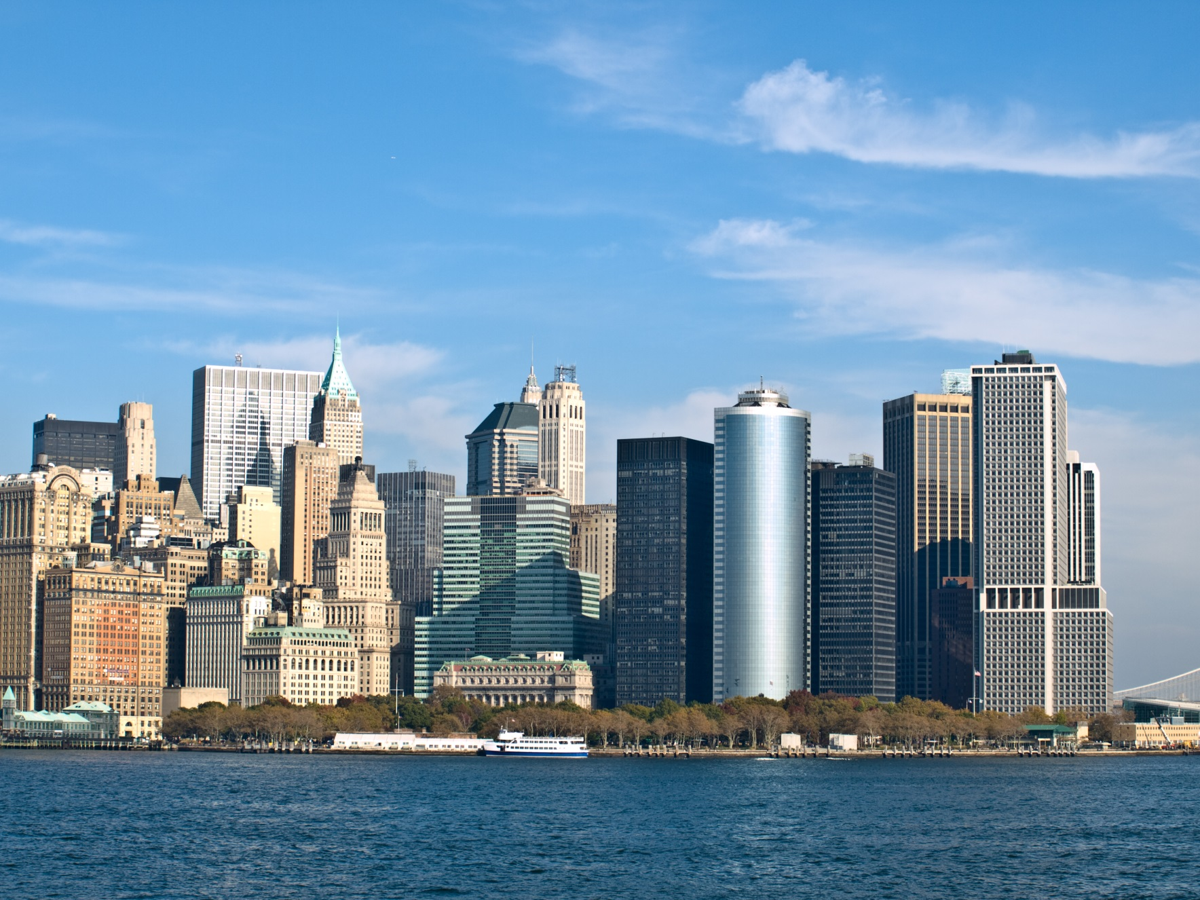

Slide 5
New York skyline

Slide 6
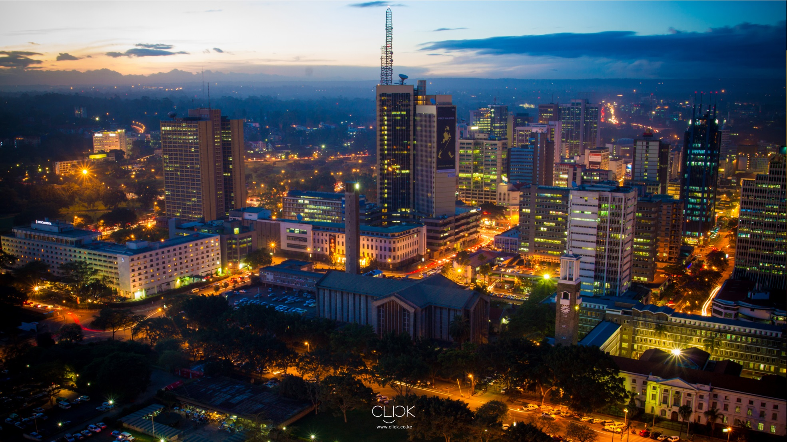

Slide 7
Nairobi - Kenya

Slide 8
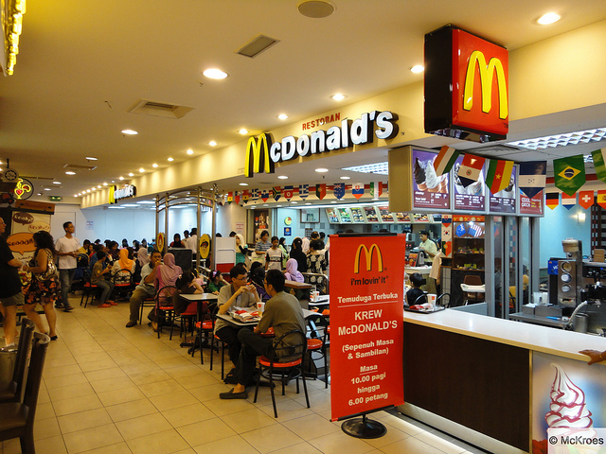

Slide 9
Kuala Lumpur - Malaysia

Slide 10
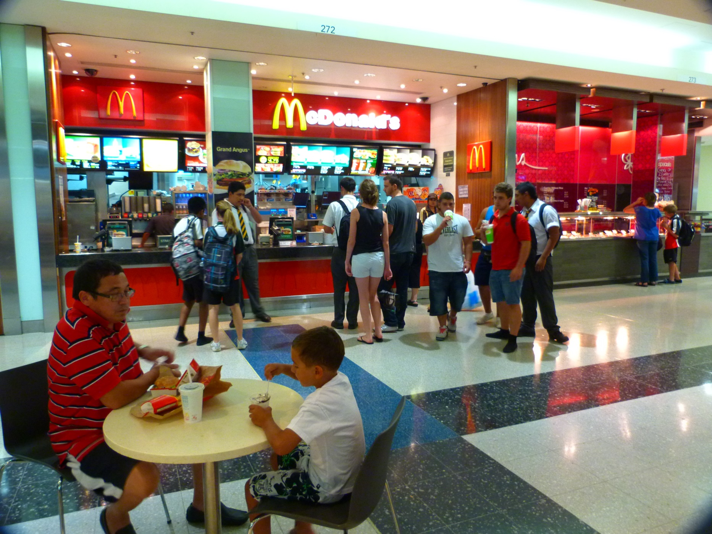

Slide 11
Sydney - Australia

Slide 12
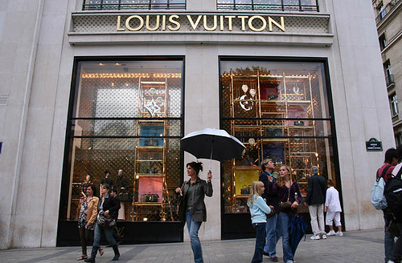

Slide 13
Paris - France

Slide 14
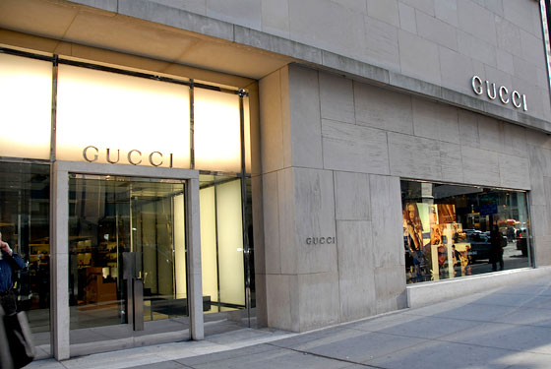

Slide 15
New York - USA

Slide 16
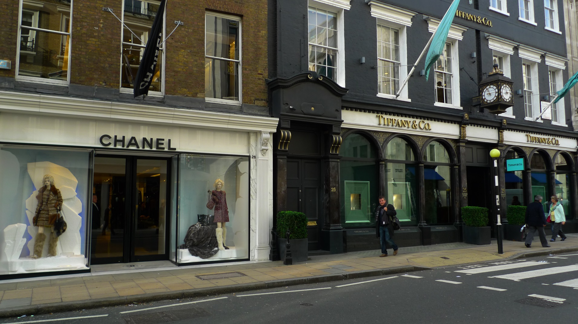

Slide 17
Bond Street London - UK

