Slide 1
Urban Modelling and Theories

Slide 2
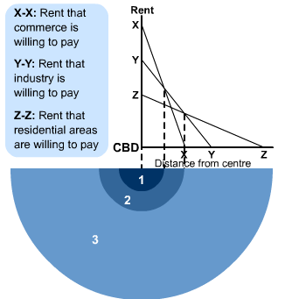
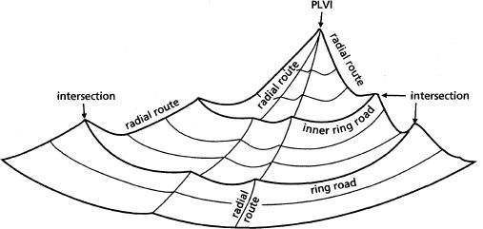
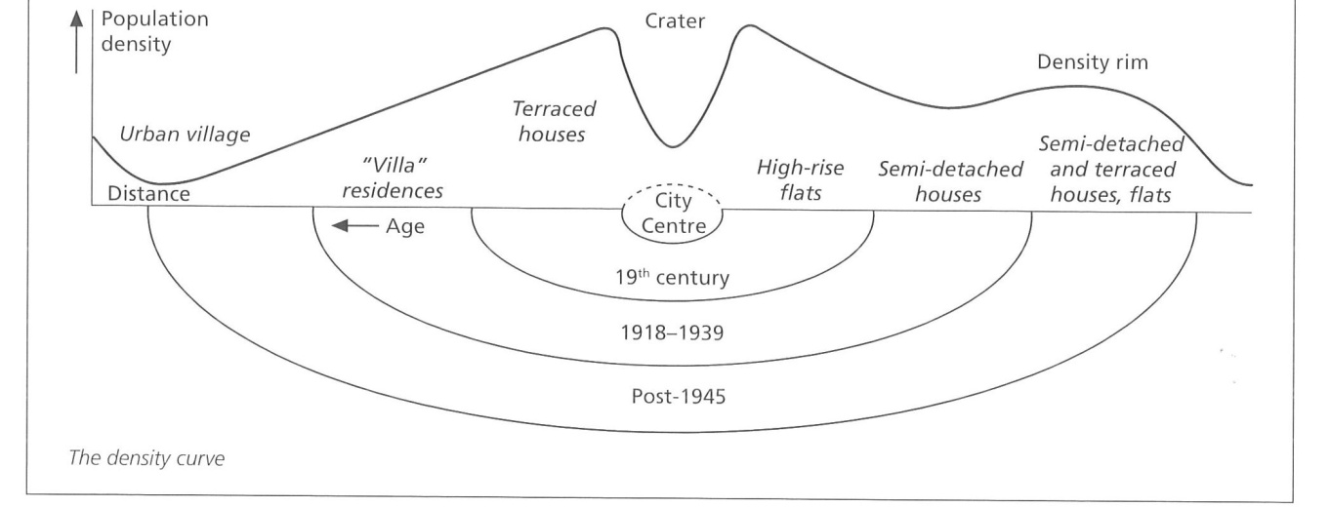
Bid-Rent Theory
Distance-Decay Principle
PLVI: Peak Land Value Intersection

Slide 3
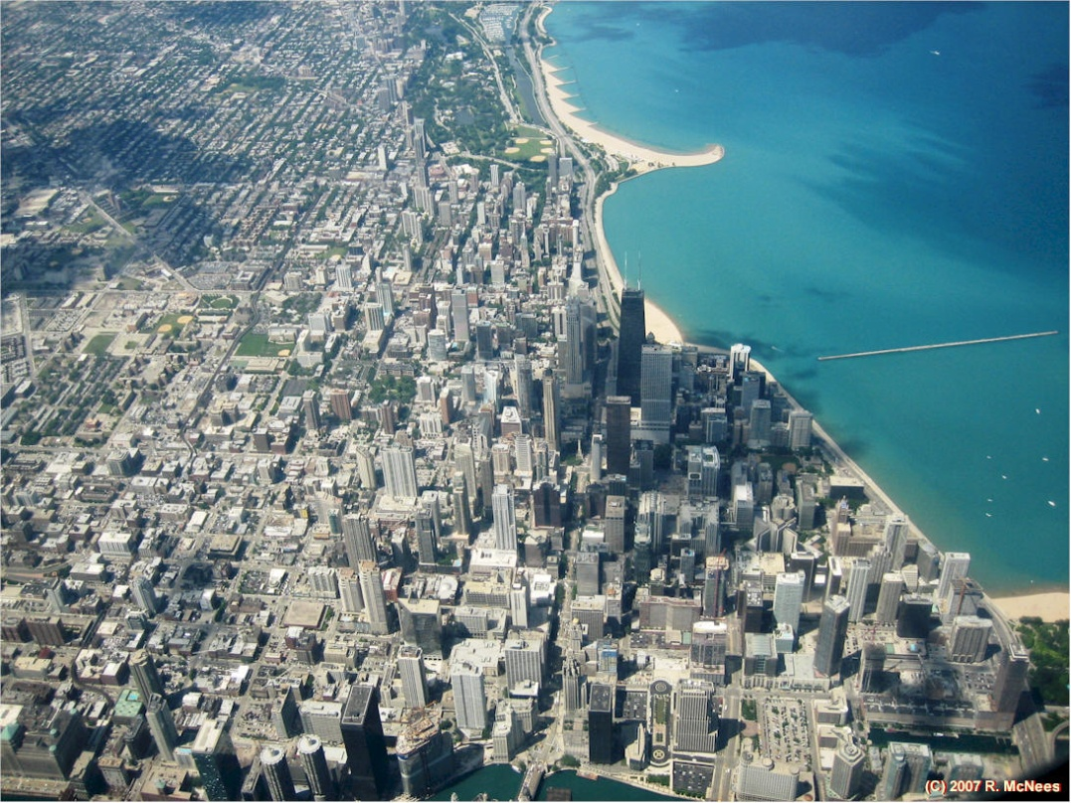
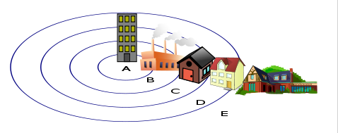
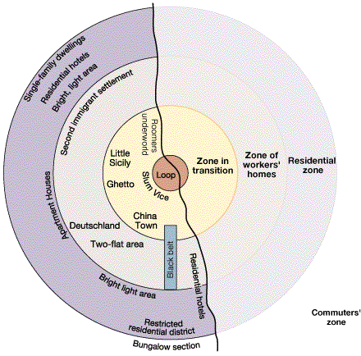
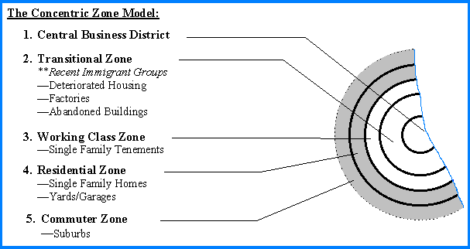
Burgess model

Slide 4
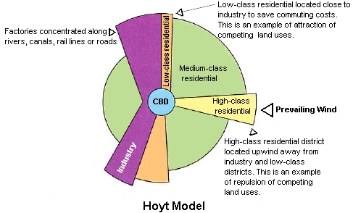
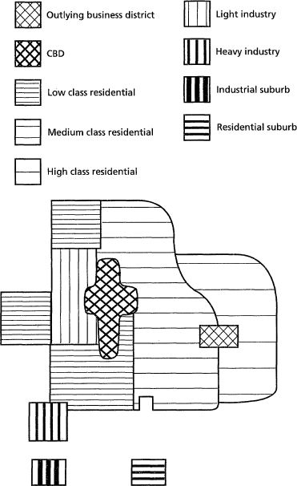
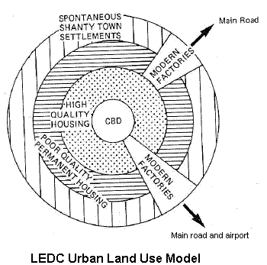
Ullman-Harris Multiple nuclei model

Slide 5
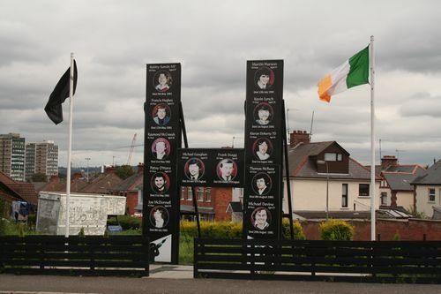
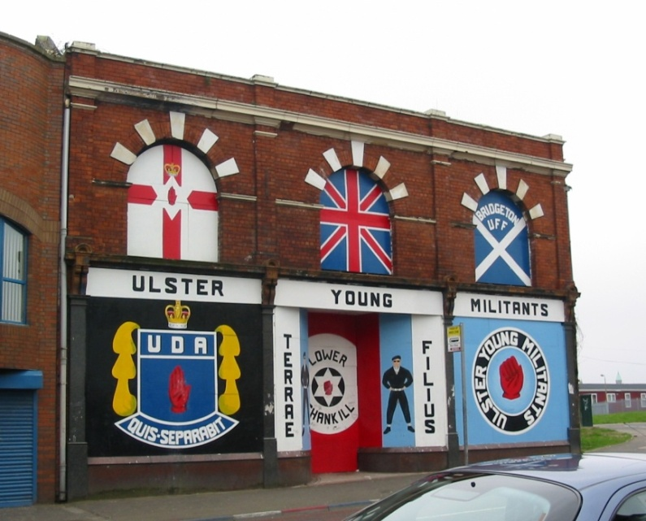
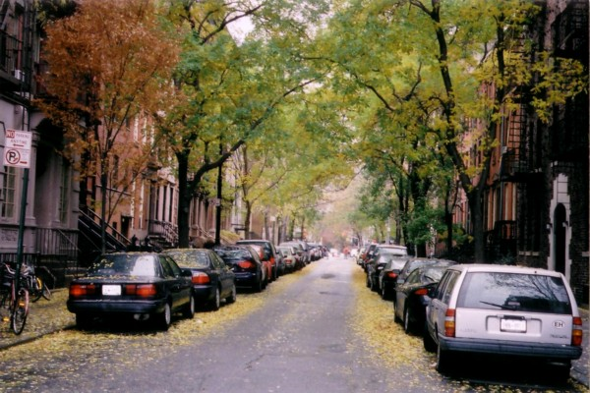
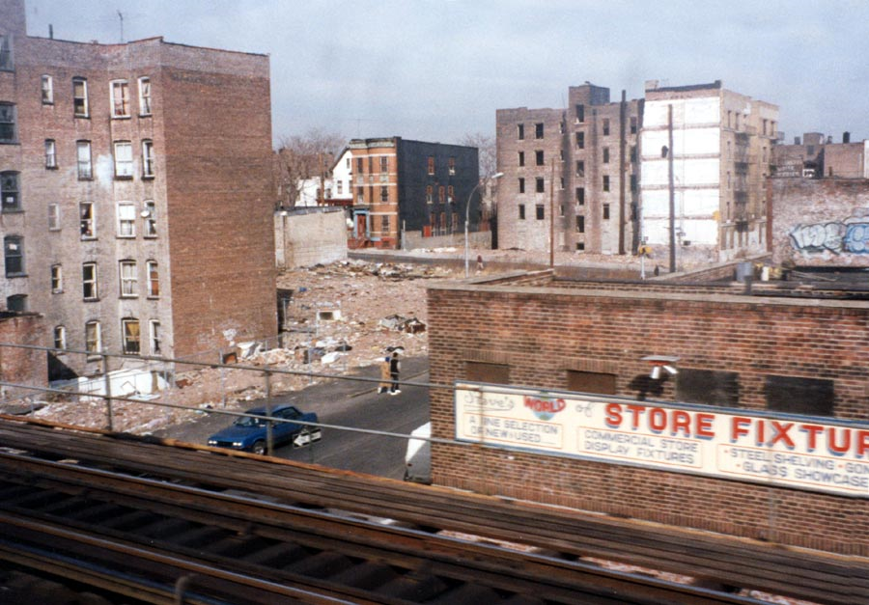
Belfast (Northern Ireland, UK): the neighborhoods of Falls vs Shankill
New York City: Greenwich Village vs the Bronx
Explain the segregation criteria for the examples shown
Suggest other criteria

Slide 6
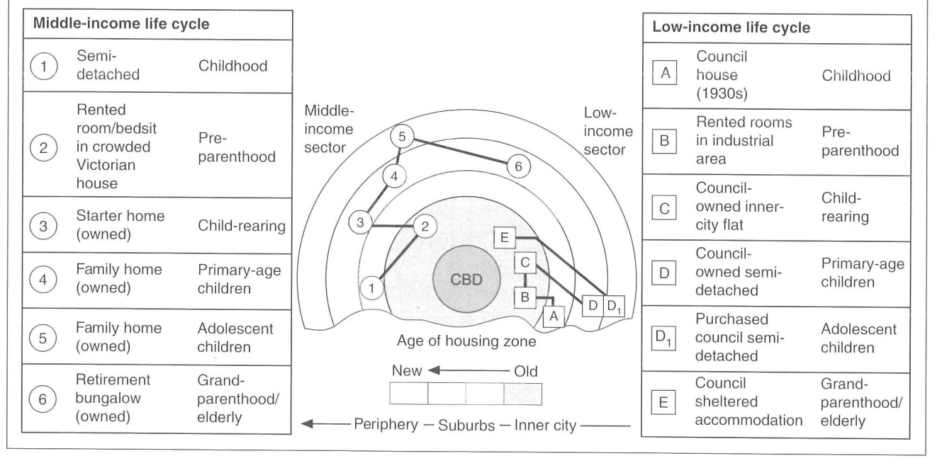
Family life cycle
Quality of life
Explain the phases of the “family life” cycle in a city

Slide 7
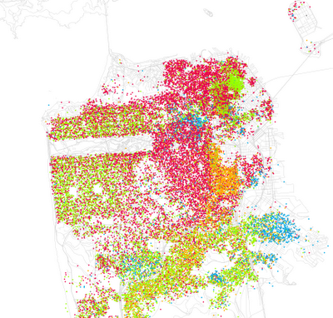
White
Asian (Chinese)
African-Am.
Latino
African-Am.
Mixed (Asian/White)
Asian (Philipino)
Identify the criteria for urban segregation on both maps
Name one homogeneous and one heterogeneous neighborhood in San Francisco
Explain the process of “positive” segregation (Mission) vs “negative” segregation (Noe Valley)

Slide 8
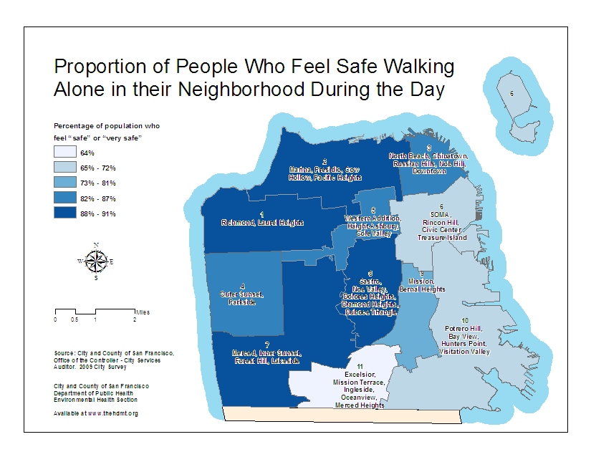
Crimes reported in Nov 2010
Perceived security/insecurity
What can you conclude from comparing the two maps?
Name other measures of urban deprivation:
“Physical” indicators
Social indicators
Economic indicators
Political indicators

Slide 9
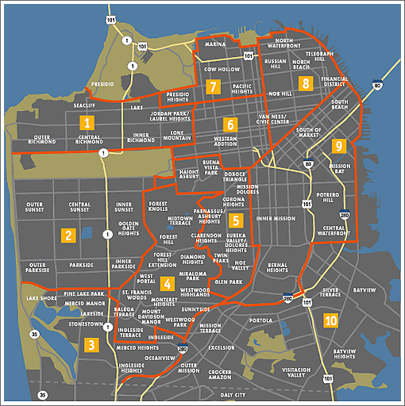
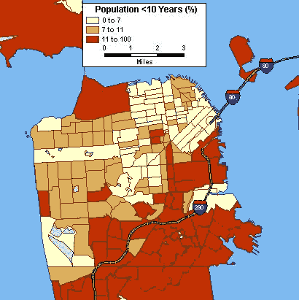
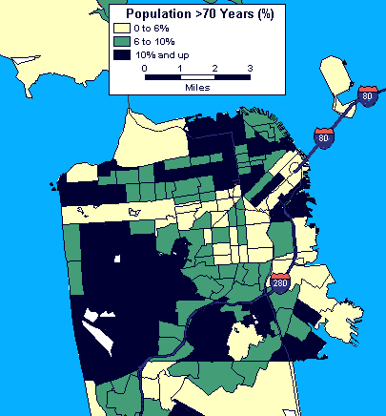

Slide 10
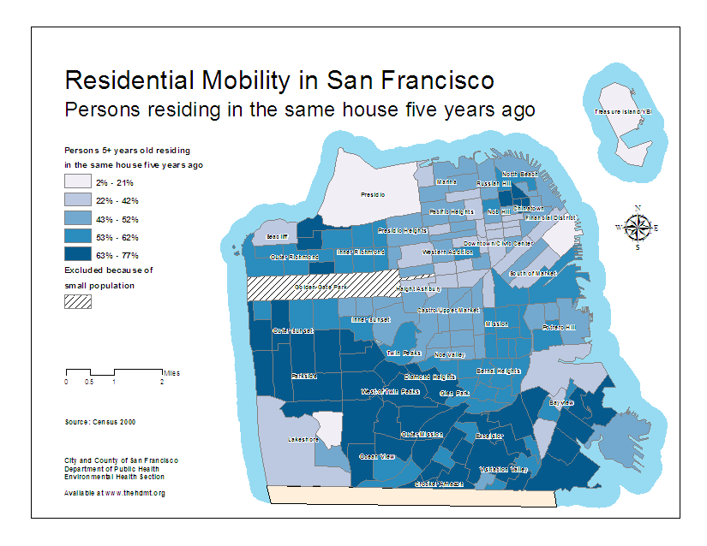

Slide 11
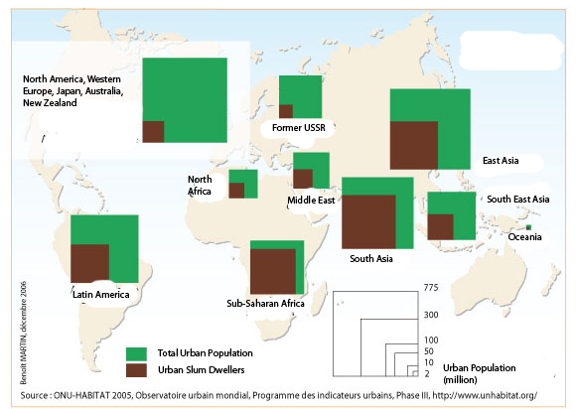
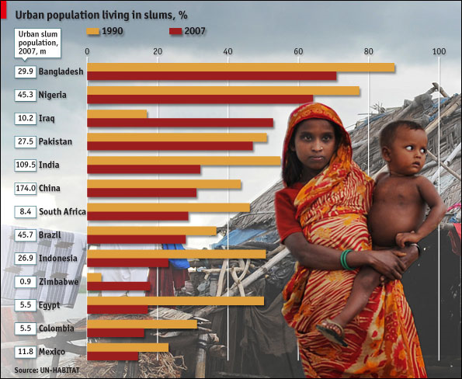
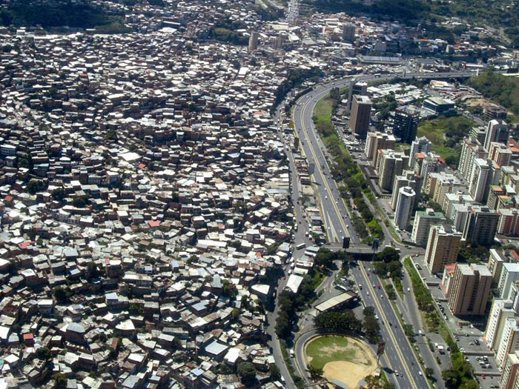
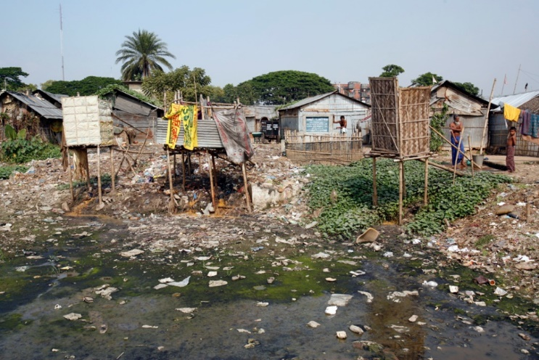
Slum Dwellers (World, 2005)
Slum Dwellers (1990-2007)
Caracas (Venezuela)
Dhaka (Bengladesh)

Slide 12
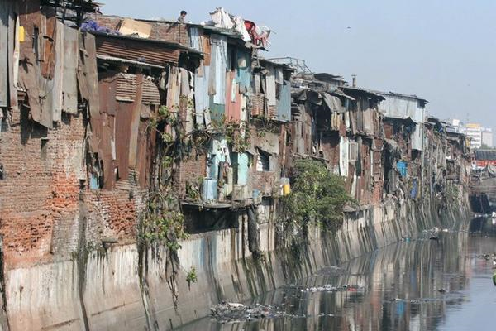
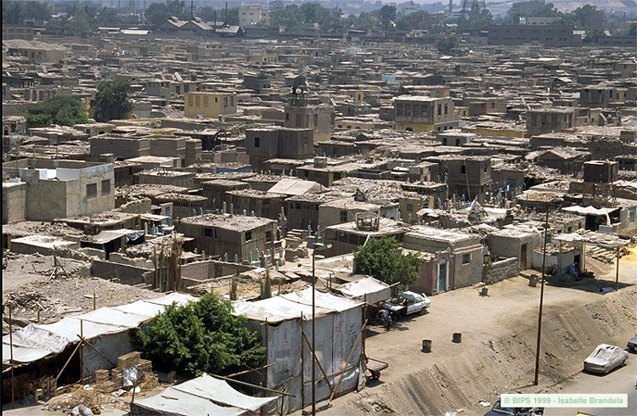
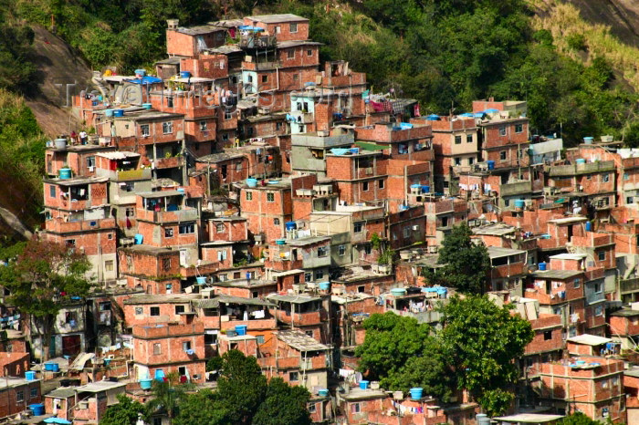
Shantytown in Mumbai (India)
City of the Dead in Cairo (Egypt)
Identify characteristics of slum:
Tenure
Services
Constructions
Population density
Type of economy
etc
Favela da Rocinha
in Rio de Janeiro
(Brazil)

Slide 13
Stage 1: “invasion” Stage 2: “Consolidation”
Stage 3: “Upgrading” Stage 4: “Assimilation”

Slide 14
URBAN SEGREGATION IN DEVELOPING COUNTRIES: RIO DE JANEIRO
Vegetation
Recent slums
Poor migrants
Lack of basic services
Older slums
upgrading process
Some services
Luxury housing
High end amenities
Middle/Upper class housing
Desirability/age of neighborhood – Wealth of residents
Beach

Slide 15
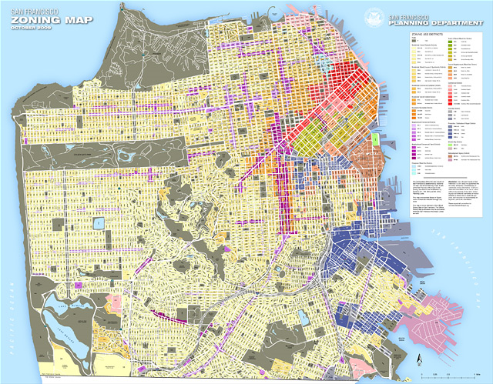
San Francisco Zoning Map (www.sf-planning.org)

Slide 16
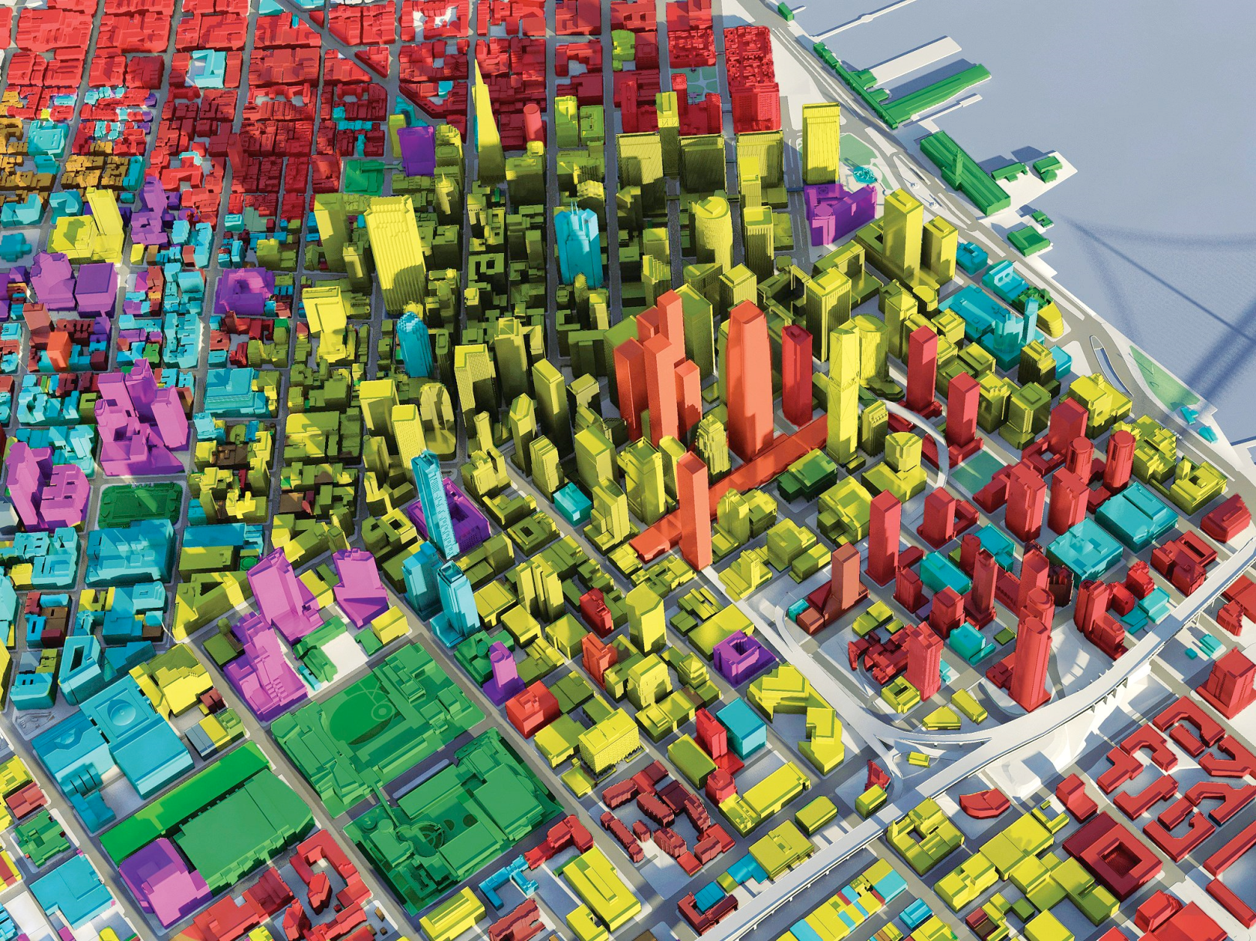
San Francisco CBD zoning

Slide 17
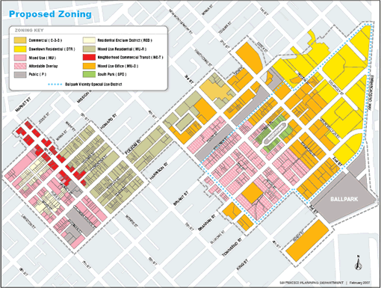

Slide 18
Key
Mostly residential
(middle/upper class)
Parks
Financial District
Shops, nightlife, boutique hotels
Luxury shops, high-end hotels
Theaters & art galleries
Cultural landmarks / Museums
United Nations
Port of New York
Airports
Train Station
Cruise Terminal
Metro link
Ferry link
Harlem
URBAN LAND USE:
MANHATTAN
Upper West Side
Central Park
“Museum Mile”
Upper East Side
Hudson River
Times Square
New Jersey
Grand
Central
Chelsea Piers
Chelsea
La Guardia
Fifth Avenue
Queens
Greenwich
Village
East River
SoHo
East Village
Battery Pk
Wall Street
JFK
Brooklyn
Newark
Statue of Liberty
Ellis Island

Slide 19
URBAN LAND USE:
SAN FRANCISCO BAY
Key
Ocean/Bay
Protected areas
Urbanized areas
Universities
CBDs
Hi-Tech district
Airports
Cruise terminal
Commercial harbors
Highways
Bridges
Urban sprawl
“Edge cities”
Walnut Creek
Vallejo
San Rafael
Berkeley
Dublin
SF Bay
Marin
Oakland
Mount Diablo
Mount Tamalpais
GG Bridge
Bay Bridge
San Francisco
Fremont
Pacific Ocean
Silicon Valley
San Jose
Stanford
Crystal Springs Reservoir

