Slide 1
Map skills
Aims:
To reflect on what we have learnt
Be able to follow and describe routes on a map

Slide 2
Topic review
What mapskills have we covered?
Symbols
Direction
Grid references
Measuring distance
Height and relief

Slide 3
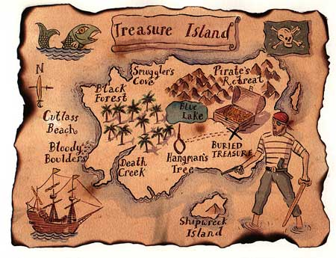
Treasure map
You need;
Grid squares
Contours
Scale
Map symbols
Direction
Height and relief (contour lines)

Slide 4
Treasure map
The purpose of your treasure map is to have 10 clues for your teacher to follow to take them on a journey across your island to find where you have buried the treasure. Your clues must be clear and you must have the correct answers for them!
Start at 258895 and walk north 3km. Now you are at GR………………………….. In order to get to GR 358899 you must walk……………………………….
Start at 234,789 walk NW for 5KM then bear east “as the crow flies” 4Km. You are now at_________________________.

Slide 5
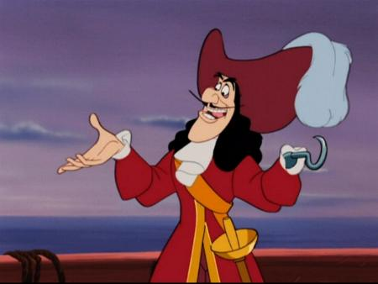
Tips
Try to make it look authentic
Plan it first
Take care with presentation and be imaginative!
Look at the markscheme

Slide 6
The most imaginative and well made maps will be receiving Credits

