Slide 1
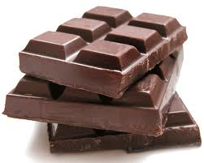
Guess what we are studying today?

Slide 2
Trade and Chocolate
LOs
1) To know key terms associated with trade?
2) To understand where chocolate is produced and traded?
3) To understand who are the winners and losers of chocolate trading?
Starter: Key term matching!!

Slide 3
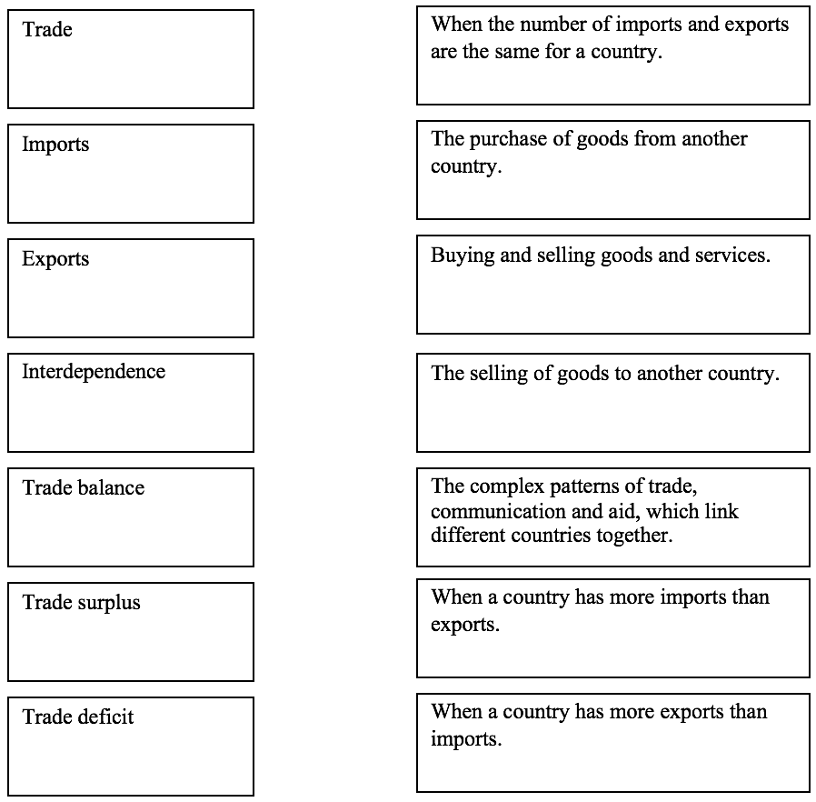
First…let’s match those key terms…

Slide 4
Where does chocolate come from?
Notes:
Discuss the map.

Slide 5
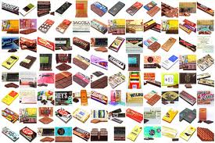
What about chocolate? Where is this traded and why? Who are the winners and losers? Film: Panorama – Chocolate: The Bitter Truth

Slide 6
Reflection
Who was aware of how these cocoa beans are produced?
Did anything surprise you?
So who makes the money out of trading chocolate?
Do you think this is fair? Why?

Slide 7
Chocolate: Where does all the money go??
Recap:
Company
Supermarket
Manufacturing
Farmer
Tax

Slide 8
Fair trade
A system whereby agricultural producers in
developing countries are paid a fair price for
their produce. This aims to help them to
achieve a reasonable standard of living.
i.e. a fair partnership between commercial owners (e.g. TNCs) and producers/farmers.

Slide 9
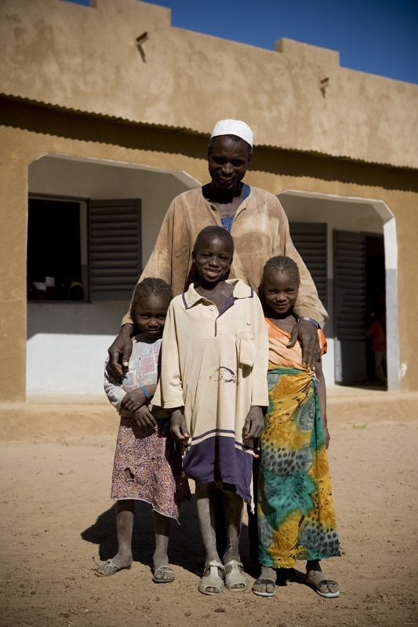
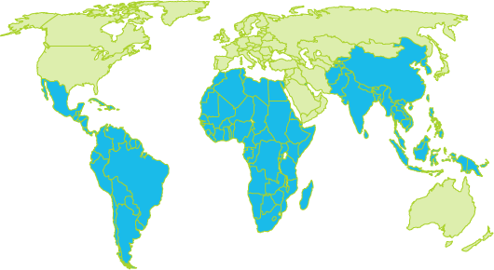
Fairtrade Foundation http://www.fairtrade.org.uk/
‘A world in which every person, through their work, can sustain their families and communities with dignity.’

Slide 10
Look for the Fairtrade symbol:
Notes:
Main policies to comply with include Composite Product Policy

Slide 12
http://www.youtube.co/watch?v=NZpUwCfINh8
Fairtrade: Homework
What is Fairtrade?
Name 10 Fairtrade products
What are the advantages of Fairtrade?
What are the disadvantages of Fairtrade?
Extension What else can be done to improve the living standards in LICs such as Ghana and the Ivory Coast?
Extension: Take photos of fairtrade products in Beijing!!!

Slide 13
Fair Trade Chocolate – Yes or No?
Is this a solution to the problems Ghana was experiencing? Why/why not?

