Slide 1
Bearings
Using a protractor to calculate bearings for the IGCSE examination

Slide 2
Bearings…
Tell us in what direction something is
Are more accurate than using compass points
Always measure the angle clockwise from North

Slide 3
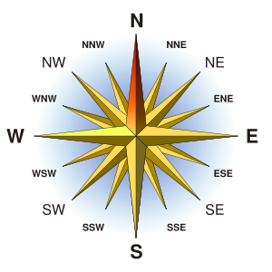
Matching compass points…
000°
338°
023°
315°
045°
293°
068°
270°
090°
248°
113°
225°
135°
203°
158°
180°

Slide 4
Important!
Always pay attention to the direction you will be taking the bearing from
A
The bearing of A to B will be completely different to the bearing B to A.
B

Slide 5
Measuring bearings…
Find the bearing of B from A.
Mark the North line on at A (if there isn’t a North line draw one in)
Draw the line connecting A to B.
x
A
Measure the angle clockwise from the North line to B
x
B

Slide 6
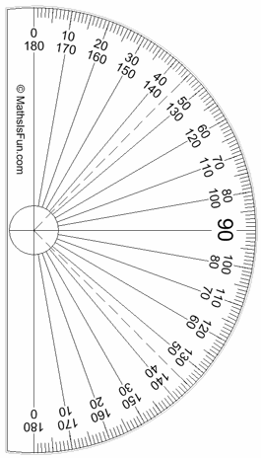
Measuring bearings…
Find the bearing of B from A.
Place your protractor over the north line with 0° at the top.
Give the answer as a three-figure bearing
A
The bearing of B from A is 135°.
B

Slide 7
Measuring bearings…
Find the bearing of A from B.
Mark the North line on at B (if there isn’t a North line draw one in)
Draw the line connecting B to A.
x
A
Measure the angle clockwise from the North line to A
x
B

Slide 8
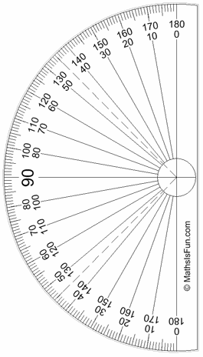
Measuring bearings…
Find the bearing of A from B.
Place your protractor over the north line with 0° at the bottom.
x
A
Because you are measuring clockwise you need to measure the exterior angle.
x
B
The angle has gone past 180° so you will need to add your measurement to 180°

Slide 9
Measuring bearings…
Find the bearing of A from B.
135 °
The measurement from the bottom 0° is 135°.
x
A
135° + 180° = 315°.
The bearing of A from B is 315°.
x
B

