Slide 1
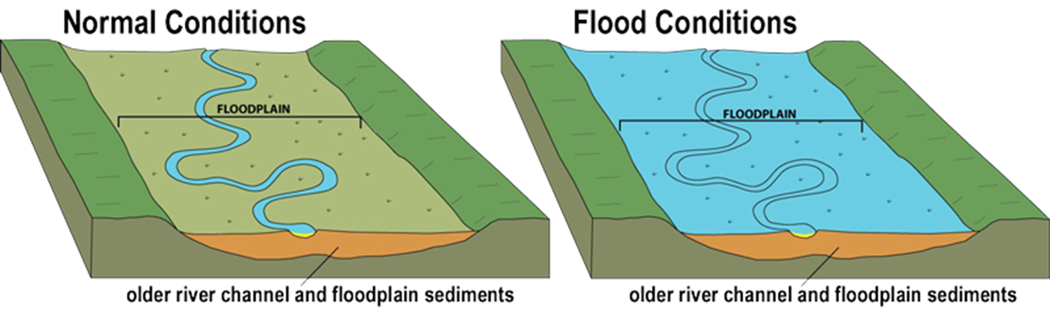
What are Floods?
When the river’s discharge exceeds the carrying capacity of the channel a river will flood. The water level then rises above the banks and spreads onto the floodplains.

Slide 2
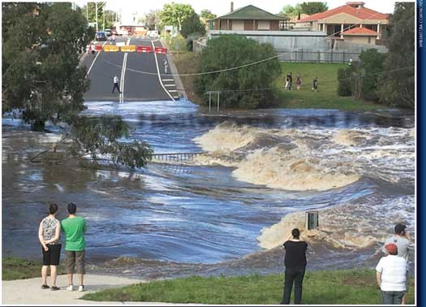
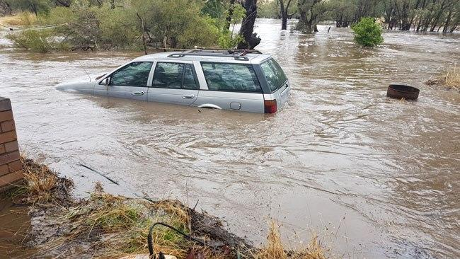
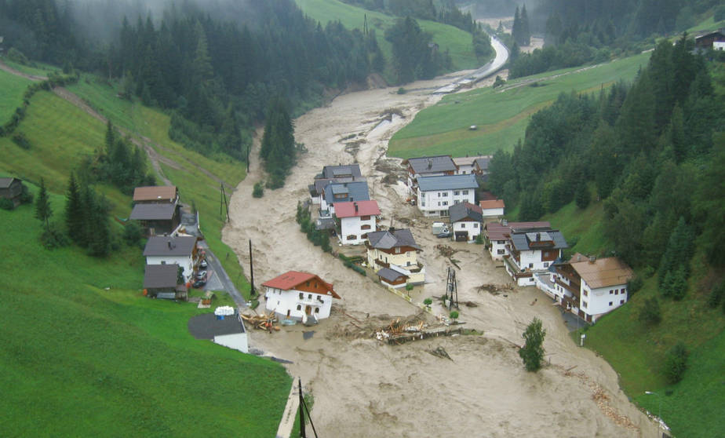
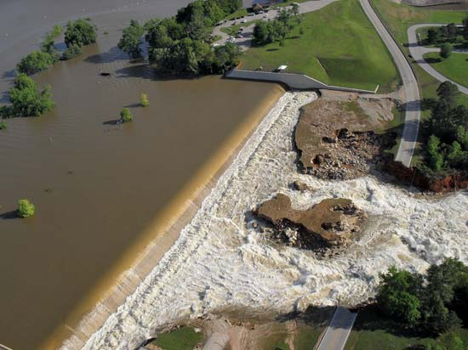

Slide 3
Construction
And
Analysis of Hydrographs

Slide 4
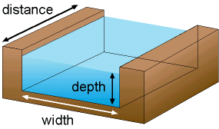
Hydrograph
Record of River Discharge over a period of time
River Discharge
= cross sectional area
X
rivers mean velocity
(at a particular point in its course)

Slide 5
Why
Construct & Analyse Hydrographs ?
To find out discharge patterns of
  a particular drainage basin
Help predict flooding events,
  therefore influence implementation of flood prevention measures

Slide 6
3
2
Discharge (m³/s)
1
0 12 24 36 48 60 72
Hours from start of rain storm

Slide 7
Rainfall shown in mm, as a bar graph
3
2
Discharge (m³/s)
mm
4
1
3
2
0 12 24 36 48 60 72
Hours from start of rain storm

Slide 8
Discharge in m³/s, as a line graph
3
2
Discharge (m³/s)
mm
4
1
3
2
0 12 24 36 48 60 72
Hours from start of rain storm

Slide 9
Rising limb
The rising flood water in the river
3
Rising limb
2
Discharge (m³/s)
mm
4
1
3
2
0 12 24 36 48 60 72
Hours from start of rain storm

Slide 10
Peak flow
Peak flow
Maximum discharge in the river
3
Rising limb
2
Discharge (m³/s)
mm
4
1
3
2
0 12 24 36 48 30 72
Hours from start of rain storm

Slide 11
Recession limb
Peak flow
Falling flood water in the river
3
Rising limb
2
Recession limb
Discharge (m³/s)
mm
4
1
3
2
0 12 24 36 48 30 72
Hours from start of rain storm

Slide 12
Basin lag time
Basin lag time
Peak flow
Time difference between the peak of the rain storm and the peak flow of the river
3
Rising limb
2
Recession limb
Discharge (m³/s)
mm
4
1
3
2
0 12 24 36 48 60 72
Hours from start of rain storm

Slide 13
Through Flow
Volume of water reaching the river through the soil and underlying rock layers
Basin lag time
Peak flow
+
3
Overland Flow
Volume of water reaching the river from surface run off
Rising limb
=
Overland flow
Recession limb
2
Storm Flow
Discharge (m³/s)
mm
4
Through flow
1
3
2
Base flow
0 12 24 36 48 60 72
Hours from start of rain storm

Slide 14
Analysis

Slide 15
Here are some theoretical interpretations of influencing factors
BUT……
When interpreting hydrographs all factors must be considered together !

Slide 16

Factors influencing
Storm Hydrographs
Area
Shape
Slope
Rock Type
Soil
Land Use
Drainage Density
Precipitation / Temp
Tidal Conditions

Slide 17
Area
Large basins receive more precipitation than small therefore have larger runoff
Larger size means longer lag time as water has a longer distance to travel to reach the trunk river
Area Rock Type Drainage Density
Shape Soil Precipitation / Temp
Slope Land Use Tidal Conditions

Slide 18
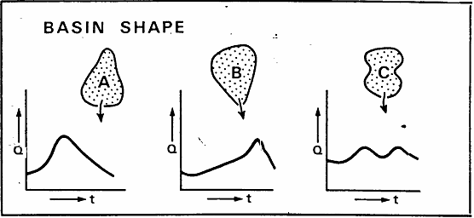
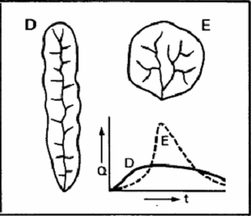
Shape
Elongated basin will produce a lower peak flow and longer lag time than a circular one of the same size
Area Rock Type Drainage Density
Shape Soil Precipitation / Temp
Slope Land Use Tidal Conditions

Slide 19
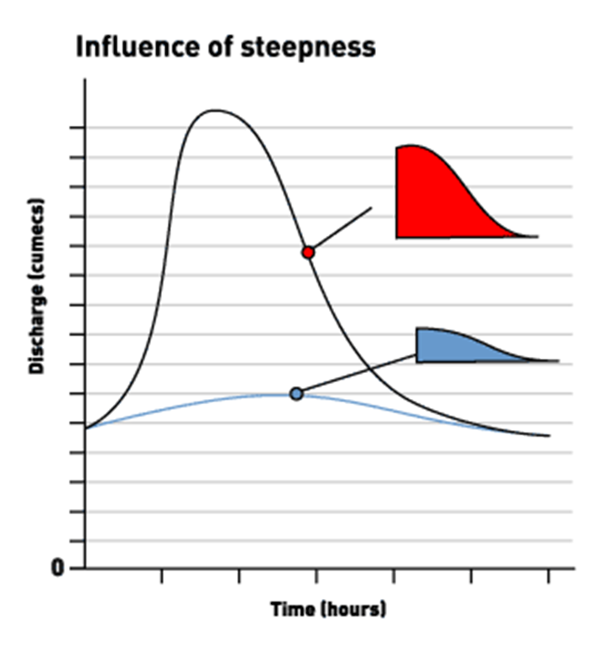
Slope
Channel flow can be faster down a steep slope therefore steeper rising limb and shorter lag time
Area Rock Type Drainage Density
Shape Soil Precipitation / Temp
Slope Land Use Tidal Conditions

Slide 20
Rock Type
Permeable rocks mean rapid infiltration and little overland flow therefore shallow rising limb
Area Rock Type Drainage Density
Shape Soil Precipitation / Temp
Slope Land Use Tidal Conditions

Slide 21
Soil
Infiltration is generally greater on thick soil, although less porous soils eg. clay act as impermeable layers
The more infiltration occurs the longer the lag time and shallower the rising limb
Area Rock Type Drainage Density
Shape Soil Precipitation / Temp
Slope Land Use Tidal Conditions

Slide 22
Land Use
Urbanisation - concrete and tarmac form impermeable surfaces, creating a steep rising limb and shortening the time lag
Afforestation - intercepts the precipitation, creating a shallow rising limb and lengthening the time lag
Area Rock Type Drainage Density
Shape Soil Precipitation / Temp
Slope Land Use Tidal Conditions

Slide 23
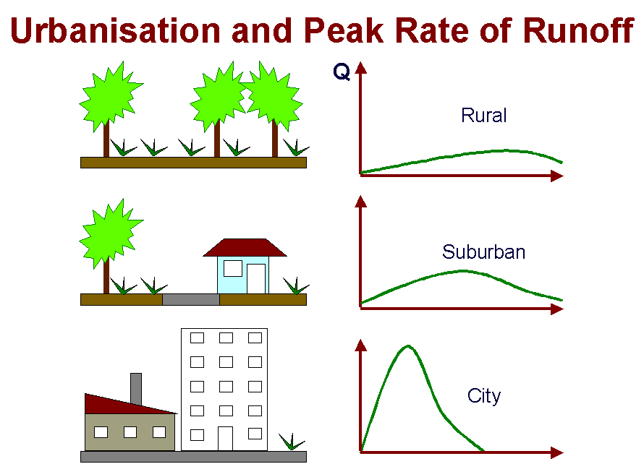

Slide 24
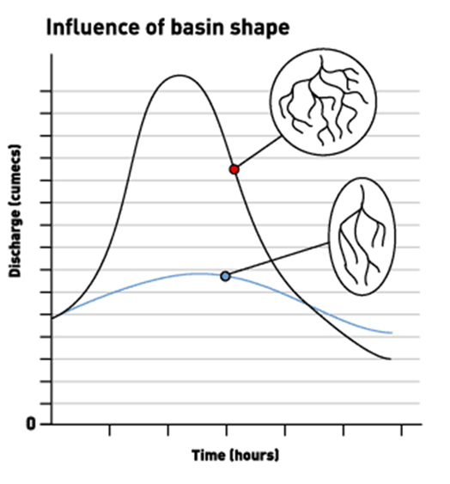
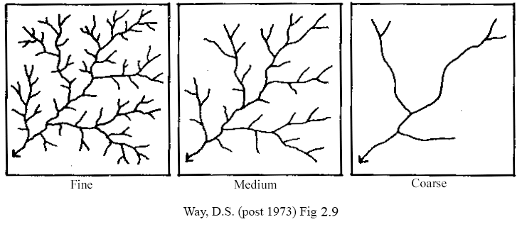
Drainage Density
A higher density will allow rapid overland flow
Area Rock Type Drainage Density
Shape Soil Precipitation / Temp
Slope Land Use Tidal Conditions

Slide 25
Precipitation & Temperature
Short intense rainstorms can produce rapid overland flow and steep rising limb
If there have been extreme temperatures, the ground can be hard (either baked or frozen) causing rapid surface run off
Snow on the ground can act as a store producing a long lag time and shallow rising limb. Once a thaw sets in the rising limb will become steep
Area Rock Type Drainage Density
Shape Soil Precipitation / Temp
Slope Land Use Tidal Conditions

Slide 26
Tidal Conditions
High spring tides can block the normal exit for the water, therefore extending the length of time the river basin takes to return to base flow
Area Rock Type Drainage Density
Shape Soil Precipitation / Temp
Slope Land Use Tidal Conditions

Slide 27
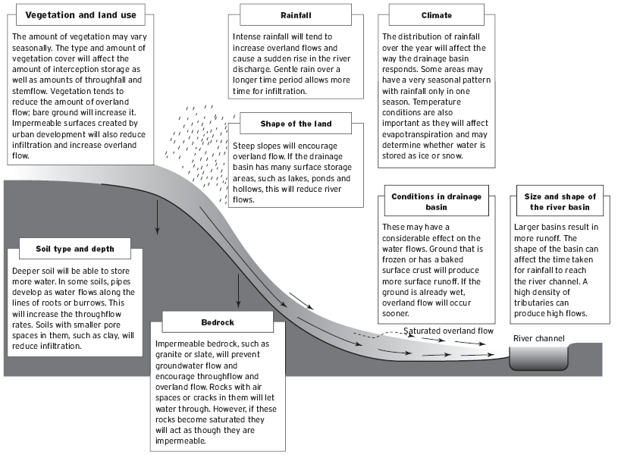
Factors influencing
hydrographs

Slide 28

Remember!
These influencing factors will:
Influence each other
Change throughout the rivers course
©Microsoft Word clipart

Slide 29

Made by:
Steven Heath

