Slide 1
What Type of Settlement Pattern can you see?

Slide 2
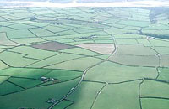
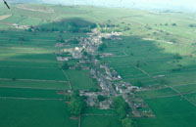
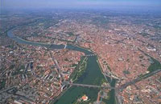
Settlement Patterns
Dispersed
Linear
Nucleated

Slide 3
Nucleated | Linear | Dispersed
When all the houses in a settlement are built very close together, often around a central village green or church. | This is a settlement that has grown in a line. The line doesn't have to be straight, but will normally follow a road, a river, the coast or the valley floor. | When individual buildings are separated by several hundred meters. They are individual isolated buildings and do not form a single settlement. Dispersed settlement traditionally occured in an area of adverse physical conditions where natural resources are insufficient to support more than a few people.

Slide 4
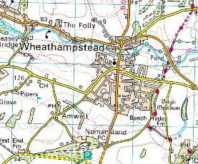
Nucleated, Linear or Dispersed?
Why?

Slide 5
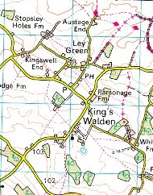
Nucleated, Linear or Dispersed?
Why?

Slide 6
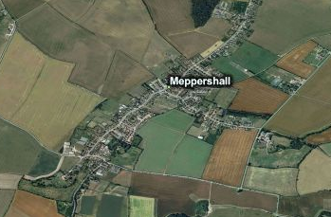
Nucleated, Linear or Dispearsed?
Why?

Slide 7
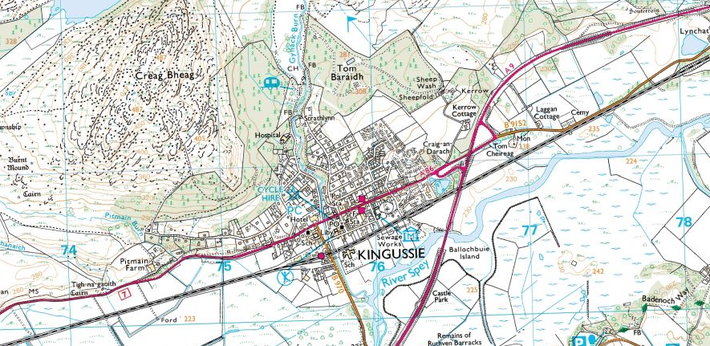
Nucleated, Linear or Dispersed?
Why?

Slide 8
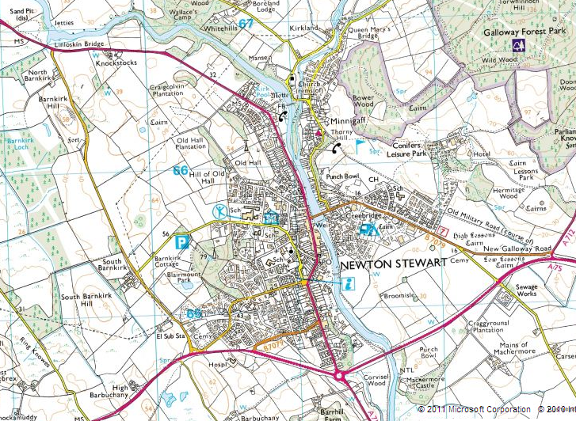
Nucleated, Linear or Dispersed?
Why?

Slide 9
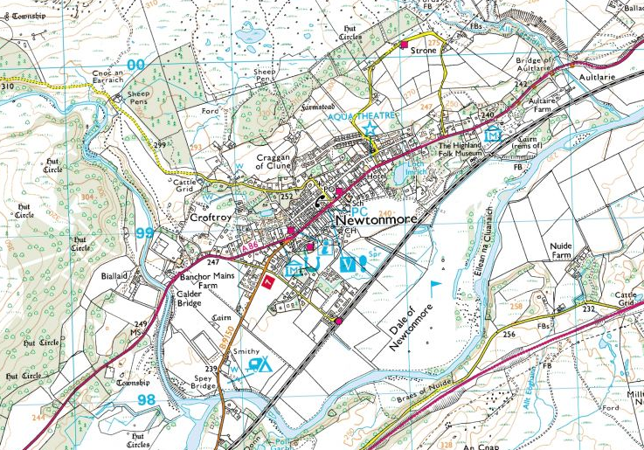
Nucleated, Linear or Dispersed?
Why?

Slide 10
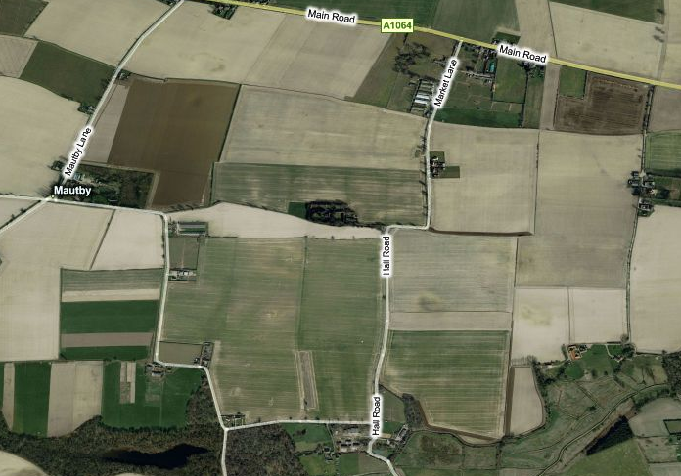
Nucleated, Linear or Dispersed?
Why?

