Slide 1
Rostow’s Stages of Development

Slide 2
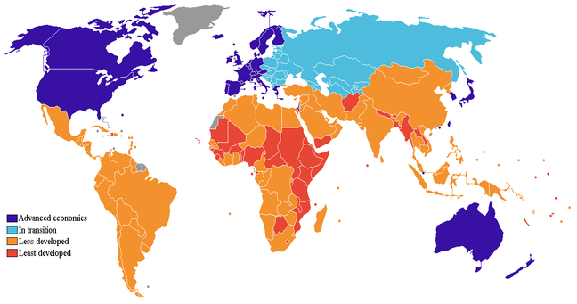
What is it?
A model of economic growth suggesting that all countries pass through a series of stages of development as their economies grow.

Slide 3
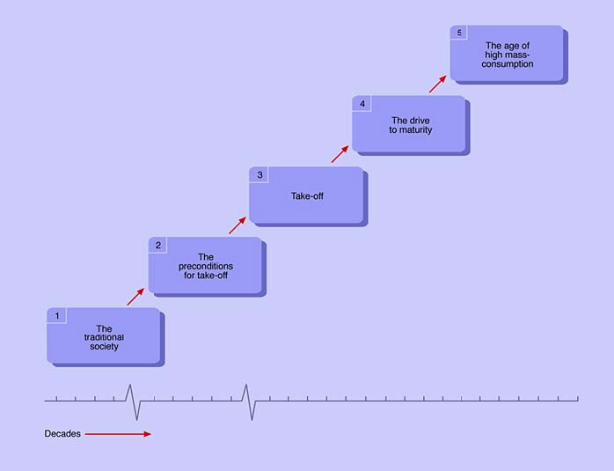
A series of 5 stages

Slide 4
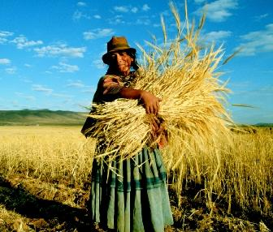
STAGE 1: Traditional Society
Dominated by subsistence agriculture
agricultural based economy
Intensive labor and low levels of trading
Having a population that has no scientific perspective on the world and technology

Slide 5
STAGE 2: Preconditions to take- off
Society begins to develop manufacturing
country advances to a more complex economy, beginning of economy development
levels of technology develop
development of a transport system- TRADE.
Rostow believed: could only be reached by a great achievement of a surplus of wealth
Notes:
When the levels of technology within a country develop and the development of a transport system encourages trade.

Slide 6
STAGE 3: TAKE- OFF
Short period of extensive growth.
Industrialization begins. Manufacturing more important part of economy
Introductions to technical innovations– economic rise
Agriculture progressed to commercial rather than subsistence

Slide 7
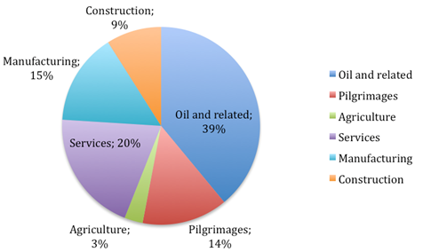
STAGE 4: The drive to Maturity
Takes place over a long period of time – standards of living rise
Use of technology increases
National economy grows and diversifies
Increased percentage of Nation’s wealth- invested into developing its economy

Slide 8
STAGE 5: High Mass Consumption
Individual incomes are greater than necessary for buying essentials
growing demand for additional consumer goods and services
Improved health care systems and education
Economy flourishes

Slide 9
DISADVANTAGES- Criticism
Has a strong bias towards a western model of modernization
Assumes that all countries follow the same route of development
Doesn’t look at variations within a country
Assumes that each country is economically and politically free

Slide 10
ADVANTAGES
Highly respected and referred to model
Primary example of the “intersection of Geography, economics and politics”
Most widely cited development theories

