Slide 1
Migration Models
Patterns of Movement
Reason for Movement

Slide 2
Push and Pull Factors
Push Factor / Push Forces
Pressures which persuade a person to move away from an area.
Pull Factor / Pull Forces
Those which attract the migrant to a particular destination.

Slide 3
Reason for Movement

Slide 4
Simple Migration Model
Location A
Location B
Push
Pull
Migration

Slide 5
Lee’s Migration Model
Real / Perceived
Intervening Obstacles
Location A
Location B
+
+
-
-
0
0
Does not isolate particular push and pull factors. Each site has a range of attributes. Different people will have different perceptions of the factors.
Intervening Place
?
+
-
0
Source: Adapted from Global Challenge. Alistair McNaught and Michael Witherick. Longman. 2001.

Slide 6
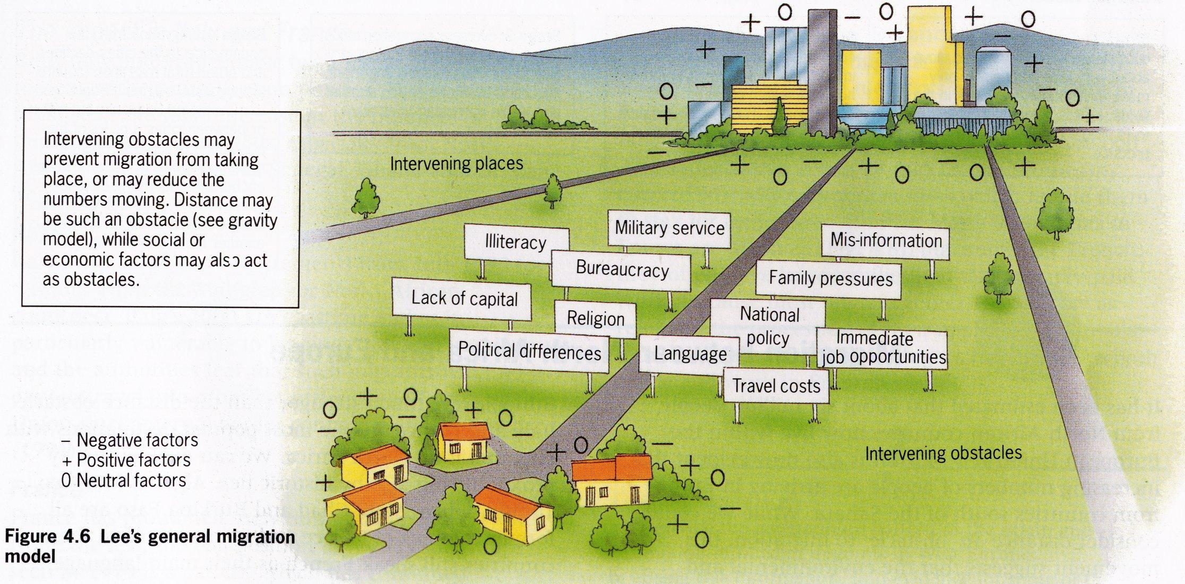
Lee’s General Migration Model
Source: Population, Resources and Development. Jane Chrispin and Francis Jegede. Collins Educational.1996.

Slide 7
Gravity Model
Based upon Newton’s law of Universal Gravitation
“The number of people moving between places A and B is equal to the population of A multiplied by the population of B divided by the square of the distance between them.”
The potential number of migrants will be bigger where the population of the of departure and and arrival are large.
The friction of distance acts as a break.

Slide 8
Todaro Model
Economic factors are the most influential of the push-pull factors.
Individual migrants weigh up the economic costs and benefits.
Policy makers can slow rural urban migration by creating investment and new employment opportunities in rural areas.

Slide 9
Patterns of Movement

Slide 10
Ravenstein’s Law
Studied patterns of migration in the UK in the 1880s.
The model is based on a series of predictive statements.
Number One
Most migrants move only relatively short distances.
There is an inverse relationship between the number of migrants and distance travels.
Distance decay.

Slide 11
Number Two
People who do move long distances are largely unaware of the opportunities that are available at their destination. So … they tend to move to large urban centres.
Number Three
Migration occurs in stages.
Number Four
People in rural areas are much more likely to migrate than those in urban centres. Based on the exponential growth of cities (natural increase + rural-urban migration).

Slide 12
Number Five
A typical migrant:
Women are more likely to migrate within their county than men.
Men are more likely to emigrate than women.
Most migrants are adult.

Slide 13
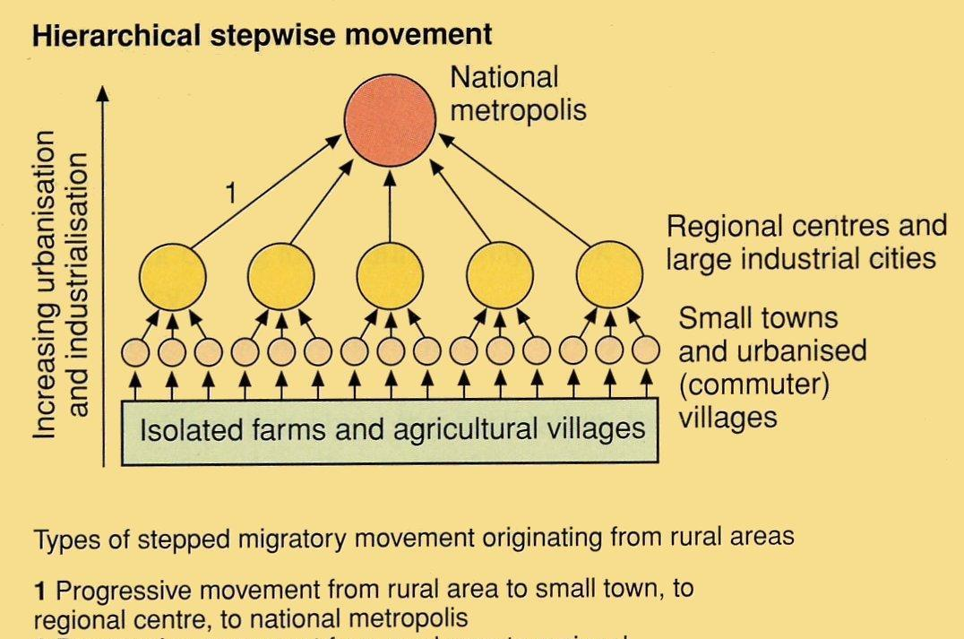
Step Migration

Slide 14
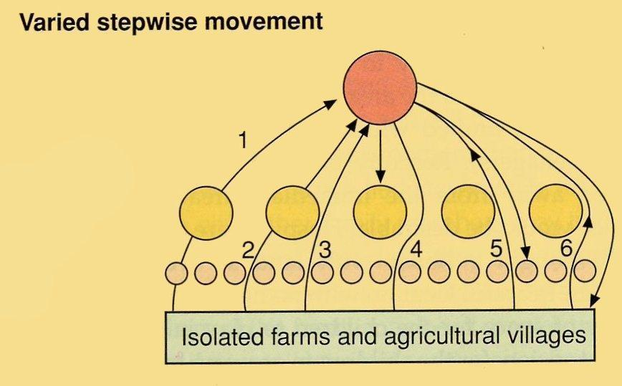
Step Migration

Slide 15
Circular Migration
Migrants do not settle permanently in their new homes.
Leave rural home at time of unemployment returning periodally with money.

