Slide 1
Migration from Mexico to the USA
Why are Mexicans leaving their country? PUSH FACTORS
Why are they attracted to the USA? PULL FACTORS

Slide 2
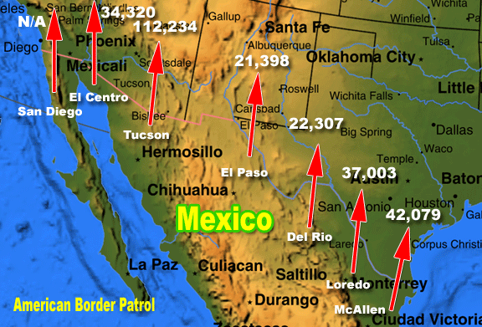
There is a 2000km border between the USA and Mexico.
1 million + Mexicans migrate to the USA every year.
Some Mexicans enter the USA legally for seasonal work.
But illegal migration is a huge problem for the USA and Mexico.

Slide 3
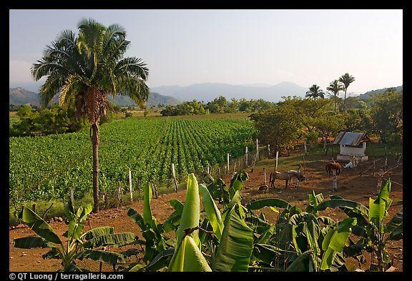
Mexican emigrants are mainly moving away from rural locations. Why?

Slide 5
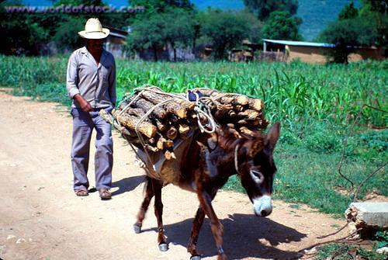

Slide 6
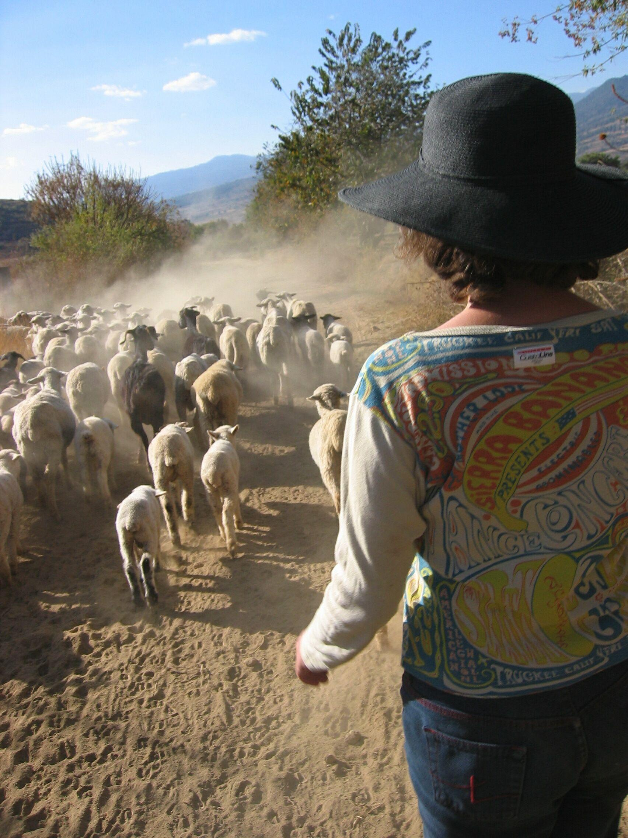

Slide 7
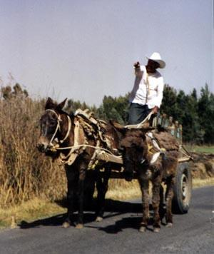

Slide 10
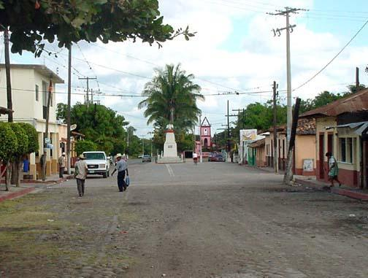

Slide 11
Push Factors – Reasons people leave Mexico
Poor medical facilities - 1800 per doctor
Low paid jobs - (GNP = $3750)
Adult literacy rates 55% - poor education prospects
Life expectancy 72 yrs
40% Unemployed
Unhappy life – poor standard of living
Shortage of food
Poor farming conditions

Slide 12
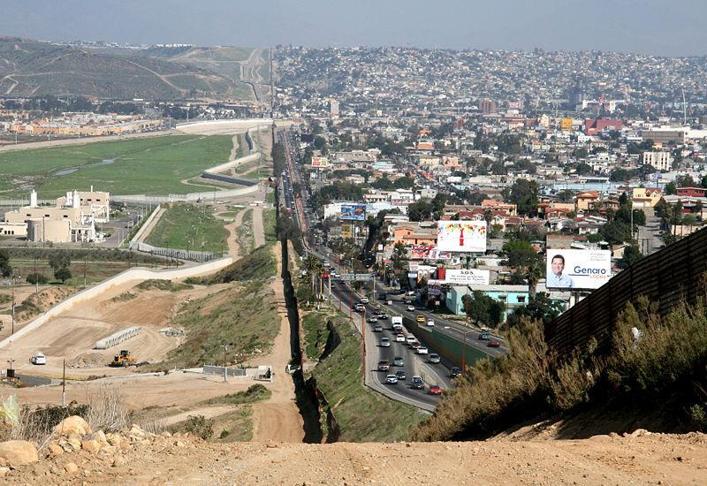

Slide 13
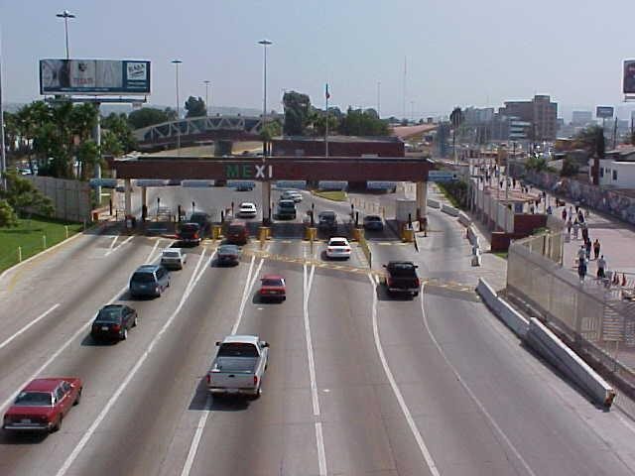

Slide 15
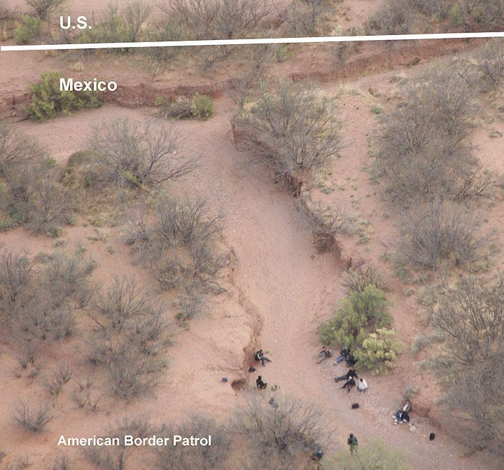

Slide 16
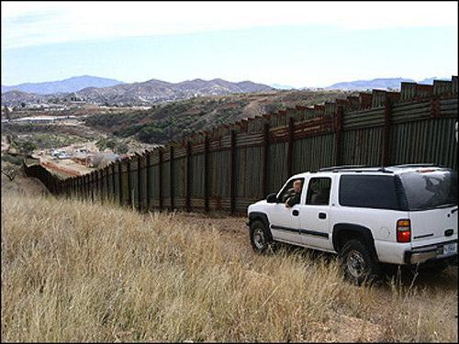

Slide 17
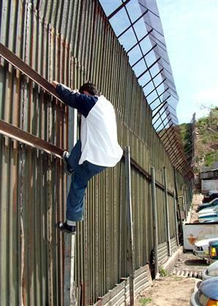

Slide 18
The US Border Patrol guard the border and try to prevent illegal immigrants.
850,000 were caught in 1995 and were deported.

Slide 20
Pull Factors – Reasons Mexicans are attracted to the USA
Excellent medical facilities - 400 per doctor
Well paid jobs - GNP = $24,750
Adult literacy rates 99% - good education prospects
Life expectancy 76 yrs
Many jobs available for low paid workers such as Mexicans
Better housing
Family links

Slide 21
What are the impacts on the USA?
Illegal migration costs the USA millions of dollars for border patrols and prisons
Mexicans are seen as a drain on the USA economy
Migrant workers keep wages low which affects Americans
They cause problems in cities due cultural and racial issues
Mexican migrants benefit the US economy by working for low wages
Mexican culture has enriched the US border states with food, language and music
The incidents of TB has been increasing greatly due to the increased migration

Slide 22
ODD ONE OUT?
BRIGHT LIGHTS
POOR FARMING
ILLITERACY

Slide 23
What are the impacts on Mexico?
The Mexican countryside has a shortage of economically active people
Many men emigrate leaving a majority of women who have trouble finding marriage partners
Young people tend to migrate leaving the old and the very young
Legal and illegal immigrants together send some $6 billion a year back to Mexico
Certain villages such as Santa Ines have lost 2/3 of its inhabitants

