Slide 1
Population Vulnerability:
Japan and Haiti Earthquakes
... Mercy, Sunny, Alex, Wei, and Teru
... IB1 Geography
... April 2013
Notes:
In this presentation, we will take a look at the 2010 Haitian earthquake and the 2011 Tohoku earthquake in Japan through the lens of population vulnerability. First off, let’s describe the earthquakes’ characteristics.

Slide 2
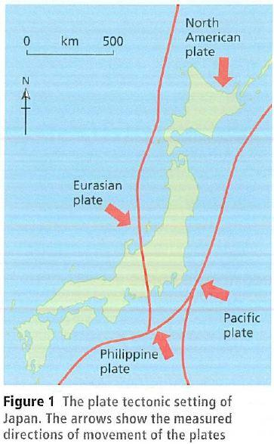
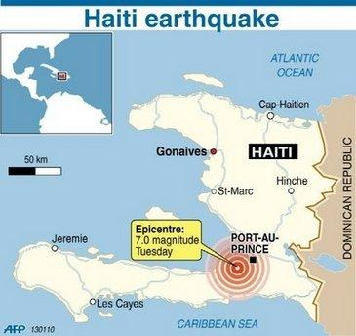
Area maps - location and plate tectonics
...................................

Slide 3
Characterization
 | 2010 Haitian Earthquake | 2011 Tohoku Japanese Earthquake
Spatial extent: | Epicenter 25 km from Port-au-Prince | Epicentre was 70 kilometres off coast of Japan.
Magnitude: | 7.0 (Richter scale) | 9.0 (Richter scale)
Speed of Onset: | No warning signal - eyewitnesses say "suddenly" | 1 min Tokyo Warning Signal.
Duration: | 30-40 seconds | 6 min
Fatalities: | 46,000-318,000 | 28,000 dead or missing
Notes:
2010 Haitian Earthquake:
"The spatial extent of the 2010 Haitian Earthquake was fairly large, the epicenter was nearest to a seaside town called Leogane and 25km away from the capital, Port-au-Prince. The magnitude of the earthquake was a 7.0 in the Richter scale. There were no warning signals and eyewitnesses say it happened suddenly. The duration of the earthquake was 30-40 seconds and the disputed fatality estimate is 220,000 people."
2011 Japan earthquake:

Slide 4
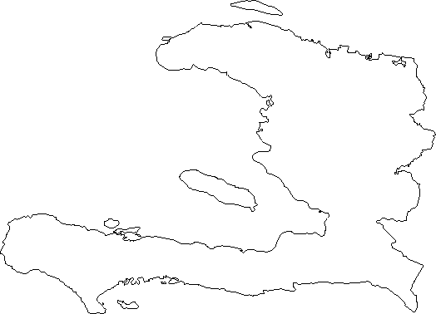
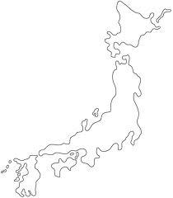
Human Development
Haiti
HDI: 0.49
Japan
HDI: 0.91
Notes:
Japan's Human Development Index in 2011 was 0.91 and Haiti's HDI was 0.49 in 2010. Really, it's the indicators behind the HDI that affect vulnerability, but it's nice to have a number for easy comparison. Haiti has a much lower human development than Japan does - now lets look into this deeper.

Slide 5
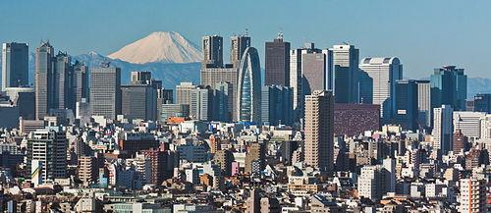
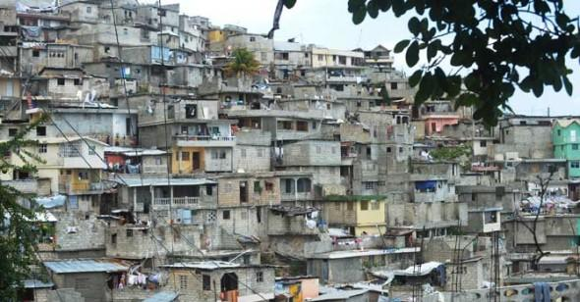
Socio-Economics: Wealth
Tokyo
Japan
- GDP/cap = $34,200
Haiti
- GDP/cap = $1200 - 77% of population lives on less than $2 a day.
Port-au-Prince
Notes:
To see the socioeconomic variations, we used the following indicators to assess vulnerability of Japan and Haiti: GDP per capita, relative poverty, and years of schooling.
The GDP per capita help us see the mean income of the population and its wealth status. In 2011, the year when Tohuku earthquake happened, Japan had a GDP per capita of $34,200. The cost of destruction of the earthquake were between 2.2 percent and 4 percent of Japan’s GDP. ue to its high income, Japan could afford to compensate its loss. On the contrary, Haiti has a much lower GDP per capita-- $1200, which is 1/30th of Japan's GDP per capita.
The second indicator, relative poverty, help us see how low the country is below the poverty line. In Japan, 15.7% of the population lives under relative poverty, while Haiti has a relative poverty of 77%. The vulnerability in Haiti is high due to the fact that most people are forced to live in improper settlements which do nto meet national construction codes.
Lastly, the mean schooling years denote how educated the people are. The mean years of schooling in Japan is 11.6 years, while Haiti has 4.9. This help us see the level of preparedness of the schoolsand their knowledge of safety protection for the impending earthquake.
Therefore, by considering all of these indicators-- Haiti was much more vulnerable than Japan.

Slide 6
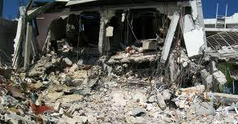
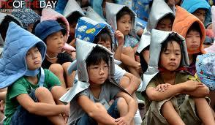
Preparedness: Education and Infrastructure
Haiti
Mean years of schooling: 4.9
Buildings designed with earthquakes in mind:
0%
Japan
Mean years of schooling: 11.6
Buildings designed with earthquakes in mind:
75%
Notes:
Disaster preparedness was definitely an important determinant in population vulnerability. If people know the

Slide 7
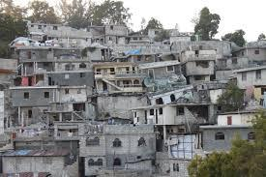
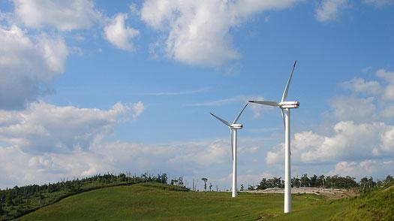
Population Density
Port-au-Prince
24,305 people/sq. km
Japan Nat. Average
337 people/sq. km
Tohoku
136 people/sq. km
Notes:
Population density is one of the factors that determines the vulnerability of the population in demographic terms. The higher the population density the more vulnerable the population is to hazards. Higher population density means more people affected by an identical hazard in an area with low population density. High population density, as in Port-au-Prince, can also be an indication of strained resources.
The population density is known to be relatively high in Japan, where the national average is about 337People / Km^2, and even higher in urban areas such as Tokyo. Compared to Port-au-Prince, of course, population density is quite low. The Tohoku area has a much more lower average for population density - about 136People / km^2. This value would be even lower in the rural coastal areas where the Tsunami's impact was large. From this fact, it could be said that the vulnerability of this demographic population in terms of population density was relatively low.

Slide 8
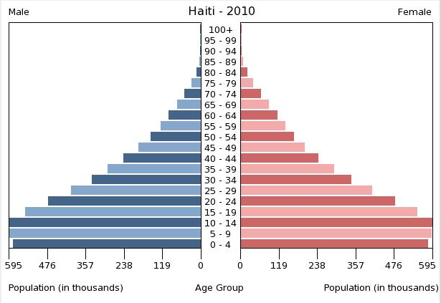
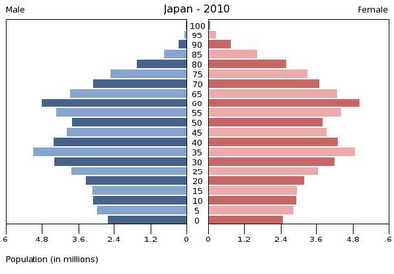
Demographic Variations
A third of Haiti's population is under 15 years old.
30% of Japan's population is over 65 years old.
56% of earthquake fatalities and over 90% of stress and chronic disease deaths were among people above the age of 65.
Notes:
The General Population of Japan is an extreme aging population where over 30% of the population is over 65. This trend is even worse in the Tohoku (North East) Area of Japan affected by the Earthquake and Tsunami where the youth population move into more industreialized and urban areas around Tokyo. The old population is said to be much more vulnerable to these hazards, since their physical abilities are limited, and cannot manage the risk properly.

Slide 9
Overall Evaluation
Japan
Why was it not so vulnerable?
-high-income nations like Japan respond better to disasters
- Prior to the disaster, Japan’s national territory is covered by early warning systems
670,000 participated in a national earthquake drill in September 2010
How did Japan Recover?
- the governent organized a massive emergency response team
- Within a day, the Ministry of Defense gathered the Japan Self-Defense Forces (JSDF) with its110,000 active and reserve troops
- dispatched National Police Force's 28000 members and the Fire and Disaster Management Agency.
Haiti Why was it so vulnerable?
- Poverty
- Young Population
- Large Population With Fatalist Perspectives
- Densely populated Area Affected
- Population Ignored Area Having High Seismic Hazard
- Speed Of Onset Was Only A Few Seconds
- Relatively weak earthquake compared to Japan but Haiti's vulnerability made the impact devastating
How Did Haiti Recover?
- 10 million cubic meters of debris was cleaned up and 20% was recycled
- Haiti government commited to pay tuition for 900,000 children
- $9.5 billion pledged in relief and recovery aid to Haiti
- The American Red Cross spent $415 million on relief and recovery efforts to date
Notes:
In conclusion, it can be said that Japan was less vulnerable to Earthquakes compared to people in Haiti, despite their aging demographic situation. Japan is well prepared with alarm systems and education on coping with earthquakes. Most buildings are built to stand and survive severe earthquakes. The whole country is much more prepared for these hazards.However what made Japan vulnerable to the earthquake in 2011, in a way could be said that, is the preparedness of the Population. Because of all the preparation made to be less vulnerable against earthquakes, Japan and its people were unable to manage a hazard over their expectations, and underestimated the risk due to this low vulnerability. In contrast Haiti and its populationwas much more vulnerable to the hazard, because of the general poverty and unpreparedness of the population and the country. People lived in much more insufficient housing that can easy collapse, nor had the correct knowledge to cope with the disaster. The government has also failed to notify its people about the disaster and was itself devastated by the earthquake.

Slide 10
VULNERABILITY + HAZARD
RISK =

Slide 11
Bibliography
https://docs.google.com/file/d/0B9S814qq0ahMWnFyQUVSRnpXNVk/edit
https://docs.google.com/file/d/0B9S814qq0ahMemt4MXlxT3VSZkU/edit
https://docs.google.com/file/d/0B9S814qq0ahMODdkMEozc29FVTg/edit
http://www.dec.org.uk/haiti-earthquake-facts-and-figures
http://reliefweb.int/sites/reliefweb.int/files/resources/F2199BA948A360EA85257865006BF549-map.pdf
http://www.aees.org.au/Proceedings/2011_Papers/14-DANIELL_James-Atimeline.pdf
www.monster-island.net
http://hdrstats.undp.org/en/countries/profiles/HTI.html
http://factsanddetails.com/japan.php?itemid=2285&catid=26&subcatid=160
https://www.cia.gov/library/publications/the-world-factbook/geos/ja.html
http://www.cjr.org/behind_the_news/one_year_later_haitian_earthqu.php?page=all
http://www.oecd-ilibrary.org/sites/soc_glance-2011-en/06/02/g6_eq2-01.html?contentType=&itemId=/content/chapter/soc_glance-2011-17-en&containerItemId=/content/serial/19991290&accessItemIds=/content/book/soc_glance-2011-en&mimeType=text/html
http://www.indexmundi.com/g/r.aspx?t=50&v=67
http://hdrstats.undp.org/images/explanations/JPN.pdf
http://thf_media.s3.amazonaws.com/2011/pdf/sr0094.pdf
http://ki-media.blogspot.com/2010/01/70-quake-hits-haiti-serious-loss-of.html
http://news.bbc.co.uk/2/hi/americas/8466385.stm

