Slide 1
2011 japan earthquake and tsunami

Slide 2
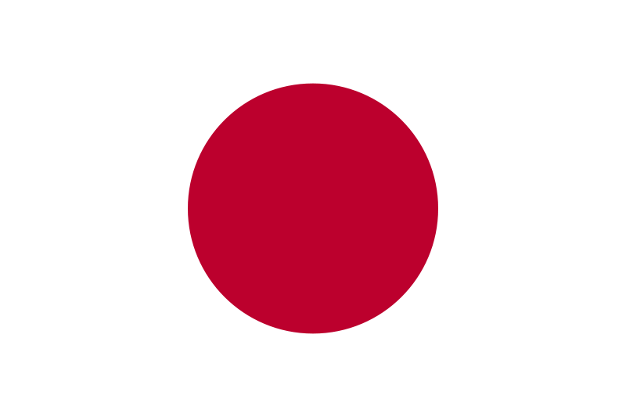
What do you already Know about Japan?

Slide 3
Starter quiz

Slide 4
Facts
Date: 11th March 2011
Time: 14:46 (local time)
Deaths:1597 (as of 13th March and could exceed 10,000)
Missing: 1481
Magnitude: 9.0
Depth: 24.4km
Secondary Effects: Tsunami, fires and nuclear meltdown
Recovery time: Not measurable at present

Slide 5
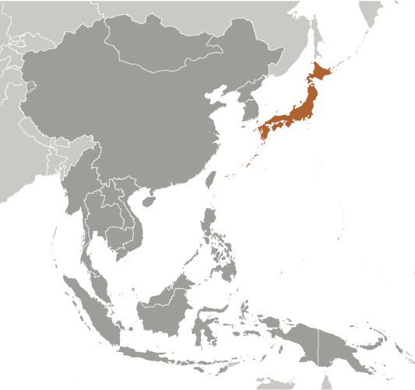
Location

Slide 6
Why do earthquakes happen?
Japan is one of the most tectonically active countries in the world. This is because it sits upon a triple junction. This is the meeting of three tectonic plates. These plates boundaries cause friction which leads to earthquakes.

Slide 7
Cause- Plate boundaries
The Eurasian, Filipino and North American plates all meet just off Japan’s southern coastlines. Japan has a history of major earthquakes such as the Great Kanto earthquake in 1923 and Kobe earthquake in 1995.

Slide 8
Video footage of earthquake

Slide 9
Video footage of tsunami

Slide 10
More video footage of tsunami

Slide 11
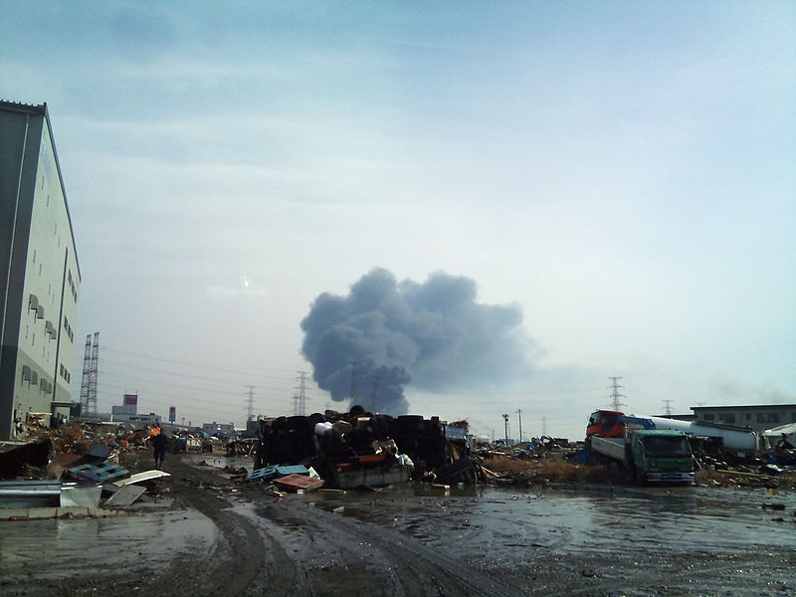
Primary effects of the earthquake
The initial earthquake caused a large amount of damage. Violent shaking caused buildings to collapse Liquefaction occurred destroying the soil structure in the ground.

Slide 12
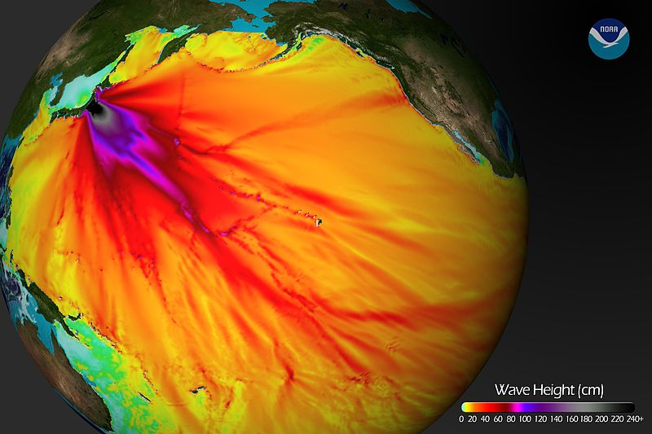
Secondary effects of the earthquake- tsunami
The earthquake occurred just offshore, triggering a large tsunami. The wave was up to 10 metres high when it struck Japan and it also caused damage in parts of the USA such as Hawaii.

Slide 13
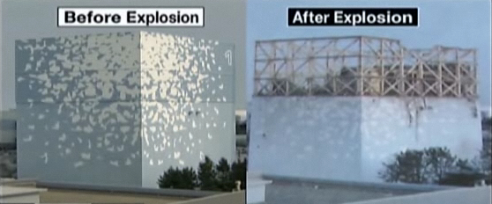
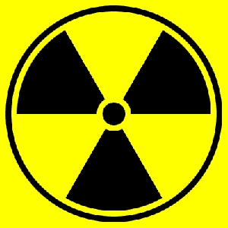
Secondary effects of the earthquake- nuclear risk
The earthquake and tsunami caused a major incident at 2 nuclear reactors. The Fukushima (above) and Onagawa nuclear plants both suffered damage and a nuclear meltdown occurred at Fukushima. This could expose people to harmful radiation.

Slide 14
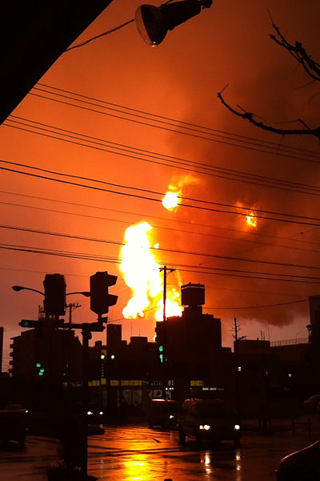
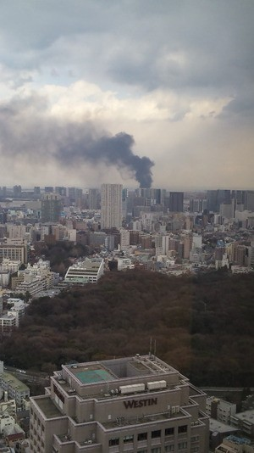
Secondary effects of the earthquake- fire
The earthquake caused many fires. A particularly severe fire occurred at the Cosmo oil depot. There were also major fires in the city of Kesennuma.

Slide 15
Some things to think about:
Why do earthquakes happen?
Why do earthquakes occur in Japan?
Why did the earthquake cause a tsunami?
How long will it take Japan to recover?
How will the rescue effort be conducted?
What can be learned from this earthquake and tsunami and applied in the future?
Why do you think Japan are so reliant on nuclear energy?

