Slide 1




What do you think of when you hear…
Geography

Slide 2
Key question / Learning objectives
What are the different types of geography?
Learning Objectives:
•To know what the study of geography involves.
•To understand the difference between physical and human geography and where they overlap, environmental geography.
•To be able to classify different topics into these categories

Slide 3
What is geography?
Remember
Identify [level 3]
Describe [Level 4]
Explain [Level 5]
Geography is the study of Earth’s landscapes, people, places and environments. It is the study about the world in which we live.

Slide 4

Physical and human geography!
What do you think is meant by
Physical and human geography?
30 seconds to think
1 minute to discuss with the person next to you
Share with the class
Learning Links

Slide 5

Physical or human geography?
Remember
Identify [level 3]
Describe [Level 4]
Explain [Level 5]
Looking at the pictures on the following slides you need to decide whether each one is a picture of . .
Physical or human geography?

Slide 6
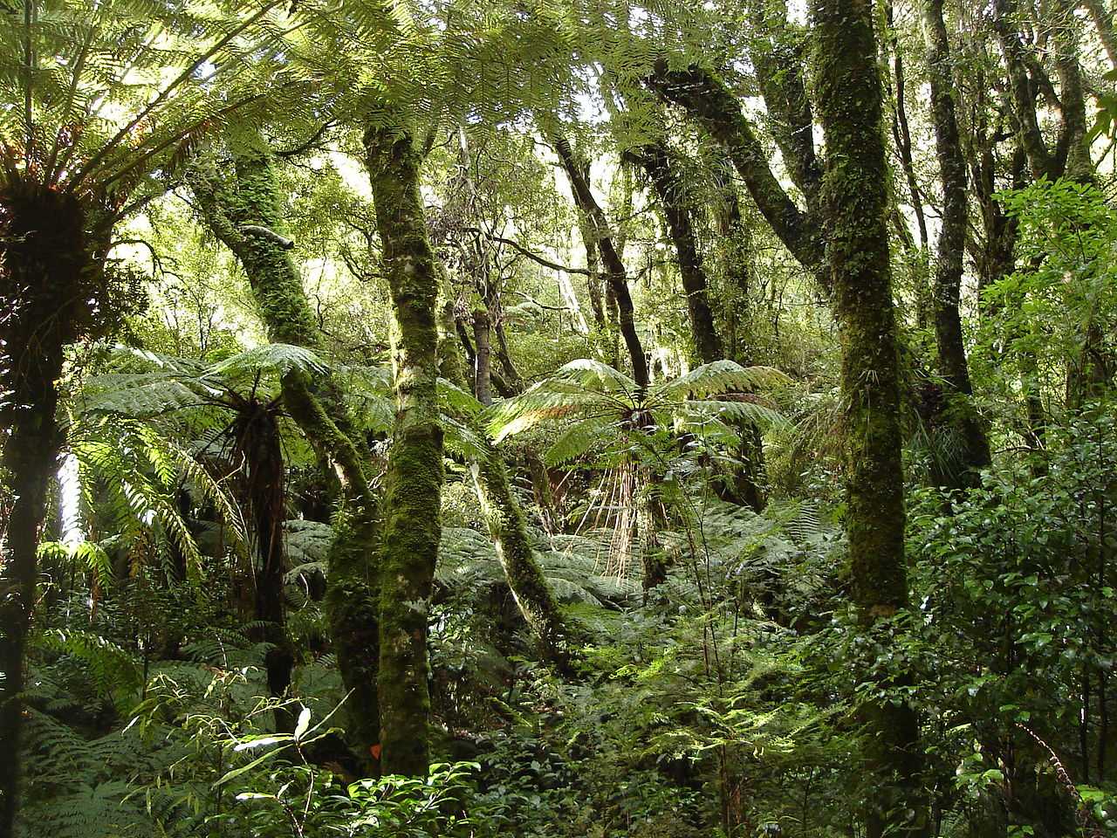
Physical or human geography?
What is this picture of?
A rainforest

Slide 7

Physical or human geography?
What is this picture of?
A high street

Slide 8
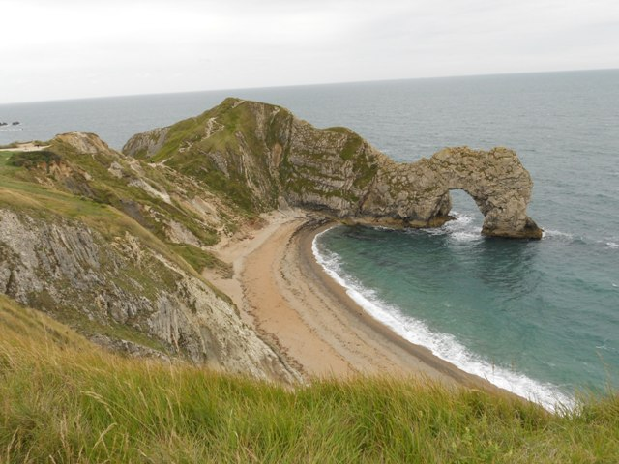
Physical or human geography?
What is this picture of?
A coastline

Slide 9
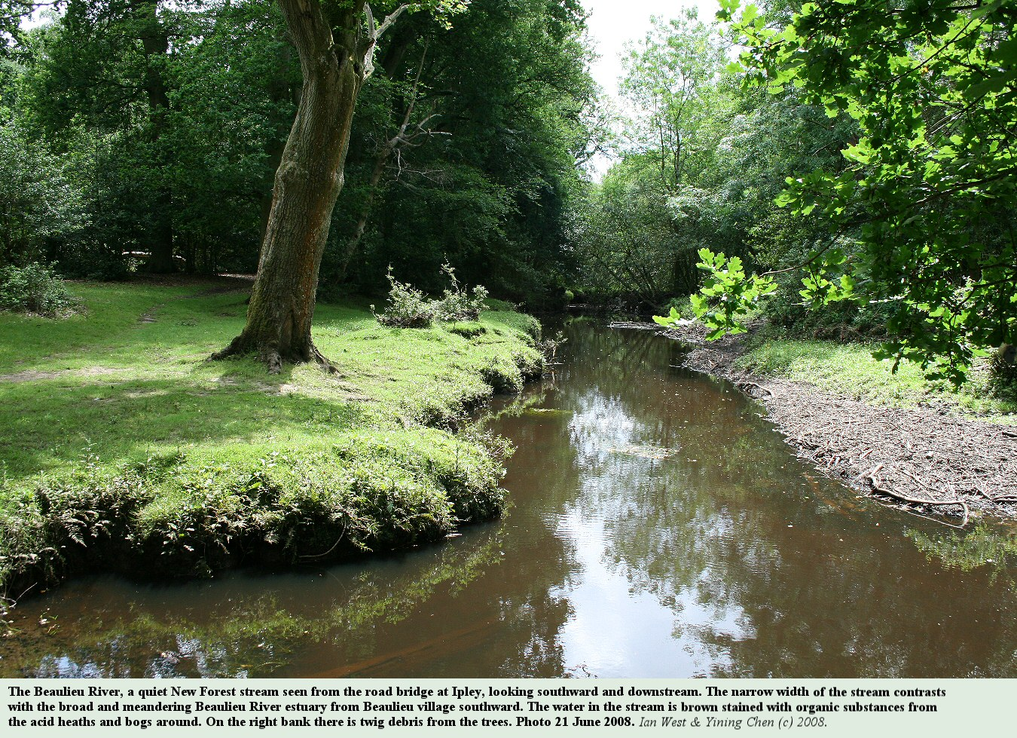
Physical or human geography?
What is this picture of?
A river

Slide 10
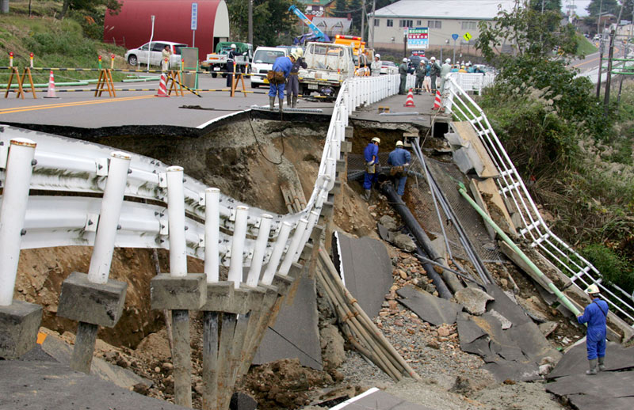
Physical or human geography?
What is this picture of?
An earthquake

Slide 11
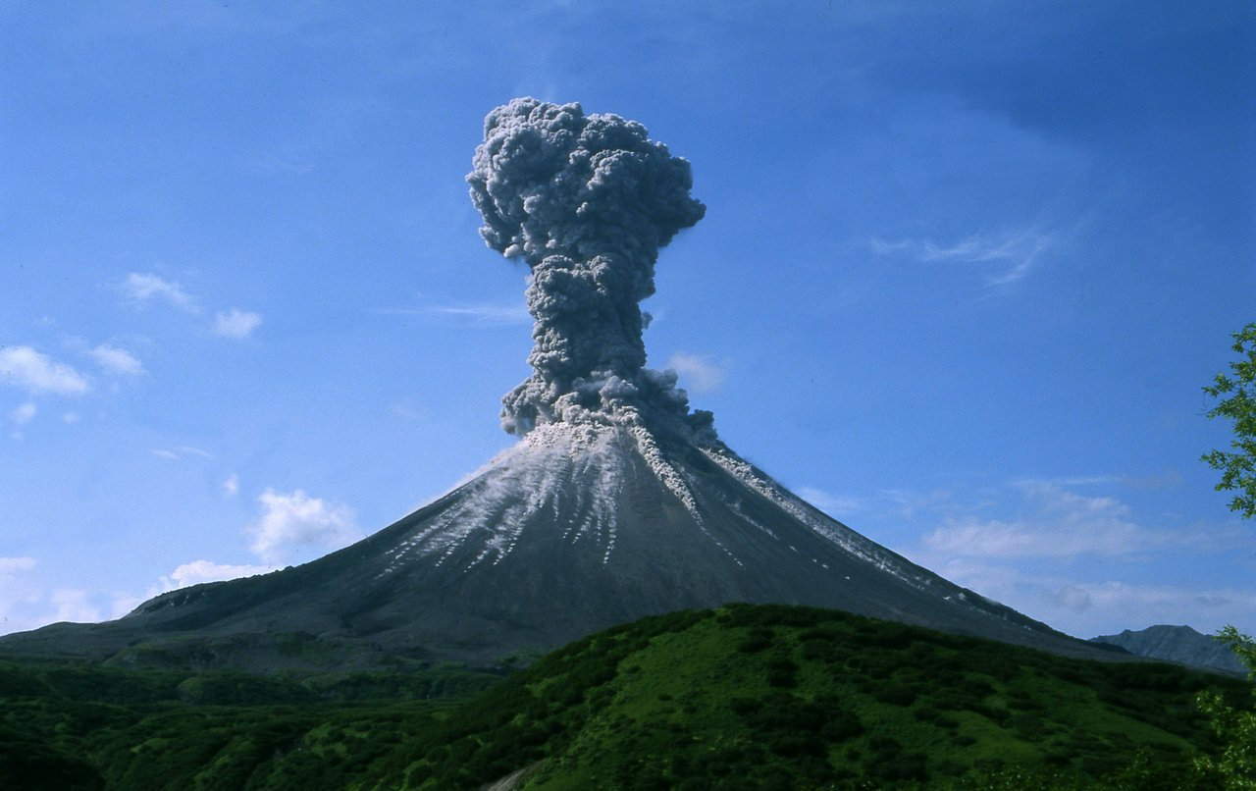
Physical or human geography?
What is this picture of?
A volcano

Slide 12
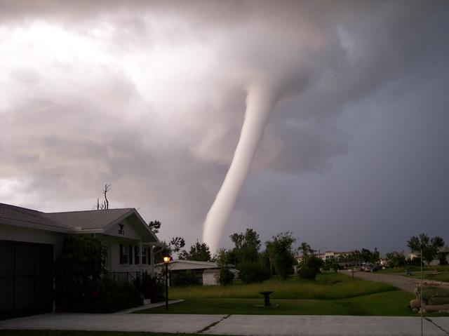
Physical or human geography?
What is this picture of?
A tornado

Slide 13
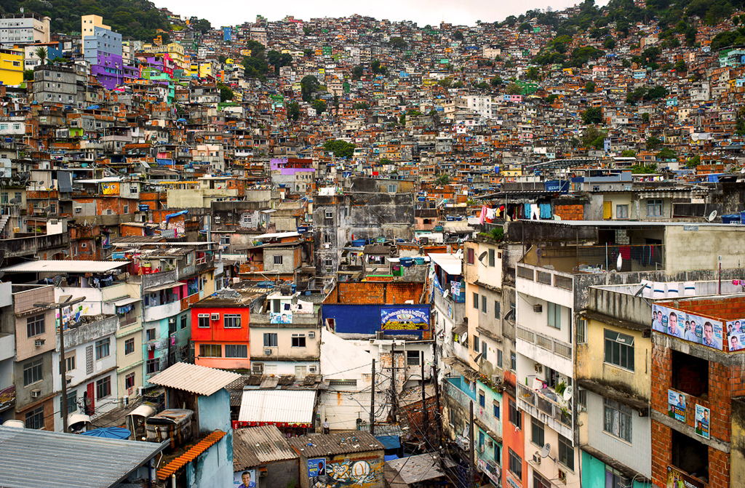
Physical or human geography?
What is this picture of?
A shanty town

Slide 14
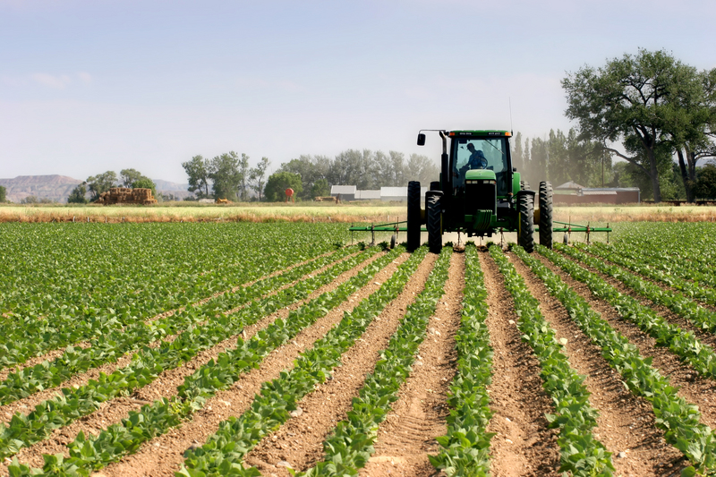
Physical or human geography?
What is this picture of?
Farming

Slide 15
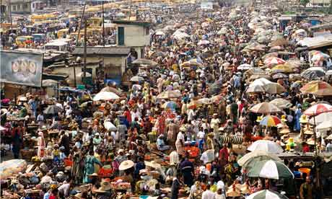
Physical or human geography?
What is this picture of?
Overpopulation

Slide 16
Categories of geography?
There are three main categories within geography:
Physical
All geography that occurs naturally for instance rivers, coasts and earthquakes.
Human
All geography that involves human activity for instance industry and population.
Environmental
All geography that involves humans working with, and changing, the natural world.

Slide 17
Physical or human geography?
Read through the list of topics within geography and next to each write whether it is a physical, human or environmental topic.
Physical human or environmental geography?

Slide 18
Physical or human geography?
Coasts
Map Skills
Fantastic Places
Population
Settlement
Shopping
Weather and Climate
Crime
Ecosystems (Rainforests)
Globalisation
Volcanoes
Tourism
Earthquakes
Billionaires
Rivers
Megacities
Environmental issues
Climate change
Select 3, why did you categorise them as physical, human or environmental geography.
Physical human or environmental geography?

Slide 19
Over to you . . .
Other than the topics we have already discussed today can you think of any other topics geographers may be interested in?
Physical human or environmental geography?

Slide 20
Main Activity: Poster!
Remember
Identify [level 3]
Describe [Level 4]
Explain [Level 5]
Physical human and environmental geography
Produce a poster to show the differences between physical, human and environmental geography.
Success Criteria:
Detailed differences
Colourful
Pictures
Use key terms – human, physical, environmental
Well presented
Easy to understand

Slide 21
Odd one out!
Mountains, earthquakes, cities, rivers
Deforestation, pollution, housing, recycling
Glaciers, population, commuting, industry
Deserts, volcanoes, oceans, shanty towns

