Slide 1
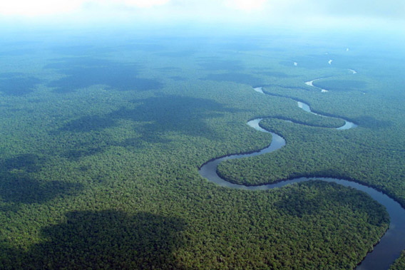
Congo Rainforest Case Study
By Giovanni, Lauriane and Jessica.

Slide 2
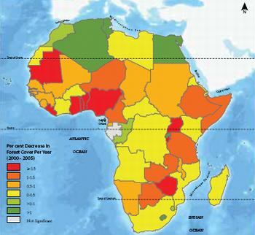
% decrease in forest cover per year between 2000 and 2005.

Slide 3
Change in deforestation in Congo

Slide 4
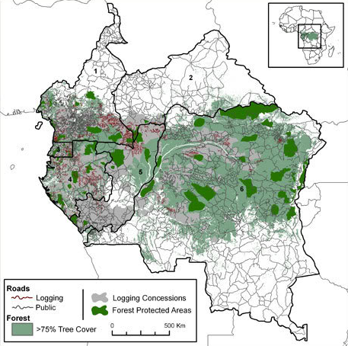

Slide 5
Human importance of the rainforest
Rich and diverse ecosystem provides food, shelter, fresh water and medicine for more than 75 million people
People also rely on the forest for subsidence, raw materials and agricultural practices

Slide 6
Environmental importance of the rainforest
Home to many endangered species (forest elephants, bonobos, gorillas, buffalos etc.)
Supports a huge range of wildlife in its rivers, swamps and savannahs
Contains 25% of the total carbon stored in tropical rainforests worldwide
(4th largest carbon reservoir in the world)
Regulates global climate and helps halting climate change

Slide 7
Economic importance of the rainforest
Forms a system of navigable waterways (where most of Africa’s copper, sugar, coffee, palm-oil and cotton is transported)
Congo River is Africa’s largest potential source of hydroelectric power

Slide 8
Damage
Logging
Encouraged by the return of peace after war
Today, 50 million hectares of rainforests in Central Africa are controlled by logging companies= need of logging road that slowly lead to 40% loss of forest
Many poor farmers rely on this commerce for food and commerce (overall, 75 million people rely on forest)
Generates hundreds of millions of US dollars because of the high timber demand from EU= huge economic importance
Bureaucrats looking for extra income= cut down trees in restricted areas= illegal logging
Heli logging has become quite common
Roads make the forests vulnerable to clearance for agriculture

Slide 9
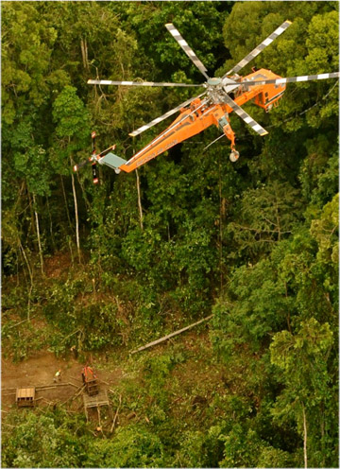
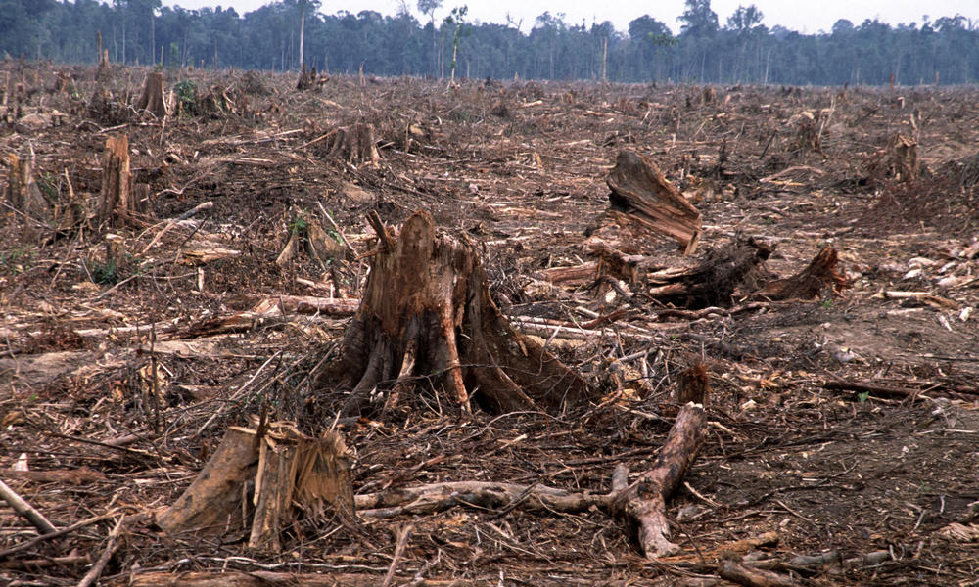

Slide 10
Increase in demand for agricultural land use
Poor farmers and villagers who rely on forest’s resources = increase demand of land to expand their agriculture activity
Slash-and-burn method commonly used to clear forests as it is fast and efficient= produce large amounts of CO²
Mining
Some of the world's richest mineral deposits are stored underneath the Congo Rainforest ground
Huge areas of vegetation have to be cleared to explore the underneath for mining= heavy deforestation
Mines=soil pollution= unfertile land= hard for reforestation actions to occur

Slide 11
Civil Conflicts (since the mid-90s in Central Africa)
Conflict= 100 000’s of refugees have moved through the forests of the Congo= used plants for medication+ food+ wood for shelter= stripped vegetation + devastated wildlife
Population growth
increased demand of forest resources for food, house furniture, agricultural products (soy and palm oil) and medicinal use= increased threat of agriculture taking over
encourages climate changes

Slide 12
Climate change
Encourages forest fires= threatens biodiversity+ alter water cycles+ soil degradation+ threat indigenous groups
Lack of education regarding deforestation as a whole
There are three basic root causes for the degradation of our forests which are best summarized in what is known as the foundation formula or the IPAT formula (I=PxAxT). What this formula says is that any environmental impact (I) is the result of population size (P) times the affluence or wealth of that population (A) and the technology (T) that the population consumes with its wealth.

Slide 13
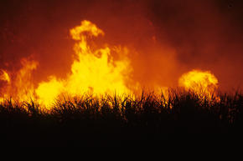
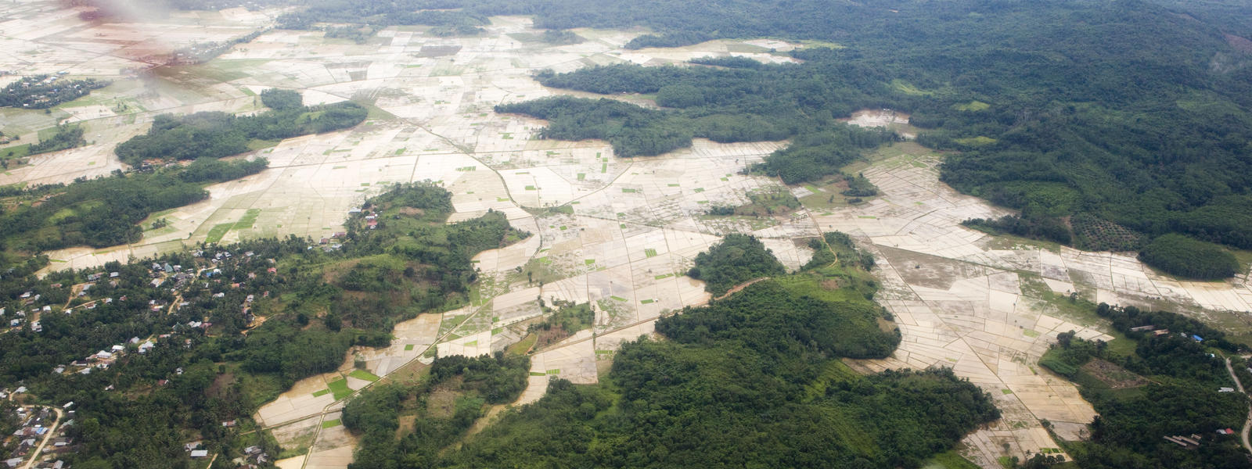

Slide 14
Conservation
Where →
Congo
The Congo Basin contains the second biggest rainforest in the world after the Amazon and is home to many mammal species including the gorilla, elephant, forest buffalo, and many birds, fish and amphibians.
What →
The biodiversity of the Congo Basin is at risk from illegal timber, exploitation, mining, poaching and large-scale commercial hunting.
The human settlements, which naturally follow these activities and their accompanying infrastructure projects such as roads, railways and hydroelectric dams, are also threatening the region.

Slide 15
What are they doing to conserve the rainforest? →
TRIDOM is a special group/charity who theirs aims is to reduce current threats and combine conservation and development, while maintaining the ecosystems of the protected areas.
There is a conservation work, which is designed to meet the development needs of the local communities by involving them in the management of natural resources.
Another objective is to improve the poverty situation by running revenue-generating eco-development activities, including eco-tourism, small-scale commercial fishponds and agro-forestry.
Money from charity or events will be used for project to create a sustainable financing mechanism to cover the core conservation costs of law enforcement and protected area management.

Slide 16
The World Wildlife Federation have 3 main goal to conserve the rainforest of Congo and various strategies:
WWF want 15 millions hectares of the rainforest by 2020 so they can protect it and manage themselves
WWF hoped that the rate of net deforestation and associated CO2 emissions can be reduced to zero, and also, bush meat trade and poaching can be reduced to sustainable levels.
WWF want to gain the half of logging concessions in the Congo, to minimize the activities of major oil and gas, mining, hydropower, agro-industries and associated infrastructures projects and other indirect impact on the biodiversity and livelihoods of the rainforest native.
For this entire goal, the strategies of the rainforest are to secure sustainable financing, strengthen governance by empowering local people as legal owner of their natural resources and forest.

Slide 17
Conservation International (CI) supported Tayna Center for Conservation Biology (TCCB), and UGADEC leaders are bolstering the management of protected areas, educating their children at the university, improving agricultural techniques and financing small enterprises.
CI main intention is to protect unique biodiversity in strict nature reserves, and to plan development in the rest of their territories to manage growth in relation to the exploding population of the mountains to the east.

Slide 18
