Slide 1
Earthquake survival
Will you survive?

Slide 2
Survival kit
You will see image of various items you might want to consider taking with you if there was an earthquake. Pick the 10 best items you think will help you with survival.

Slide 5
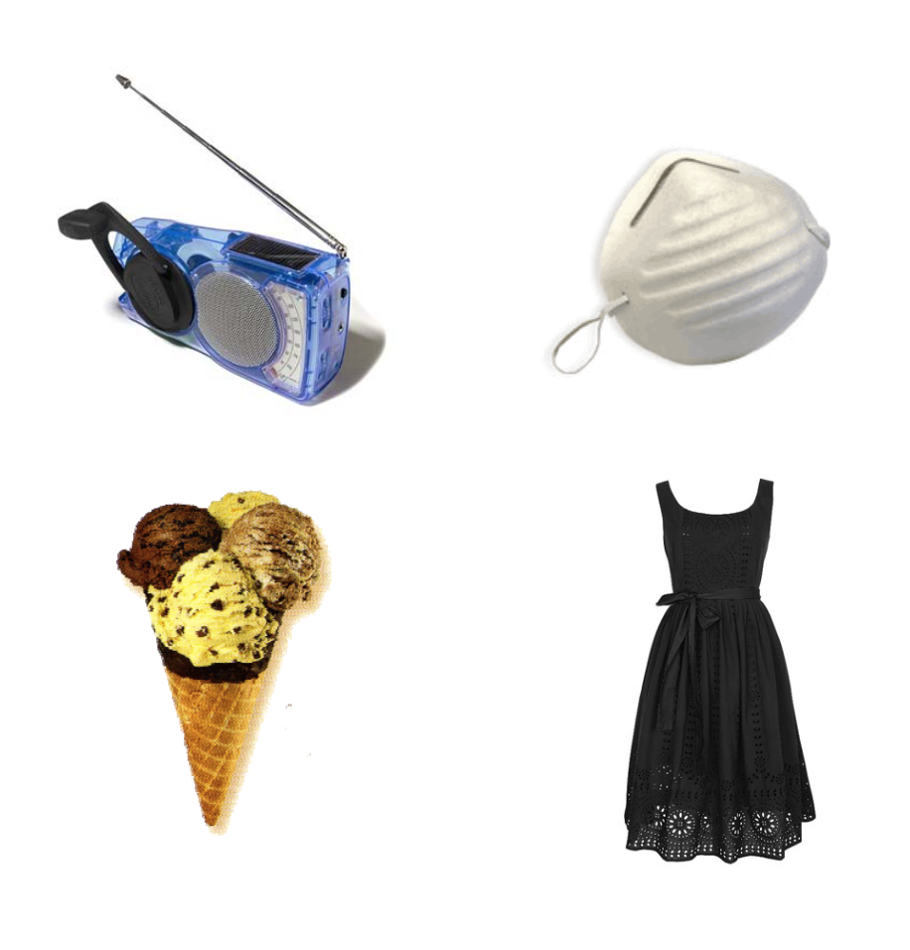

Slide 6
Count your score
The highest score means you are more likely to live through the earthquake

