Slide 1
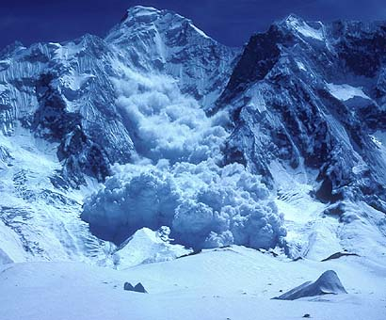
Avalanches

Slide 2
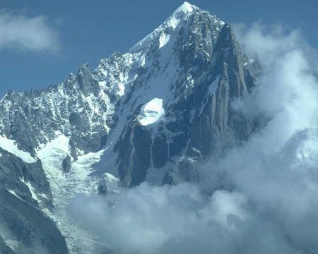
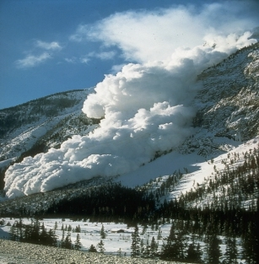
Definition
Rapid flow of snow down a slope, from either natural triggers or human activity.
Typically occurring in mountainous terrain

Slide 3
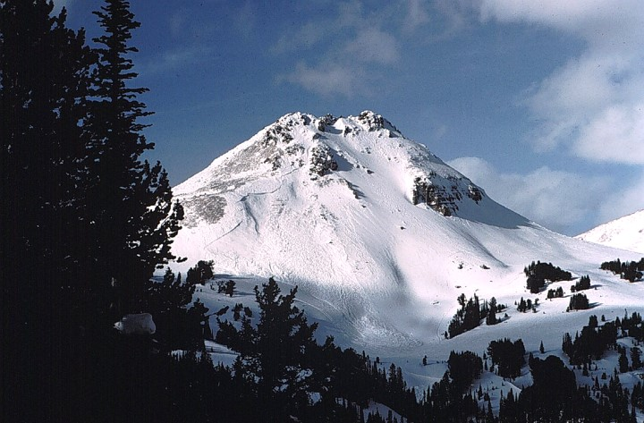
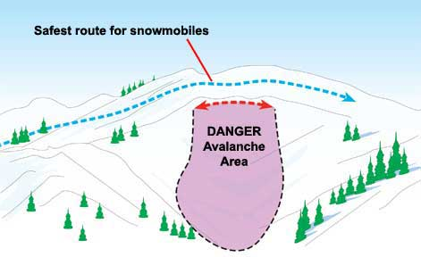
Where do avalanches occur ?
Avalanches occur on slopes between 25 to 50 degrees. Avalanches start most often on slopes above the timberline that face away from prevailing winds.
Danger area – Snow build up is visible

Slide 4
What factors increase the likelihood of Avalanches
1. Snowstorm and Wind Direction: Heavy snowstorms are more likely to cause Avalanches. The 24 hours after a storm are considered to be the most critical. Wind normally blows from one side of the slope of mountain to another side. While blowing up, it will scour snow off the surface which can overhang a mountain.
2. Heavy snowfall: Heavy snowfall is the first, since it deposits snow in unstable areas and puts pressure on the snow-pack. Precipitation during the summer months is the leading cause of wet snow avalanches.
3. Human Activity: Humans have contributed to the start of many avalanches in recent years. Winter sports that require steep slopes often put pressure on the snow-pack which it cannot deal. Combined with the heavy deforestation and soil erosion in mountain regions, it gives the snow little stability in the winter months. Further natural causes include earthquakes and tremors, since they can often create cracks in the snow-pack.

Slide 5
What factors increase the likelihood of Avalanches
4. Vibration or Movement: The use of All Terrain Vehicles and Snowmobiles creates vibrations within the snow that it cannot withstand. Coupled with the gravitational pull, it is one of the quickest ways to cause an avalanche. The other is construction work done with explosives, which tend to weaken the entire surrounding area.
5. Layers of Snow: There are conditions where snow is already on the mountains and has turned into ice. Then, fresh snow falls on top which can easily slide down.
6. Steep Slopes: Layers of snow build up and slide down the mountain at a faster rate as steep slopes can increase the speed of snow. A rock or piece of huge ice can shake the snow and cause it to come down.
7. Warm Temperature: Warm temperatures that can last several hours a day can weaken some of the upper layers of snow and cause it to slide down.

Slide 7
The effects of avalanches
1. Damage to Life and Property: A large number of casualties takes place after avalanches hit heavily populated areas. Infrastructure is damaged and the blockage caused, impacts the livelihood of many. People who enjoy skiing, snowboarding and snowmobiling are at a greater risk of losing their lives. A powerful avalanche can even destroy buildings and power supplies can be cut off.
2. Flash floods: When an avalanche occurs, it brings down all the debris with it and can cause havoc in low lying areas. Flash floods are seen to happen after avalanches, which is a long term problem many villagers and townspeople have to deal with. They can also change weather patterns and cause crop failure in farms present on the lower fields.
3. Economic Impact: An avalanche can block anything in its path and even restrict the normal movement of traffic. Various ski resorts depend on tourists to run their business successfully. Ski resorts and other businesses are forced to close until the avalanche decreases and weather conditions become suitable.

