Slide 1
Atmospheric depressions
How they work and what weather you get.

Slide 2
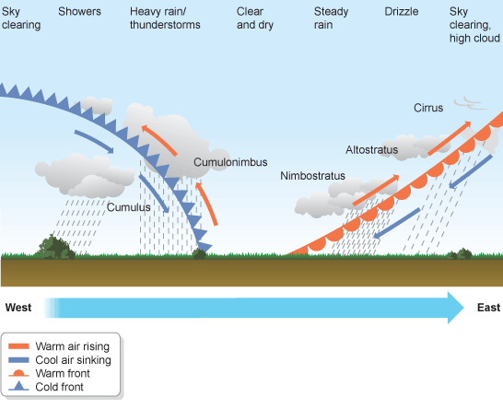

Slide 3
The passage of an atmospheric depression
The weather is moving from left to right!
I am not moving! The weather is moving
Stage 1
Stage 2
Stage 3
Stage 4
Stage 5

Slide 5
What conditions are you expecting?
Stage 1

Slide 6
What conditions are you expecting?
Stage 2

Slide 7
What conditions are you expecting?
Stage 3

Slide 8
What conditions are you expecting?
Stage 4

Slide 9
What conditions are you expecting?
Stage 5

