Slide 1
Where should our
Headquarters be located?

Slide 2
Learning objectives
To know the factors affecting the location of tertiary industries
To understand what a bank HQ might be looking for in a new location
To be able to research places and present our findings back to the class

Slide 3
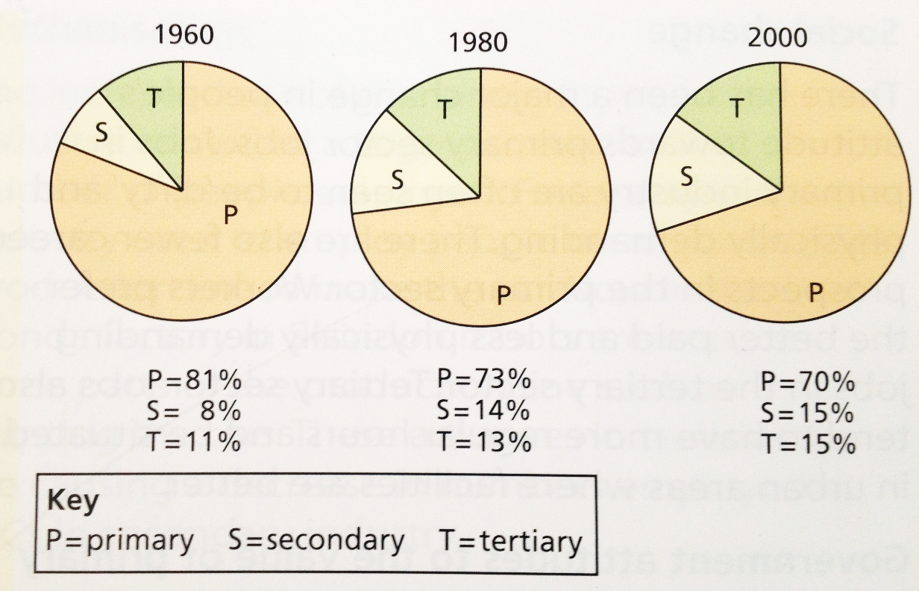
The Tertiary Sector
Tertiary activities are services such as health, education, tourism
and financial services.
The tertiary sector is the fastest growing sector of the Chinese
economy.
Notes:
2013 figures – P34%, S30%, T36%

Slide 4
A Japanese Bank, relocating their HQs to Europe
Imagine you are the CEO of Sanwa Bank – and you want to relocate your headquarters to a European city.
Starter: What will a bank HQ be looking for in a location?
Brainstorm in your tables

Slide 5
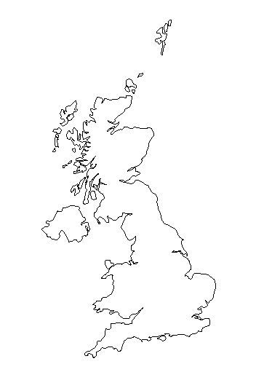
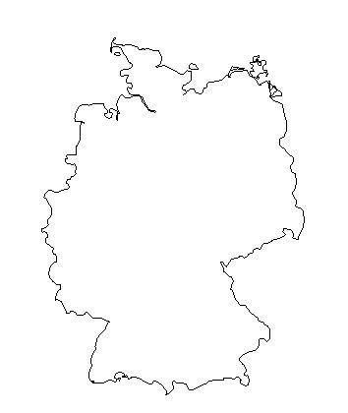
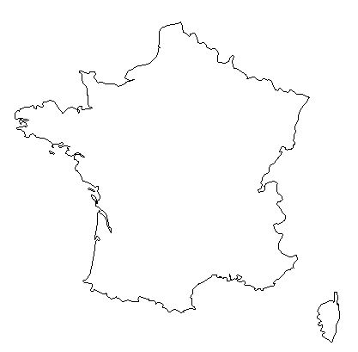
Japanese Bank
Sanwa Bank was established in 1919 and is the fifth largest bank in Japan, with its headquarters in Tokyo, Japan’s capital
It is the 59th largest bank in the world based on revenue, which is roughly £500 billion each year
It employs 34 000 people in Japan alone, and is looking to expand this by establishing a second headquarters in Europe to boost its European trade
It is therefore very important that the bank picks a suitable location for its new headquarters
What else do you think it might need??
?
The bank is looking for (amongst other things):
Good transport links
Contact with other banks
A central location
An attractive business
environment
Etc…
?
?
Notes:
If you need 4 countries

Slide 6
Locating Tertiary Sector business A Japanese bank is looking to locate their new headquarters in Europe. Proposals have been put forward for Frankfurt (Germany), Paris (France) and London.
TASK:
In groups, you must present the advantages of your city for the bank’s relocation – what do you have that the bank would really want? This should be done using a large A2 Poster.
At the same time, Japan must design a series of questions to ask the representatives (think carefully - what are they looking for?). You need to know the advantages and disadvantages of staying in Japan.
Resources – information sheets and i-pads
Sales pitch each group will have a 5 minute slot to advertise their country to the Japan group and then answer their questions.
Japan must decide which city will be the new headquarters, and justify their choice to the class

Slide 7
Research tips
Smart searching
Search CIA worldfactbook + country name and use this as a starting point
Corruption – search corruption perception index 2014 and click on first link (transparency.org)
Travel websites:
Skyscanner.net
Kayak.com

Slide 8
8C
Japan | London | Paris | Frankfurt
Kai | Yifu | Jack | Sunny
Tracy | Kay | Amber | Angela
William | Rita | Jim | Edward
 | Lion | Blanca | Cathy

Slide 9
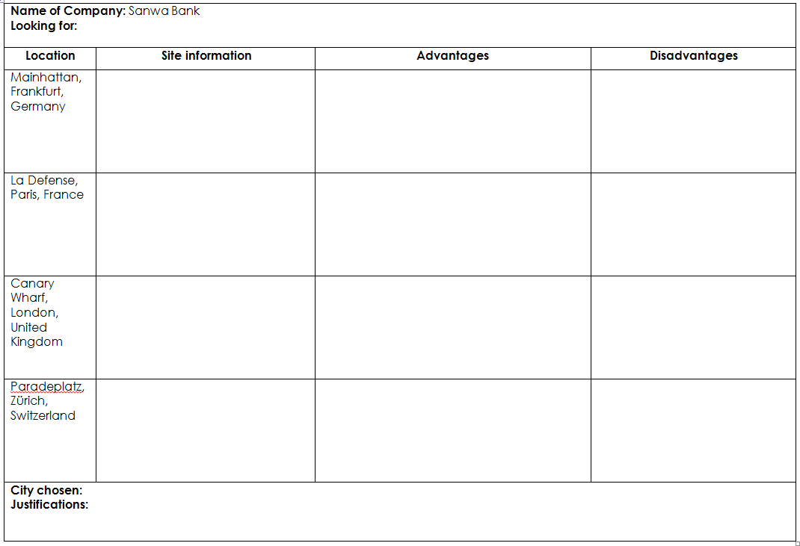
Presentations (3 cities + Japan)
Complete your table as each group presents

