Slide 1
Climate Detectives!

Slide 2
Learning Objective
To understand why places have different climates
Success Criteria
To describe the different factors which affect climate.
To explain the reasons for the climate in certain areas.
To interpret information on a world map.

Slide 3
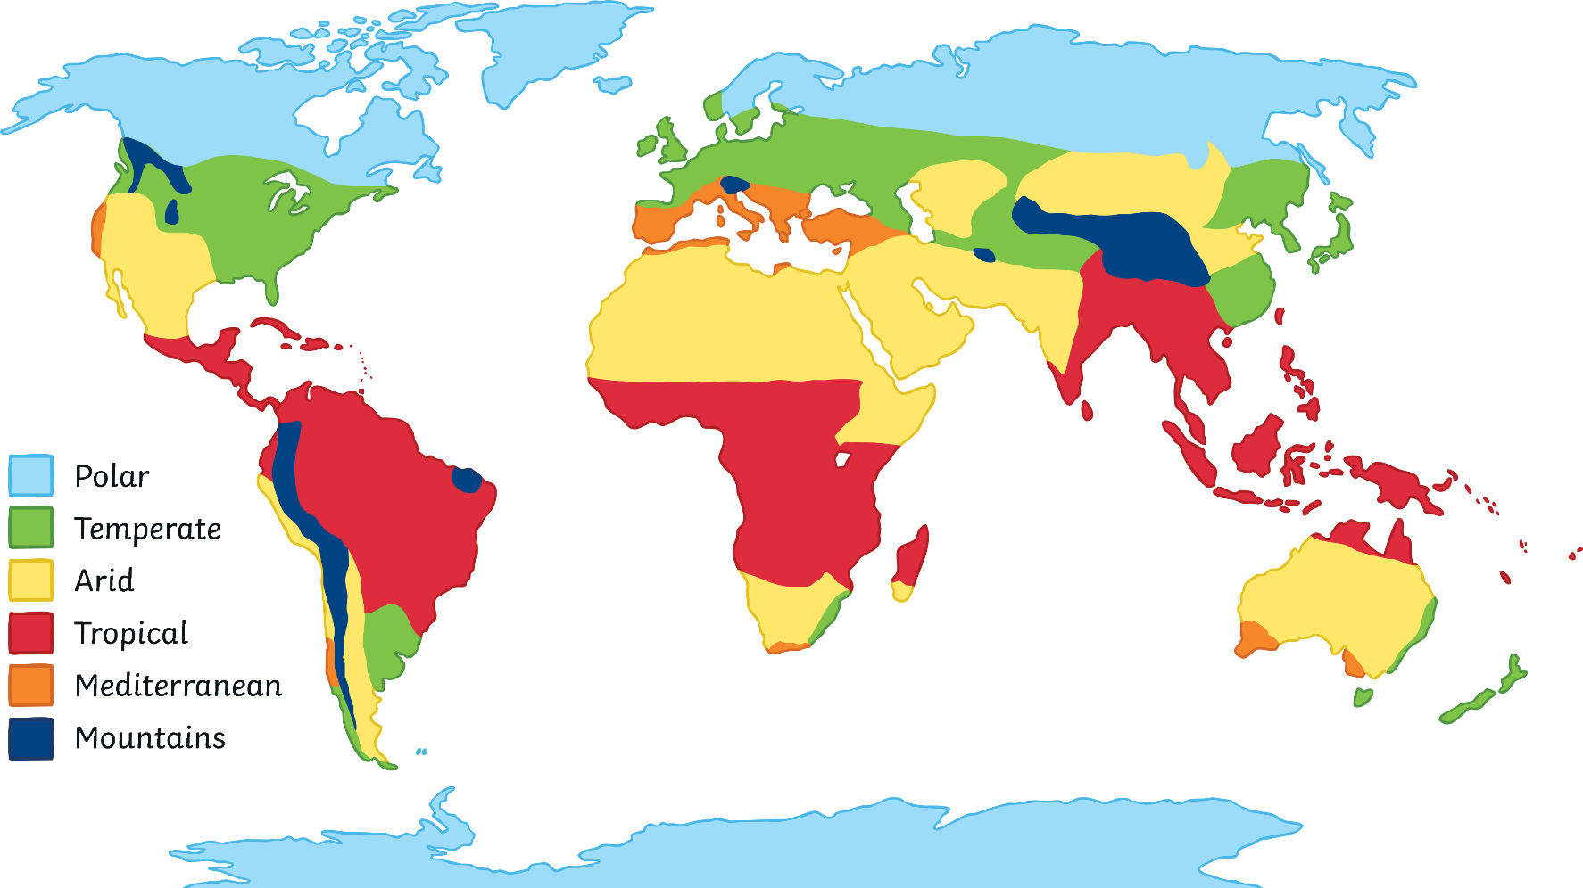
Starter
Can you name the climate zones?

Slide 4
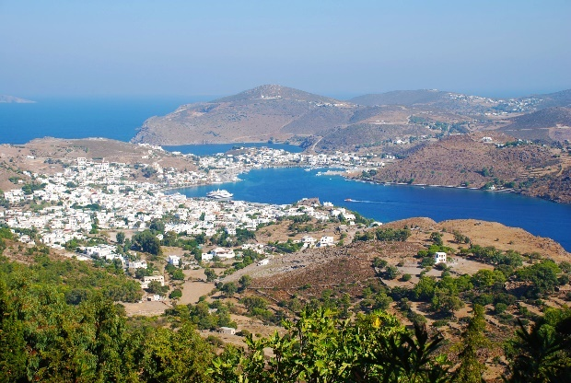
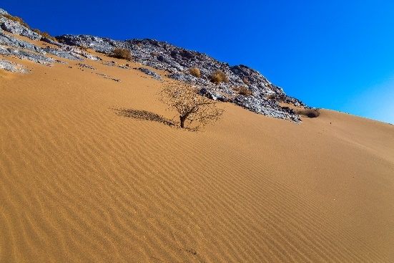
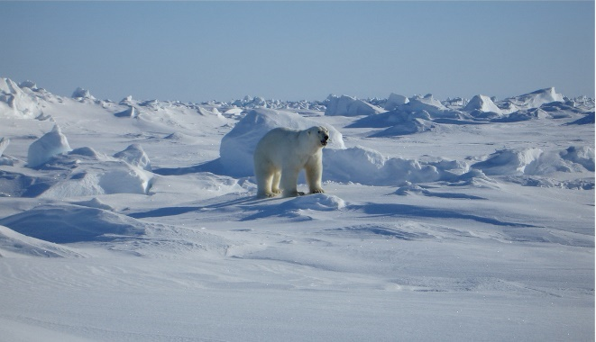
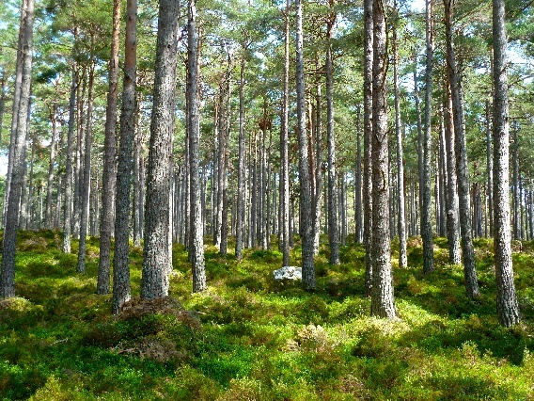
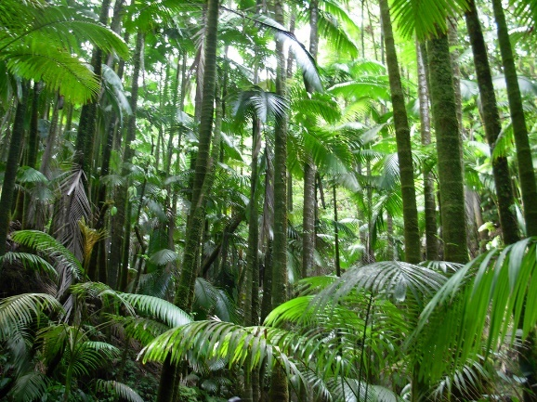
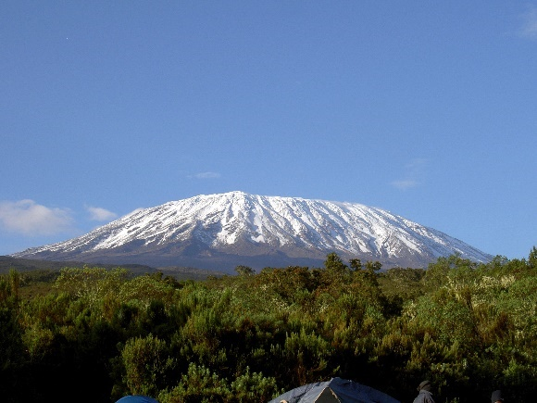
Why Do Places Have Different Climates?
We have seen that there are many different climates zones. Can you suggest any reasons to explain this?
Photo courtesy of M Samadi (@commons.wikimedia.org) - granted under creative commons licence – attribution
Photo courtesy of Chris 73 (@commons.wikimedia.org) - granted under creative commons licence – attribution

Slide 5
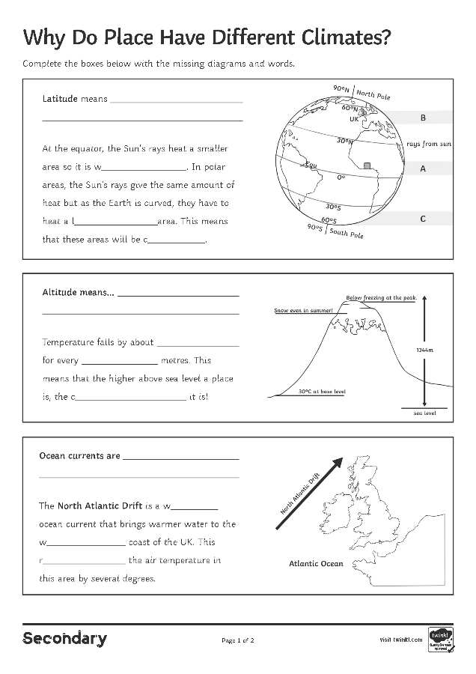
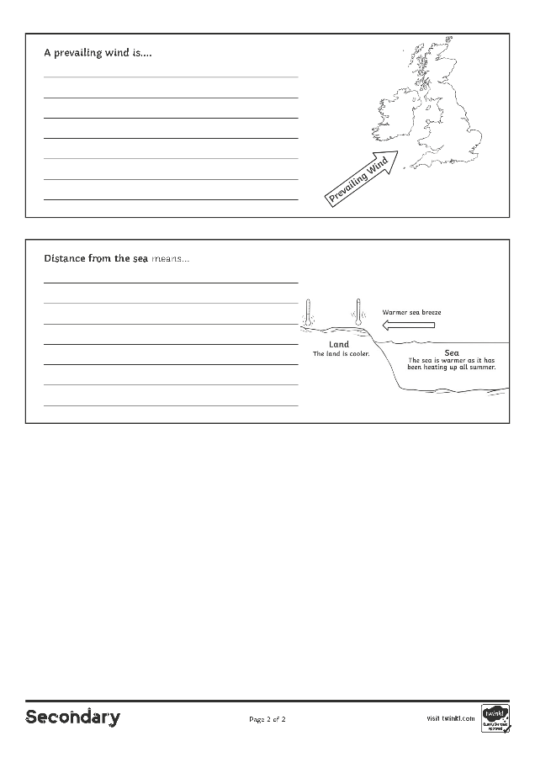
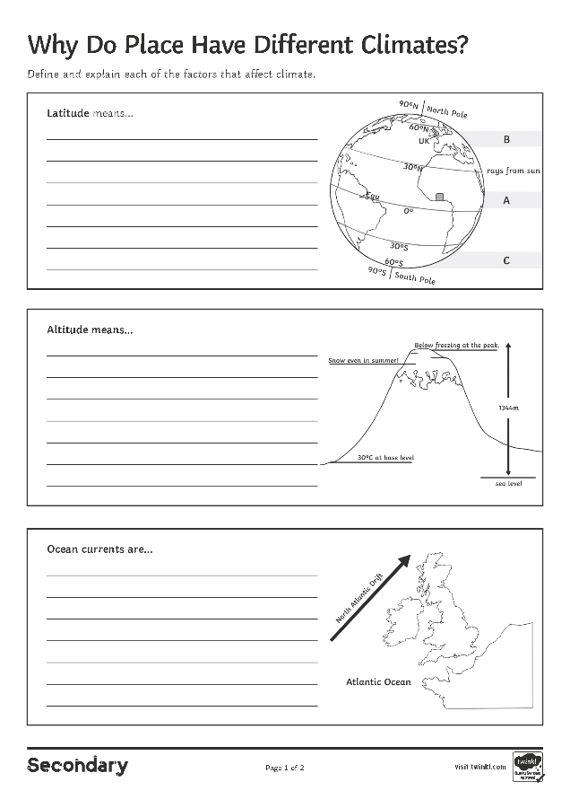
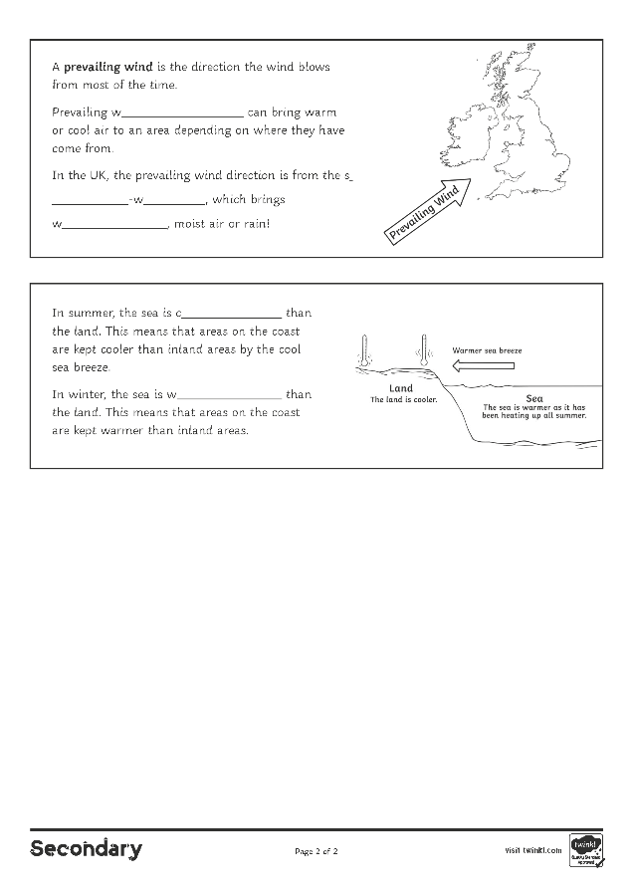
Why Do Places Have Different Climates?
There are five main factors which affect why places have a different climate:
1. the effect of latitude;
2. the effect of altitude;
3. ocean currents;
4. prevailing wind direction;
5. distance from the sea.
Complete the Why Do Places have Different Climates? Activity Sheet as you learn about each one.

Slide 6
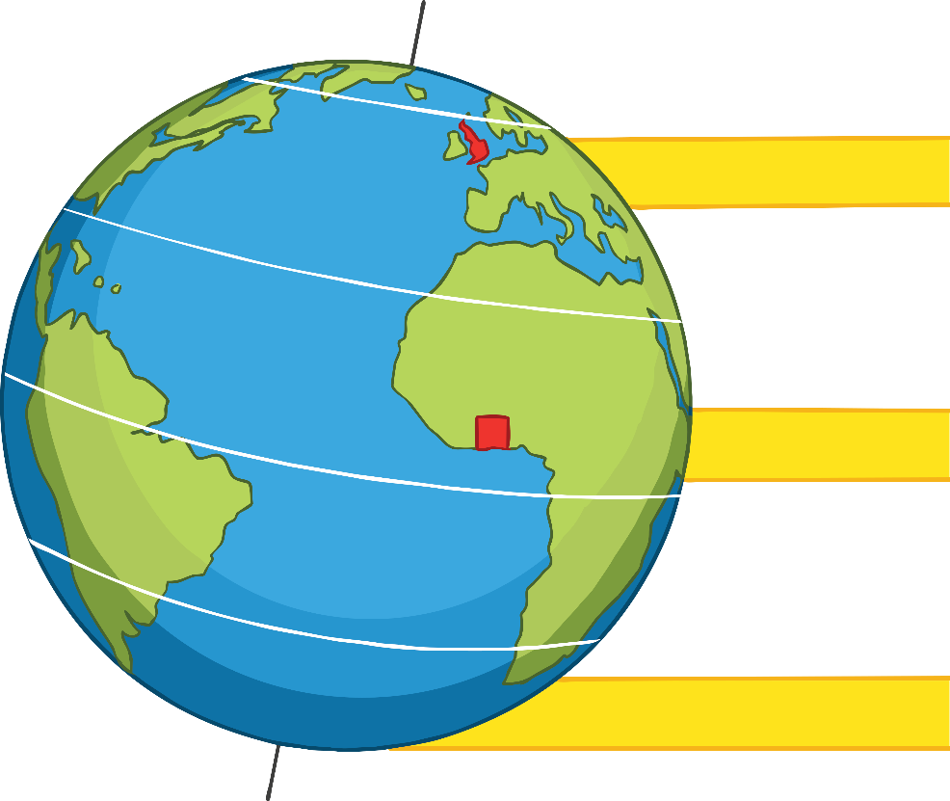
Why Do Places Have Different Climates?
1. the effect of latitude;
90˚N
North Pole
60˚N
Latitude means how far a place is from the equator.
Latitude is the main factor which affects climate.
Places on or near the equator have higher temperatures. Places that are further away from the equator are cooler.
B
UK
30˚N
rays from sun
Equ
A
0˚
30˚S
60˚S
C
90˚S
South Pole

Slide 7
Why Do Places Have Different Climates?
The Earth is a globe and this affects how different areas are heated by the Sun’s rays.
At the equator, the Sun’s rays heat a smaller area so it is warmer.
In polar areas, the Sun’s rays give the same amount of heat but as the Earth is curved, they have to heat a larger area. This means that these areas will be cooler.
90˚N
North Pole
60˚N
UK
B
30˚N
rays from sun
Equ
A
0˚
30˚S
60˚S
C
90˚S
South Pole

Slide 8
Why Do Places Have Different Climates?
Explain to your partner why…
90˚N
North Pole
60˚N
UK
B
it is very warm in Ghana.
it is cooler in the UK.
it is very cold at the North Pole.
30˚N
rays from sun
Equ
A
0˚
30˚S
60˚S
C
90˚S
South Pole

Slide 9
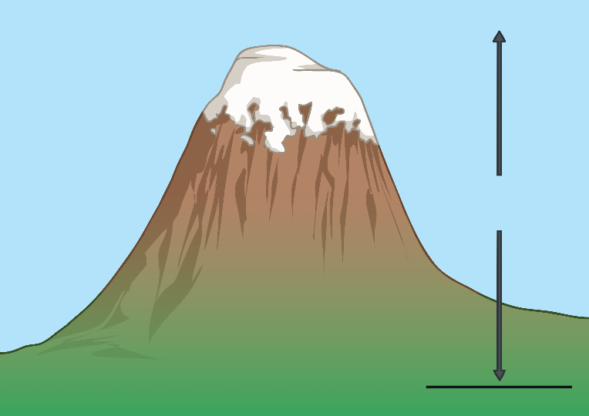
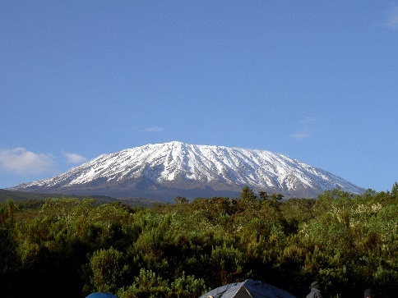
Why Do Places Have Different Climates?
Below freezing at the peak
2. Height above sea level (altitude)
Snow even in summer!
Altitude means how high land is above sea level.
Temperature falls by about 1°C for every 100 metres. This means that the higher above sea level a place is, the cooler it is!
This is why mountain areas have their own climate. Very high mountains often have snow on them, even in summer!
1344m
30˚C at base level
sea level
Ben Nevis – Scotland’s highest mountain
Mount Kilimanjaro, Tanzania
Photo courtesy of Chris 73 (@commons.wikimedia.org) - granted under creative commons licence – attribution

Slide 10
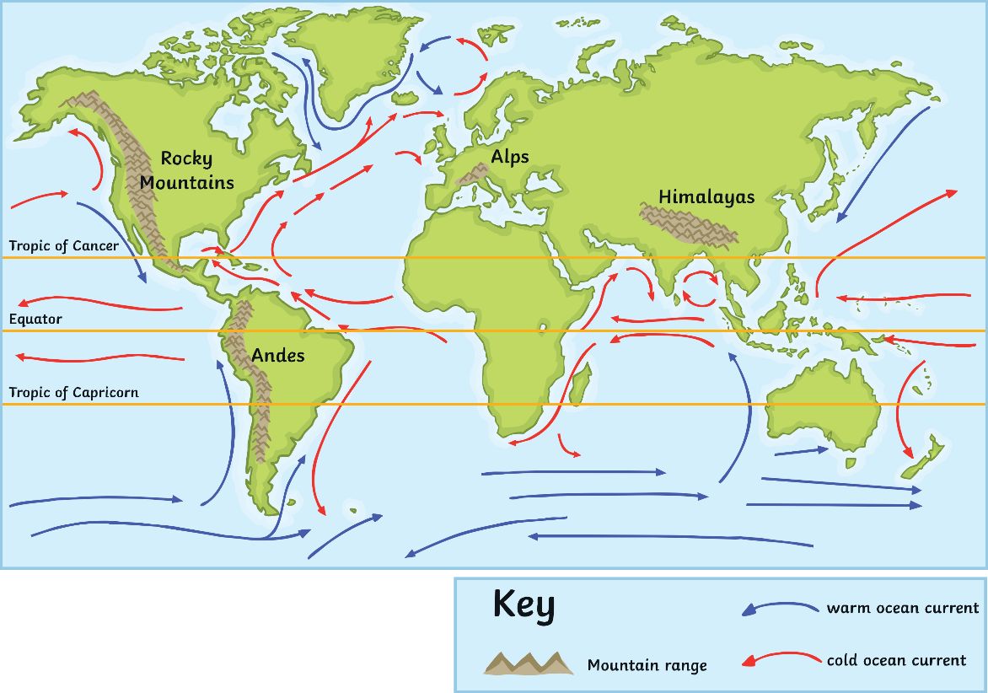
Why Do Places Have Different Climates?
3. Ocean currents
Ocean currents are movements of warm or cold water around the oceans. Ocean currents can raise or lower the temperatures of coastal areas.
Can you name an area which is affected by a warm ocean current…
and one that is affected by a cold ocean current?

Slide 11
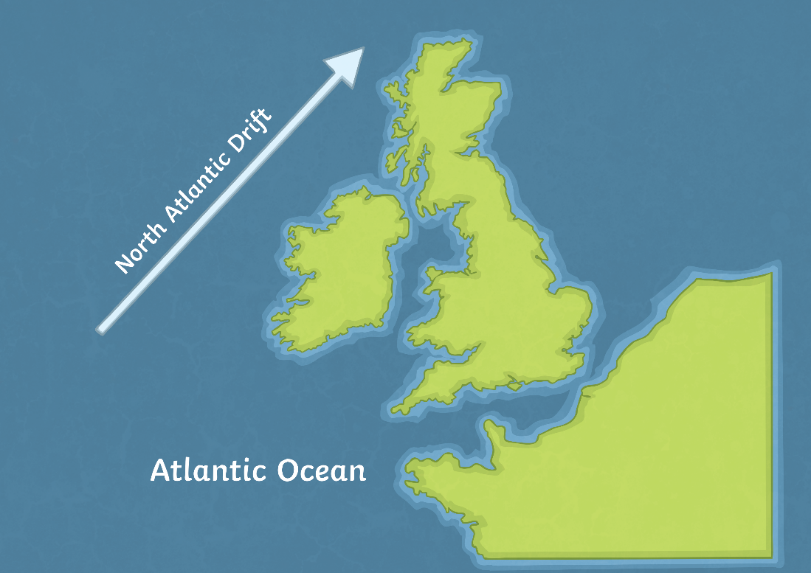
Why Do Places Have Different Climates?
The North Atlantic Drift is a warm ocean current that brings warmer water to the west coast of the UK. This raises the air temperature in this area by several degrees.
Without the North Atlantic Drift, winters in the UK could be more than 5°C cooler! The average temperature for London in December would be 2°C !

Slide 12
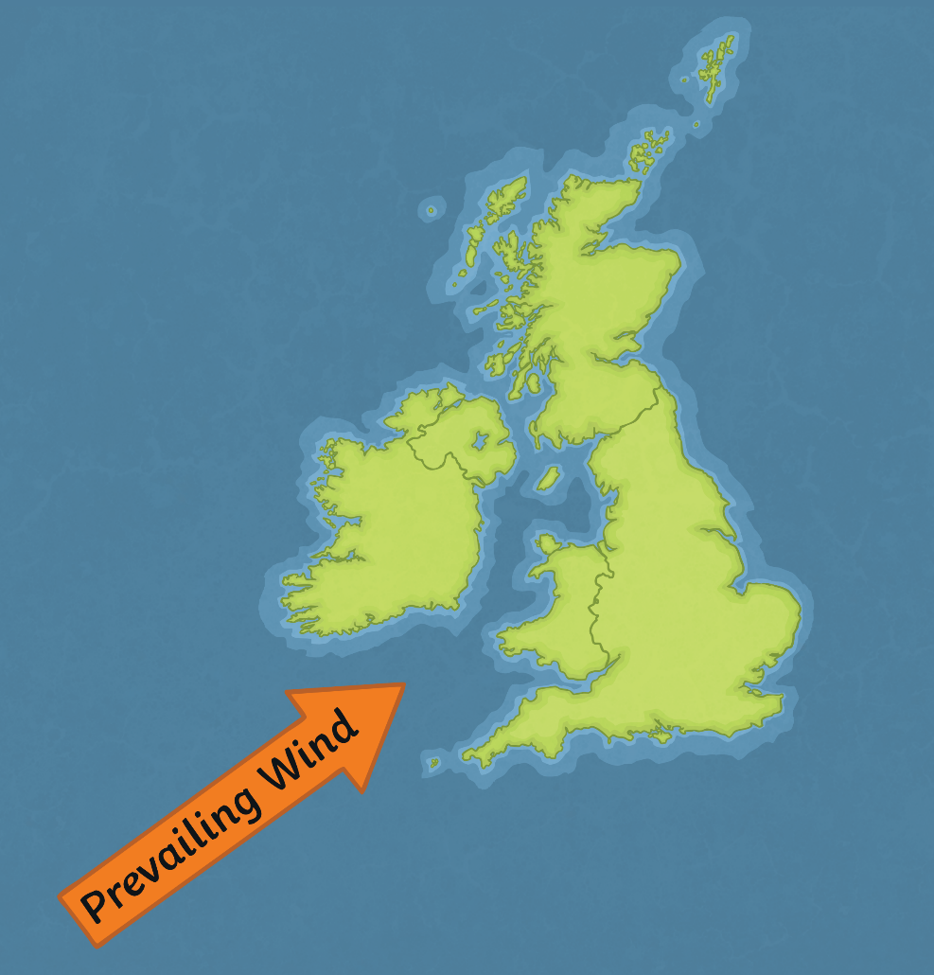
Why Do Places Have Different Climates?
4. Prevailing wind direction
A prevailing wind is the direction the wind blows from most of the time.
Prevailing winds can bring warm or cool air to an area, depending on where they have come from.
In the UK, the prevailing wind direction is from the south-west (the Atlantic Ocean), so it brings warmer, moist air or rain!

Slide 13
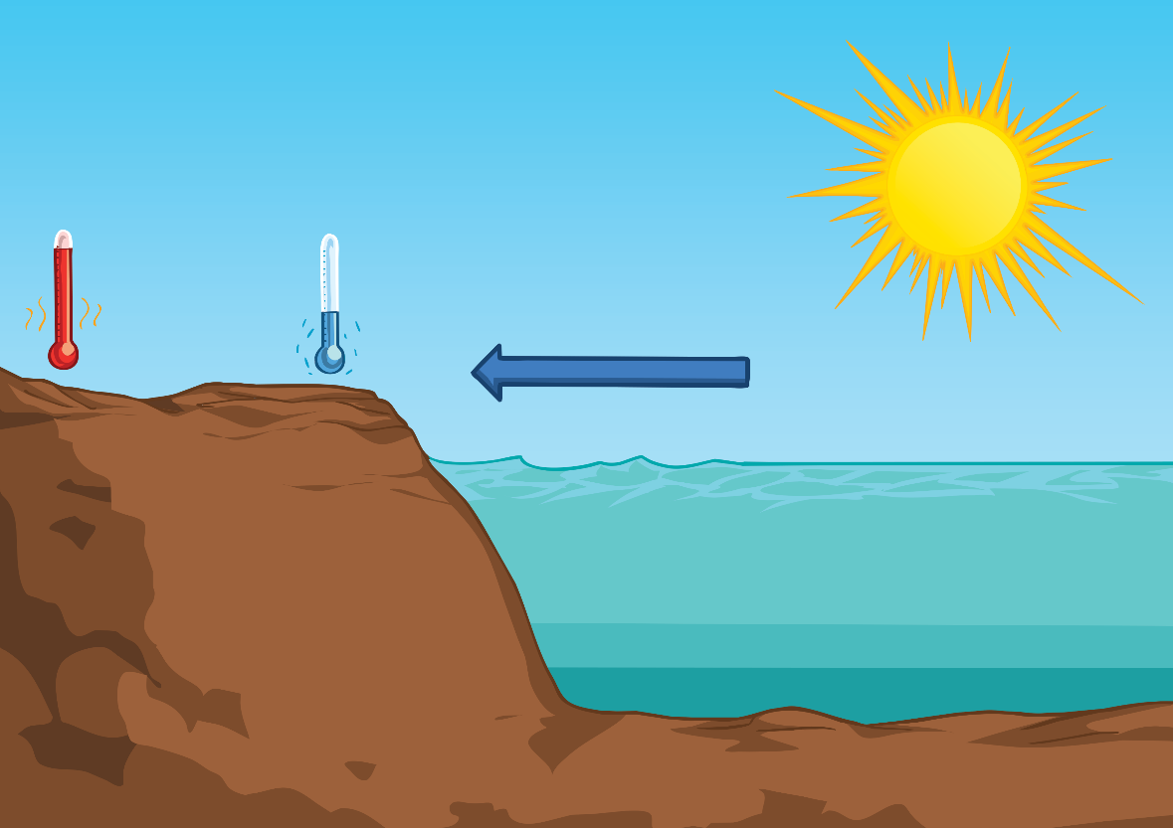
Why Do Places Have Different Climates?
5. Distance from the sea
In summer, the sea is cooler than the land. This means that areas on the coast are kept slightly cooler than inland areas by the cool sea breeze.
Cool sea breeze
Land
The land is warmer as it heats up more quickly.
Sea
The sea is cooler as it heats up more slowly.

Slide 14
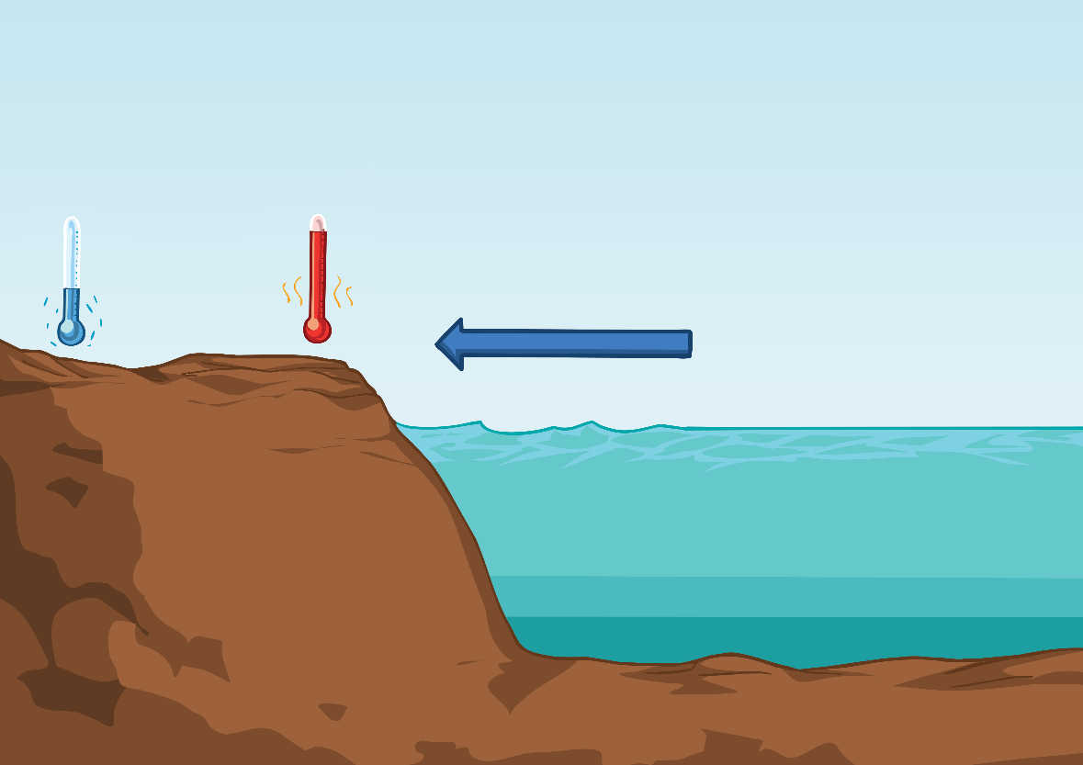
Why Do Places Have Different Climates?
In winter, the sea is warmer than the land. This means that areas on the coast are kept slightly warmer than inland areas.
Cool sea breeze
Land
The land is cooler
Sea
The sea is warmer as it has been heating up all summer

Slide 15
Why Do Places Have Different Climates?
How well do you understand the factors which affect climate? Are these statements true or false?
Temperature increases with altitude.
Warm ocean currents can lower the temperatures of coastal areas.
Places at the equator are hotter because the equator is closer to the Sun.
The sea is cooler in summer than in winter.
Places at the coast are cooler in summer than places further inland.
A prevailing wind that has come from polar areas will bring warm temperatures.

Slide 16
Why Do Places Have Different Climates?
Temperature increases with altitude.
Warm ocean currents can lower the temperatures of coastal areas.
Places at the equator are hotter because the equator is closer to the Sun.
The sea is cooler in summer than in winter.
Places at the coast are cooler in summer than places further inland.
A prevailing wind that has come from polar areas will bring warm temperatures.

Slide 17
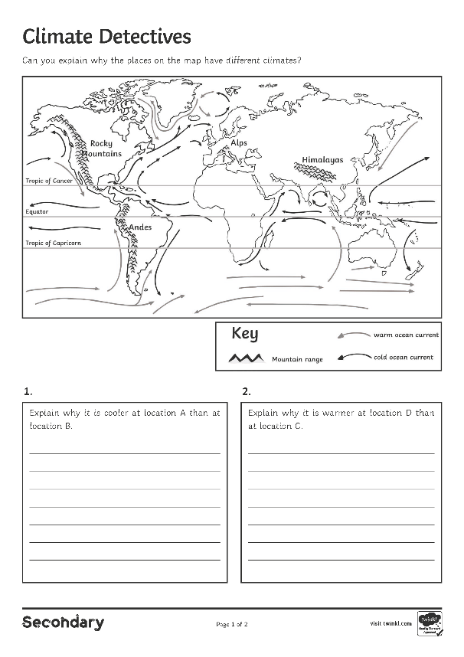
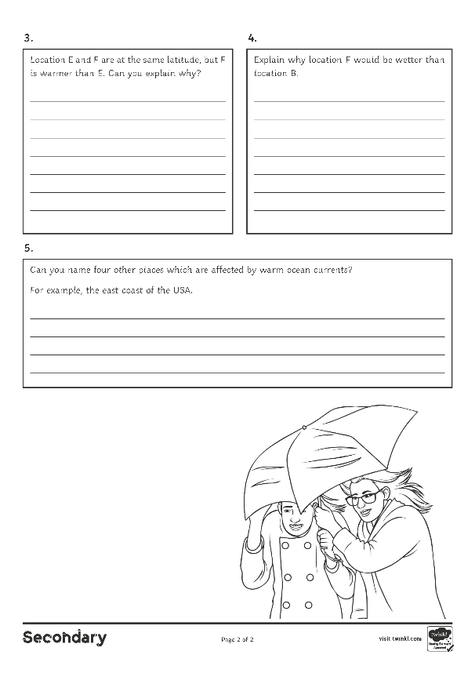
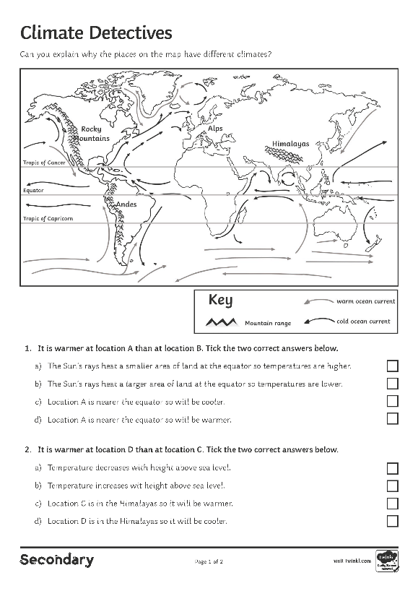
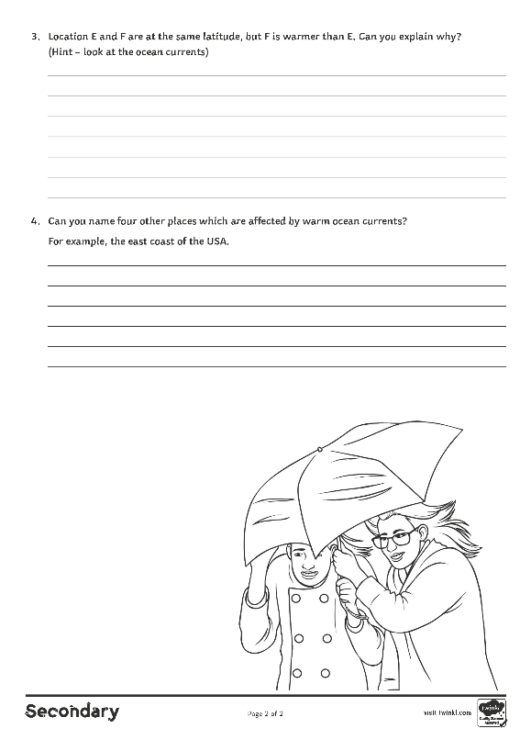
Why Do Places Have Different Climates?
Complete the Climate Detectives Activity Sheet.

Slide 18
Plenary: Weather Bingo
Write one key term in each square of your bingo grid. Tick off each key word when its definition is read out. The winner is the first to tick all nine boxes!
altitude
polar climate
latitude
arid climate
prevailing wind
storm surge
climate
weather
ocean currents
Mediterranean climate
tropical climate
arid climate
climate zone
drought
North Atlantic Drift

Slide 19
Photo courtesy of Dun.can (@flickr.com) - granted under creative commons licence - attribution

