Slide 1
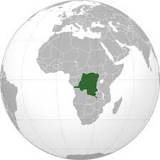
Case study Congo

Slide 2
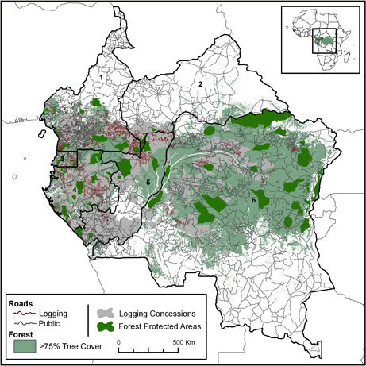
Locate and deforastation
As we can see all of the deforestation happens in central Congo which is situated in central Africa. This map shows how the tree cover increases from one side to the other, this shows how trees are gradually getting cut down. I have also remarked that just a few areas are protected areas. A lot of logging happens in the less tree covered areas in the west of Congo.

Slide 3
Why & how is it being damaged?
Conflict
Deforestation (majority for logging)
→ Logging:
Resources → financial value
Helicopter logging: selectively picking valuable trees with helicopters
“Out of control”, “international logging companies operating in the Democratic Republic of Congo are causing social chaos and wreaking environmental havoc” (Greenpeace)
Danzer logging company (2nd largest in DCR, 2 million+ hectares of forest titles):
“Violence associated with logging companies in DCR is more in the norm than the exception” → ‘social responsibility agreement’ signed with traditional chiefs in Jan 2005
Military intervention following village protests about their “unfulfilled promises to provide social basic infrastructure to the communities in exchange for to their forest exploitation”
Government’s capacity & ability to manage revenues is weak

Slide 4
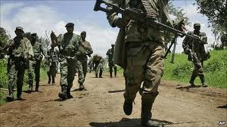
Conflict
Cutting down trees for resources
Conflict between loggers and people
Government interests, Government want to sell the resources in order
to gain money to fund the war

Slide 5
Addressing Deforestations
In congo deforestations occurs because farmers need to eat and poor companies need revenue.
By adressing the subject and help those people in difficulty, they would stop deforesting the rainforest.
Stop Privatizing the land and make it public
This will allow the government to have the power to choose what to do of the land, therefore it can keep its rainforest

Slide 6
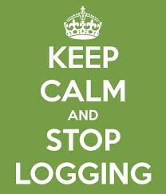
Thanks for watching

