Slide 1
The Kyoto Protocol
Reaching Global Agreements 1997

Slide 2
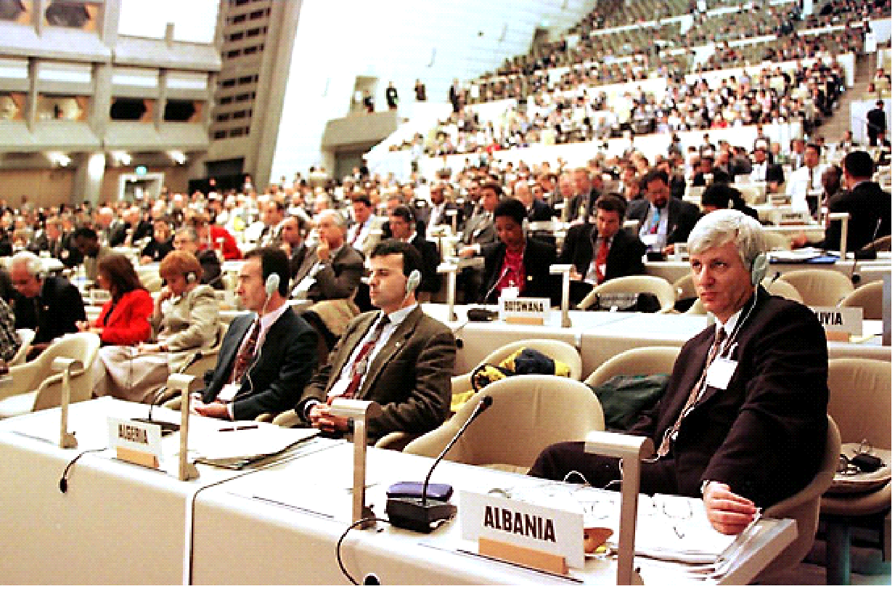
What is the Kyoto Protocol?
A global Agreement that set targets for reducing greenhouse gas emissions
175 countries signed up

Slide 3
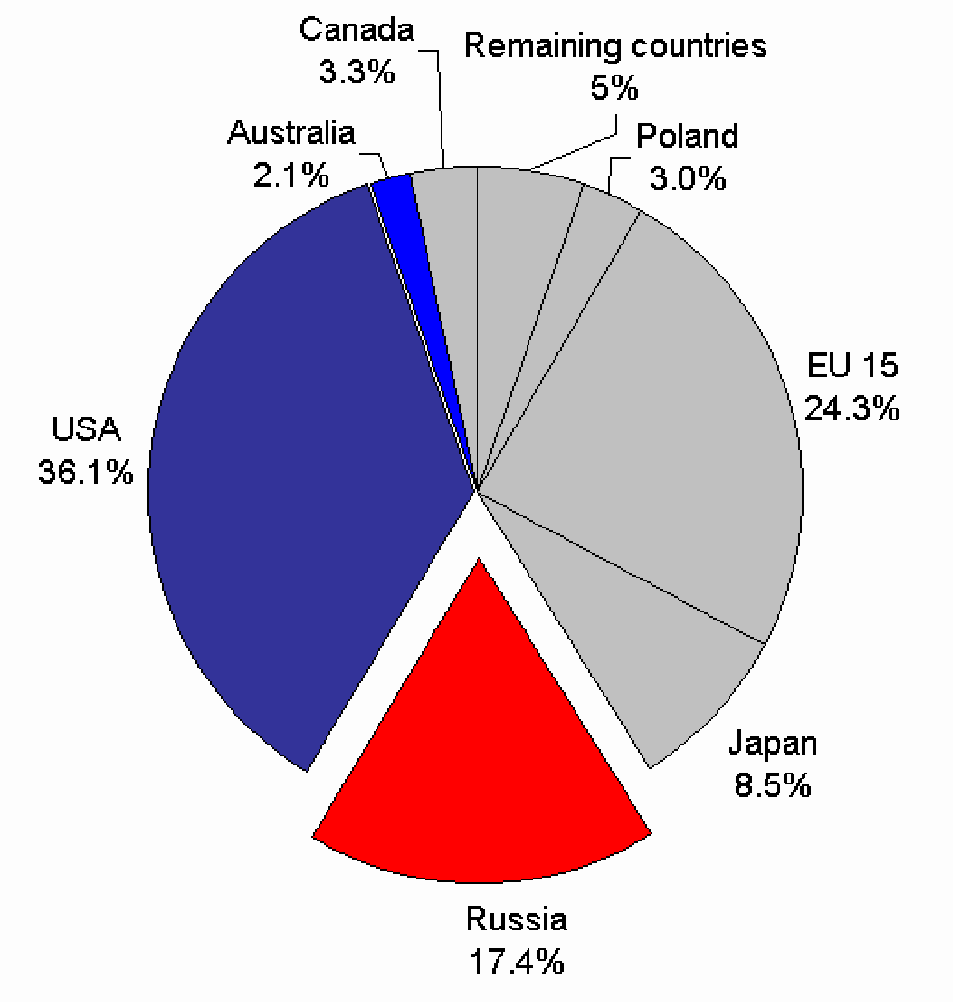
Kyoto Protocol Aims:
Share of CO2 Emissions in 1990
Industrialised countries to cut emissions to 5% below 1990 levels by 2008/12
Had varying targets EU by 8% and Japan 5% (It is a lower polluter)
Countries like Iceland were allowed to increase emissions

Slide 4
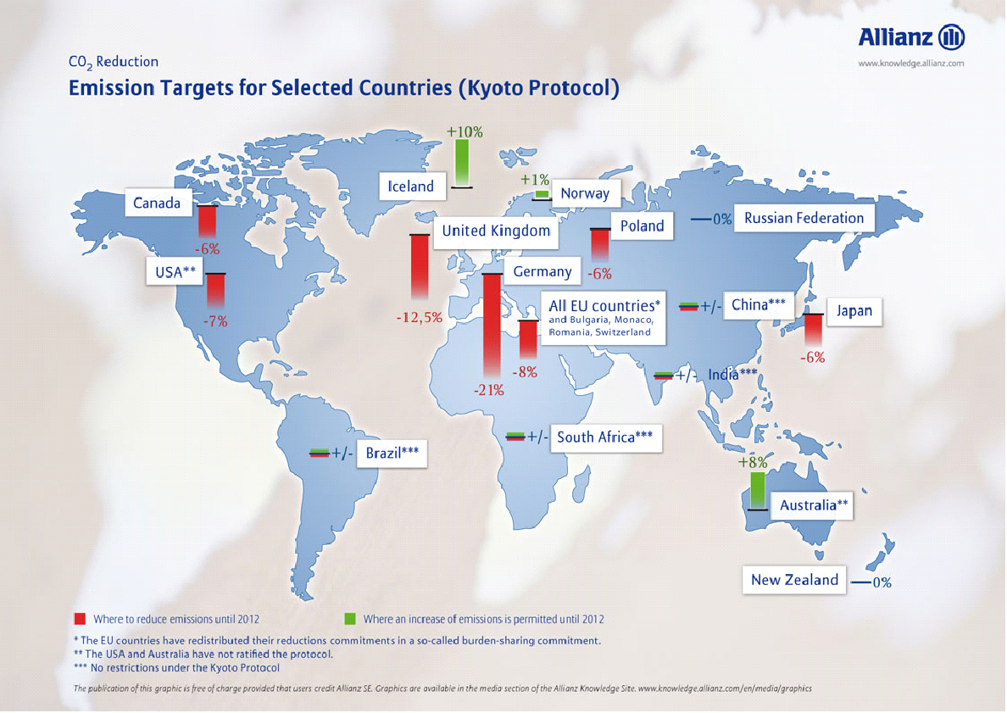

Slide 5
Problems
Some delayed in signing up to Kyoto such as Russia who signed in 2004
Some still have not. Australia the world’s 2nd largest polluter per capita.
USA initially signed but then withdrew in 2001 following GW Bush’s election (USA emit 25% of world emissions)

Slide 6
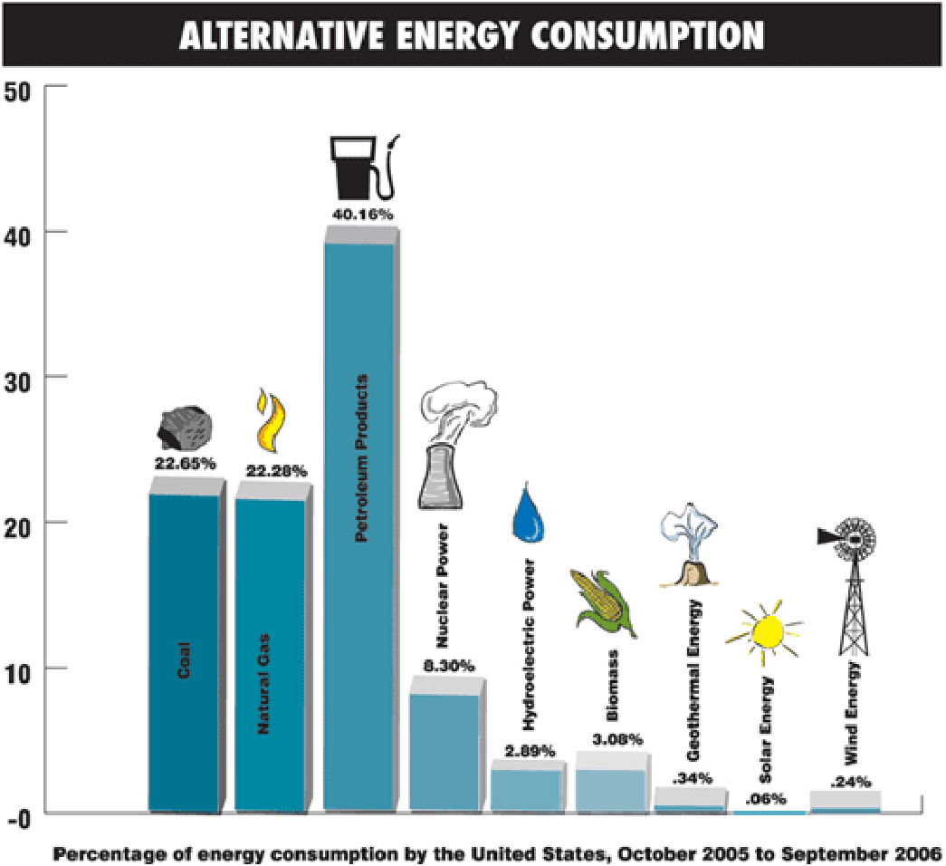

Slide 7
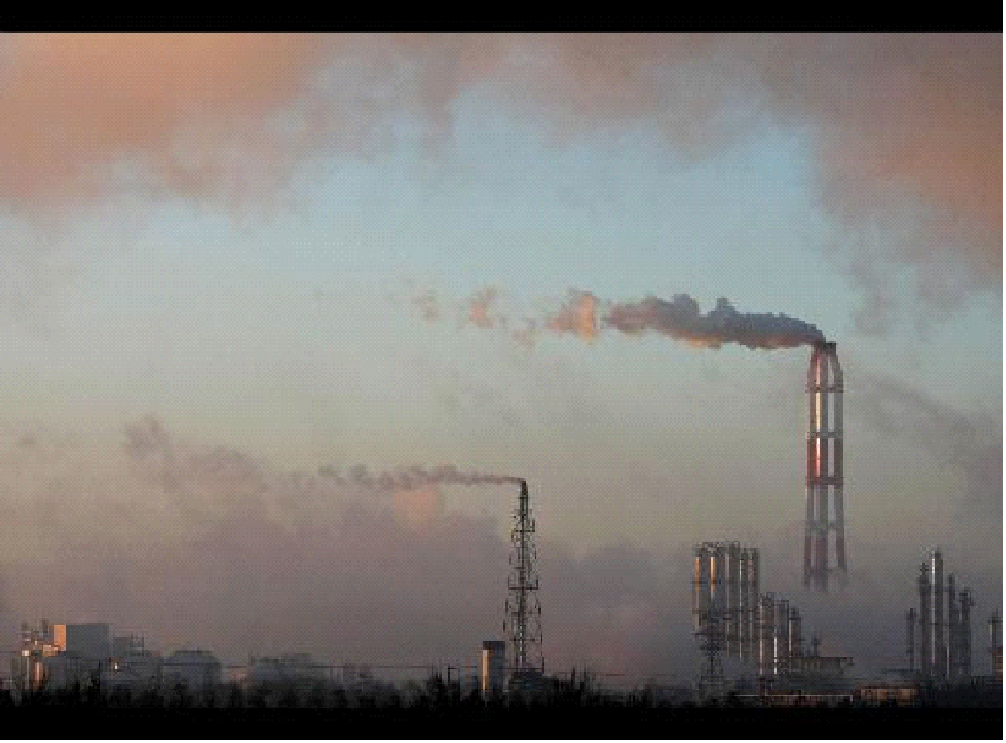
Success?
Overall most Industrialised countries such as UK cut emissions to 3% below 1990 by 2000
Collapse of former USSR mainly the reason
Emissions from other high emitters actually rose 8%
UN reckons it will emit 10% ABOVE 1990 levels by 2010

Slide 8
Many developing countries signed up but didn’t commit to actual figures.
The EU will meet its target France, Sweden and UK did
Spain, Portugal and Ireland have made no progress.
Many scientists believe Kyoto targets are far to low and believe not 5% but 60% is necessary.

Slide 9
Implications for the UK
A change from coal to cleaner gas fired power stations has helped reduce emissions
Renewable energy policy of 10% of electricity is near to target yet unlikely to reach it as a whole
Government has taxed petrol to help curb demand. Protests have followed and are likely to continue.
Big reductions can only be met by moving to nuclear however this brings it’s own set of issues

Slide 10
So what for the future?
Renewable energy can only supply 10-15% of the UK’s energy needs
Must replace coal fired with nuclear power stations
Building nuclear power plants takes time

Slide 11
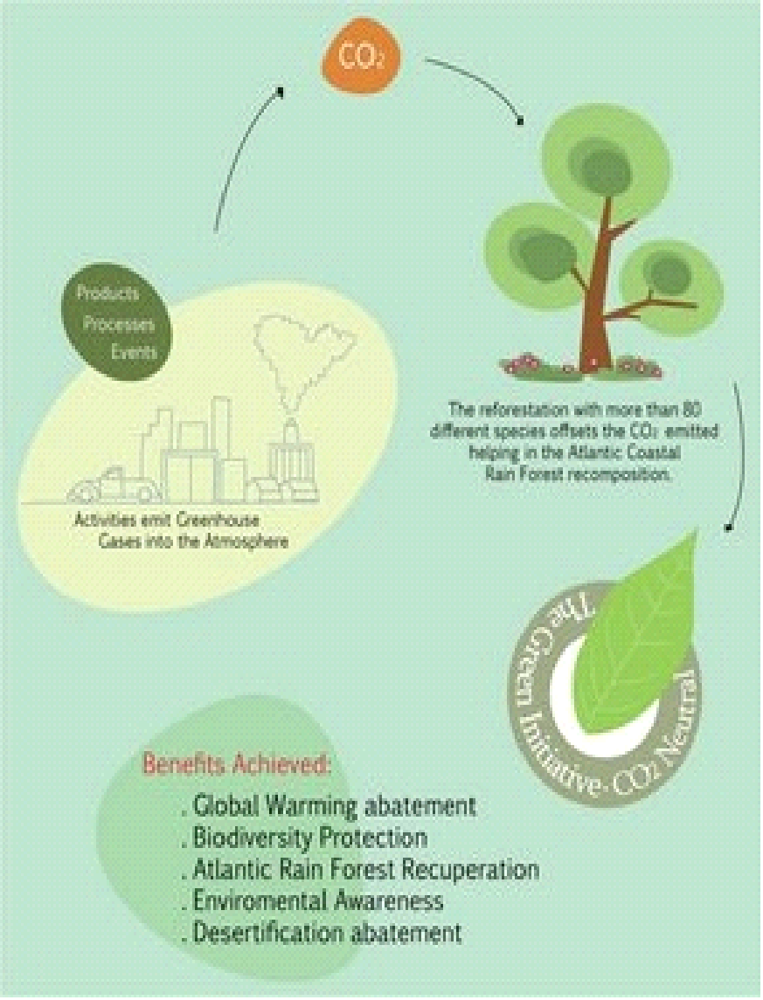
What is Carbon offsetting?
Forests and woodland cover 10% of the UK and they absorb CO₂ and store it
Several UK and EU schemes allow businesses to offset their emissions by planting trees
However there is a limit to the amount of CO₂ that they can hold and therefore are limited in viability
UK woodland removes 4 million tonnes a year
UK emits 150 million tonnes it would take a huge increase in woodland to offset all of UK emissions

Slide 12
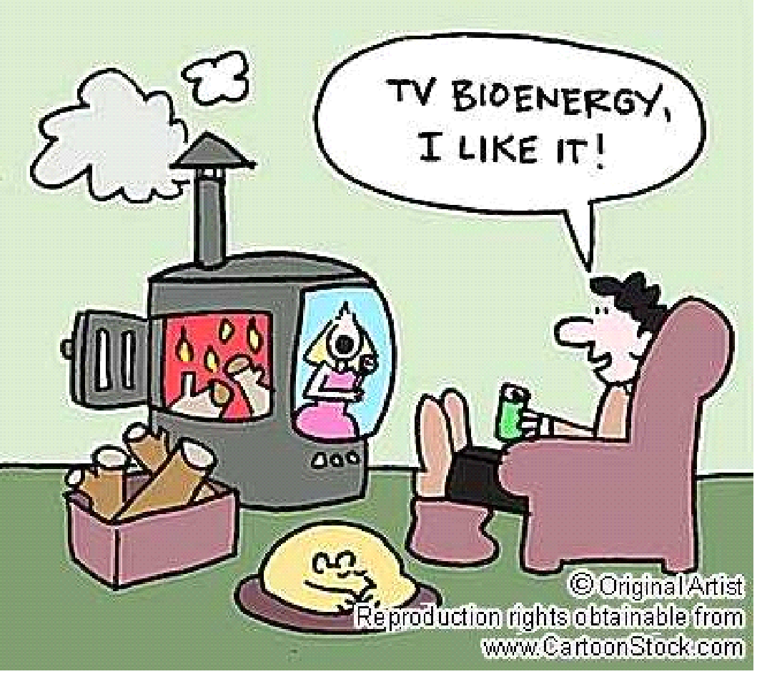
Alternatives
Biomass fuels
Wood fuel
Ethanol and bio diesel
Alcohol fermented from sugar
Oil extracted from soybeans
Methane Gas coming from rubbish dumps

Slide 13
Problems
Unfortunately these rely on removing plants from the planet thus removing a carbon sink and need to be followed by mass replanting schemes
Growing biofuels reduces the land available to grow food

Slide 15
Reducing Our Carbon footprint
Individuals can make a difference
Turn lights out
Don’t leave on ‘Stand-by’
Walk or ride rather than drive
Take the bus or public transport
Get eco friendly washing machines, fridges etc
Together it can make a difference.

Slide 16
The Stern Review
2006 UK Govt reviewed global warming
Focused on impacts and the actions needed
Argued it could be reduced if emissions were stabilised by 2025 and fell 1-3% annually thereafter
Costs would be 1% of GDP to invest.

Slide 17
Key Features
Increased global flood risk
Fall in crop yields especially Africa due to climate shifts
Rising sea levels effecting 200m people
Extinction of 40% of earth’s species due to destruction of coral reefs

Slide 18
Economic Impacts
More extreme weather leads to increased costs equal to 1% of GDP
2-3ºC rise in temps reducing global economic output by 3%
Poor countries ability to cope would be reduced with lack of basics like water

Slide 19
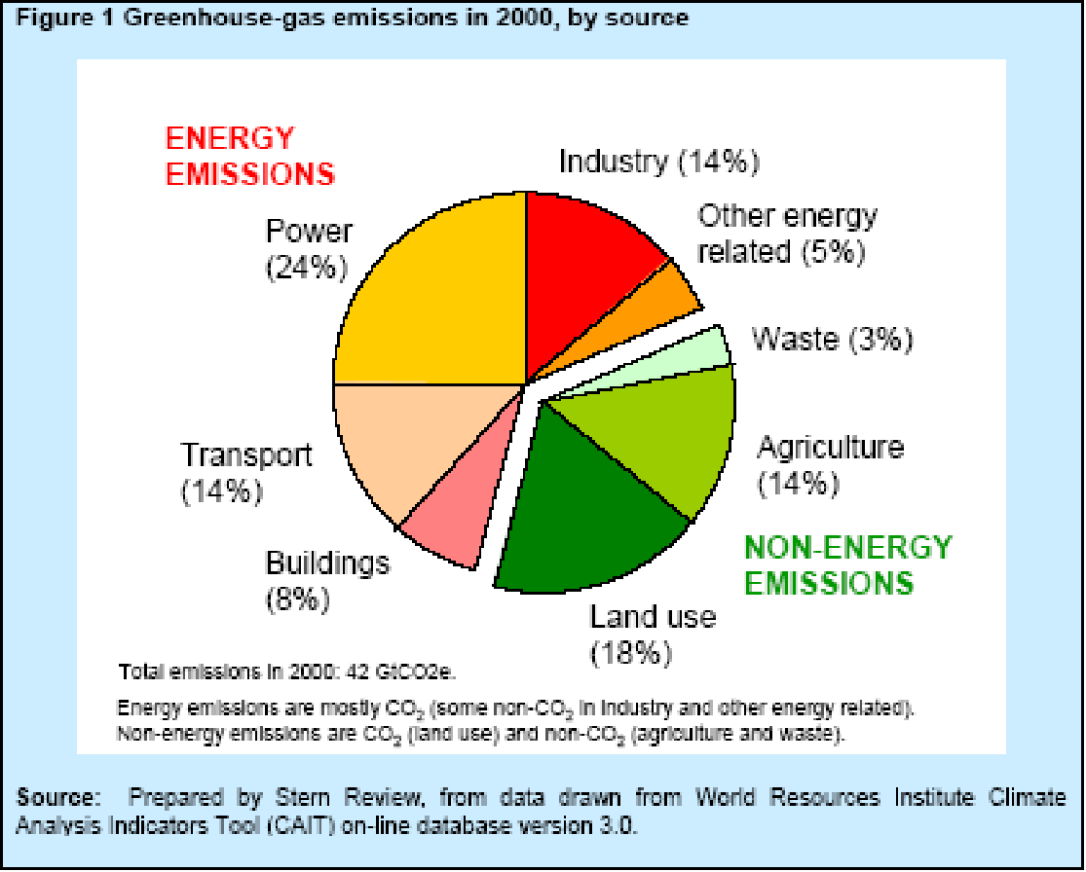

Slide 20
Options
Reduce demand for heavily polluting goods and services
Improve efficiency of global energy supply
Prevent global deforestation
Promote cleaner energy technology

Slide 21
UK Government Response
Set targets to reduce emissions by 30% by 2020 and 60% by 2050
Pass laws on carbon reduction targets
Invest in green technology creating 100,00 new jobs
Create a $20 billion World Bank Fund to help poorer countries

Slide 22
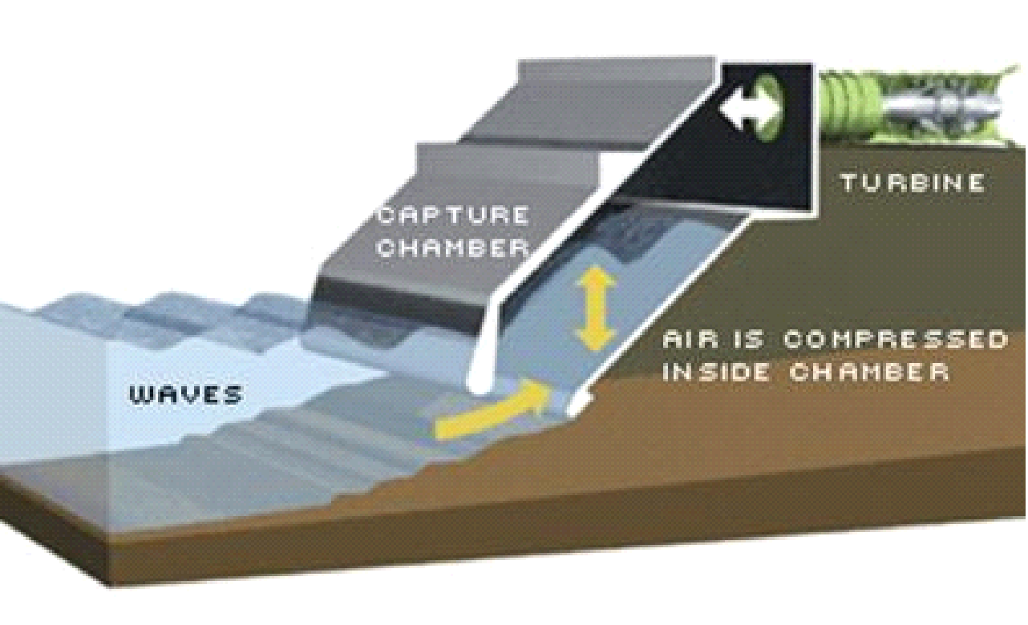
Sustainable Energy
Wave Power

Slide 23
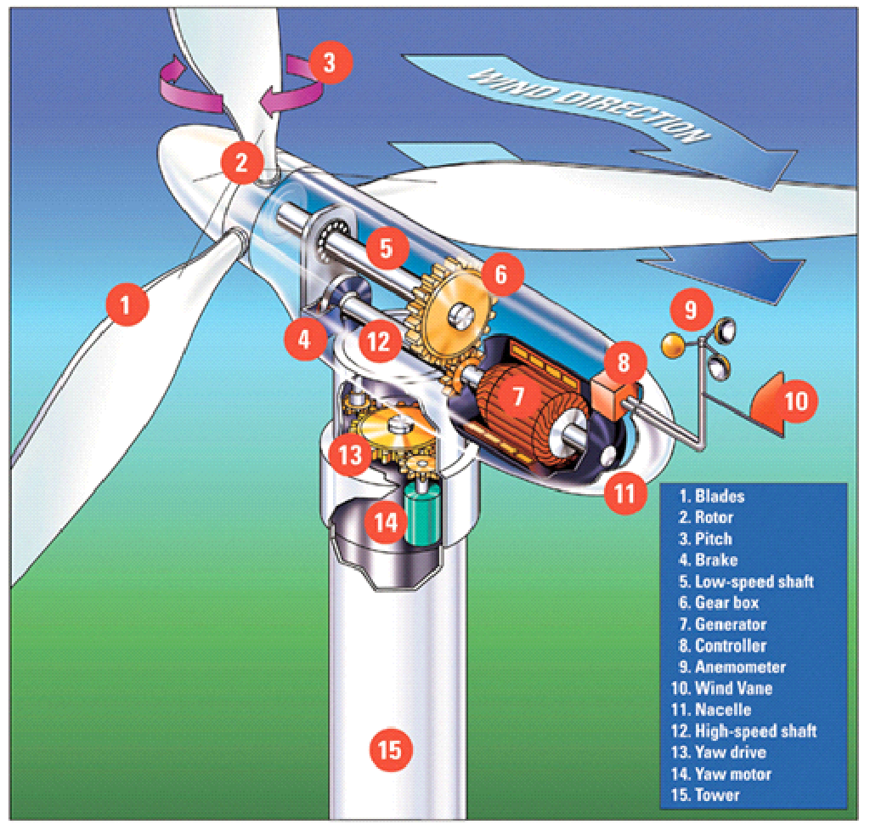
Sustainable Energy
Wind Power

Slide 24
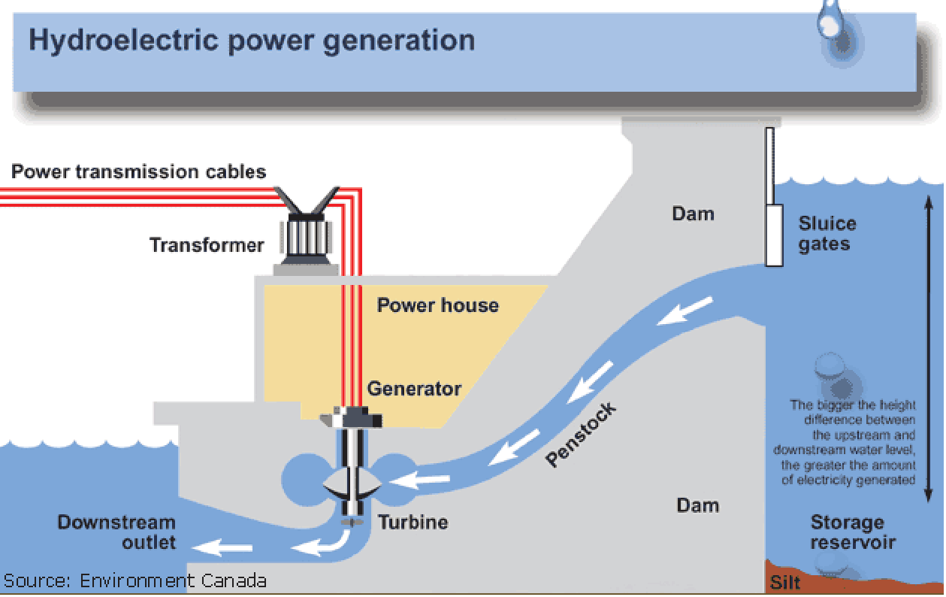
Sustainable Energy
Hydro Electric Power

Slide 25
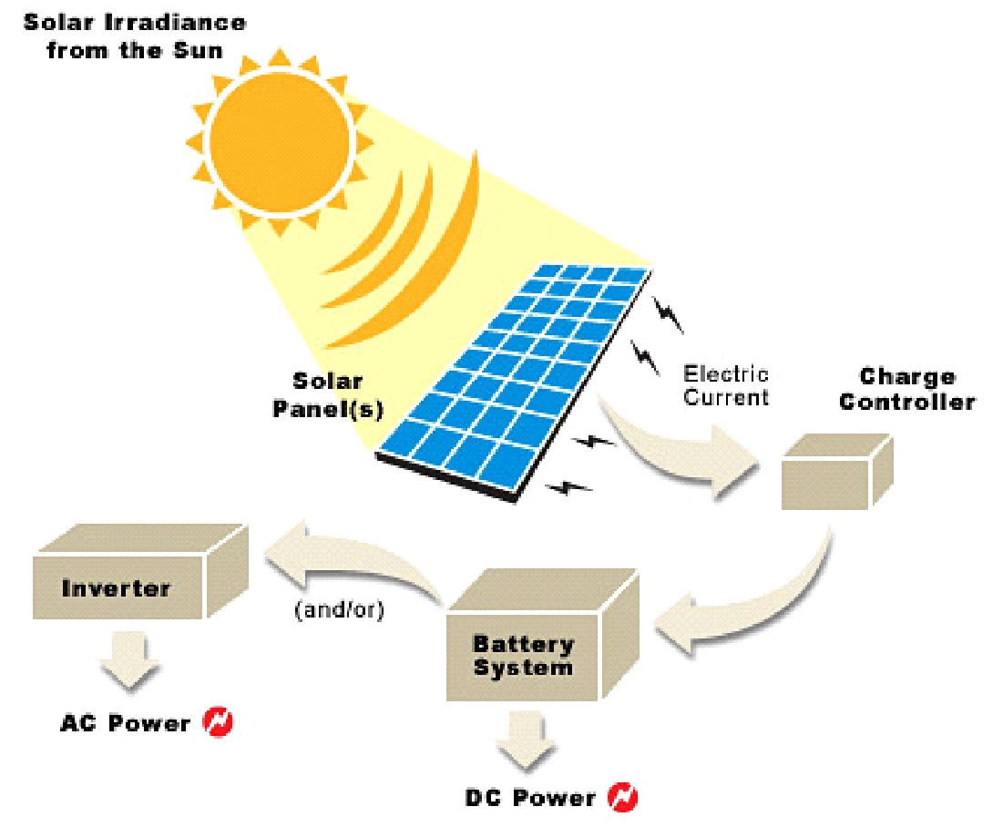
Sustainable Energy
Solar Power

Slide 26
Sustainable Energy
Wind
Wave
Water
Solar
These account for only 2% of world electricity production
What are there criticisms?

Slide 27
Costs
It would be very expensive to shift to these power sources
Governments do not like to reduce national income
Growth that is fossil fuel driven needs to end

