Slide 1
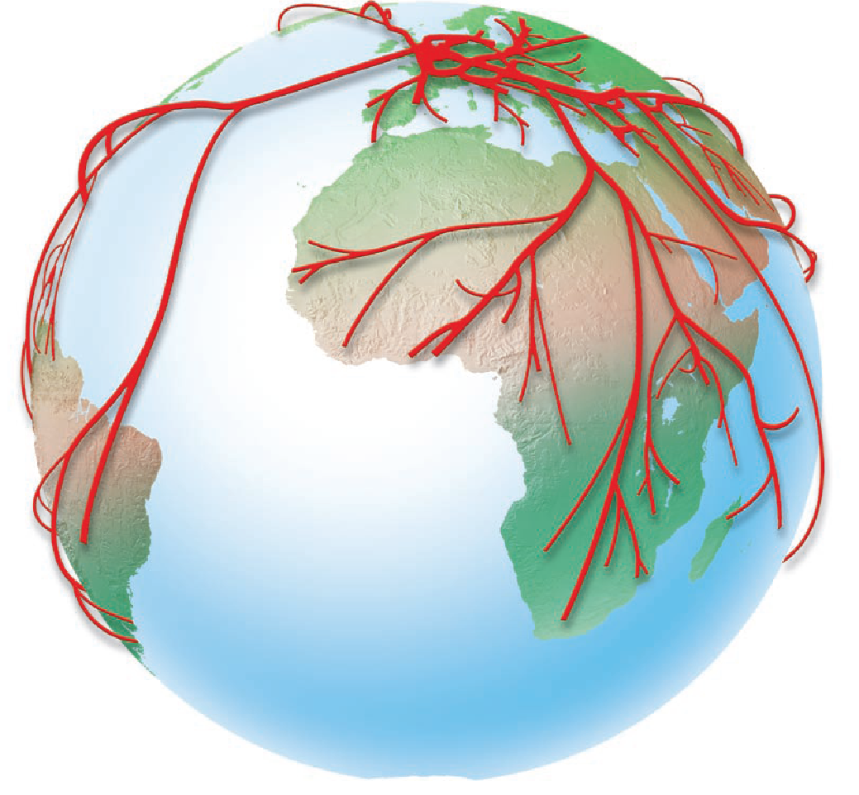
KOF
LEARNING OBJECTIVES
To identify the strengths and weaknesses of the KOF index
To evaluate which is the best index for showing Globalization

Slide 2
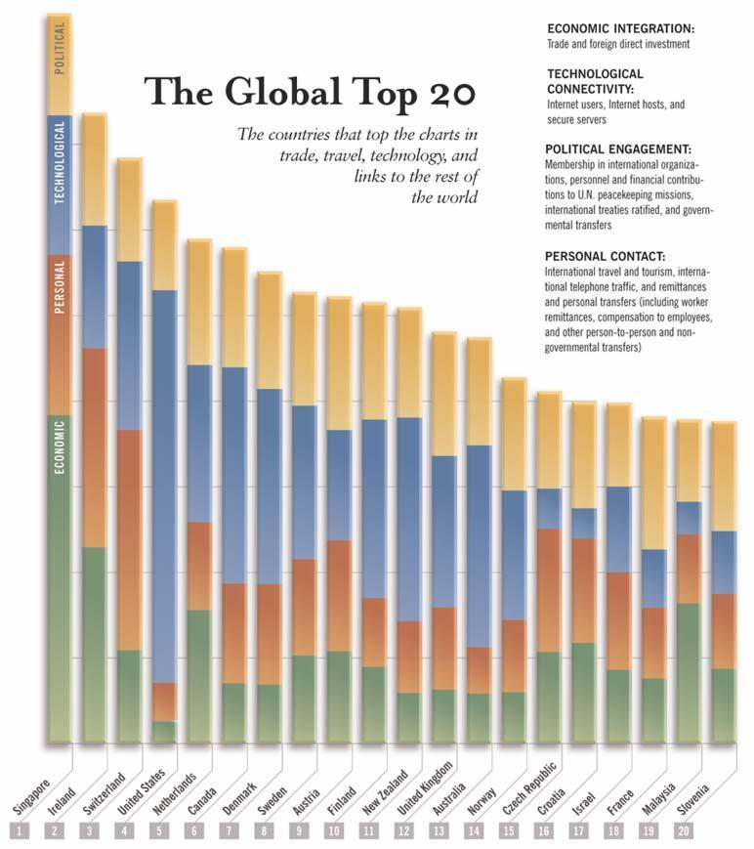

Slide 3
What is the KOF Index
KOF Index: KOF are a leading Swiss economic think tank that also release a yearly globalisation index.
The KOF Index of Globalization measures the three main dimensions of globalization:
economic
social
and political.

Slide 4
What is the KOF Index
In addition to three indices measuring these dimensions, we calculate an overall index of globalization and sub-indices referring to
actual economic flows
economic restrictions
data on information flows
data on personal contact
and data on cultural proximity.

Slide 5
Points of Note with KOF Index
The KOF Index of 2011 shows that globalization is still on the rise, driven by increased economic and political globalization, while social globalization stagnates.
According to the KOF Index of Globalization 2012, Belgium is the world's most globalised country.

Slide 6
Advantages of KOF
The index allows comparing degree and changes in globalization over a large number of countries and more than 30 years.
The KOF Index of Globalization 2009 is available for 158 countries over the period 1970–2006,
It is calculated on the basis of 24 variables.

Slide 7
Advantages of KOF Index
employing the weighted individual data series instead of using the aggregated lower-level globalization indices data can enter the higher levels of the index even if the value of a sub-index is not reported due to missing data

Slide 8
Disadvantages of KOF
the results were sometimes driven by extreme outlying observations and missing values.
cultural globalization mostly refers to the domination of U.S. cultural products. Arguably, the United States is the trend-setter in much of the global socio-cultural realm

Slide 9
The Criticism of KOF
Although the KOF index can give us an idea of overall globalisation, it has got some critics, particularly about the accuracy and relevancy of the data. Criticisms include:
Measures like international letters per capita are very dated. Most people now use e-mail because it is quicker and cheaper.
Trade in newspapers is slightly dated, more and more people now access there news via the internet. Again trade in books is also becoming dated as more people buy e-books or visit libraries and borrow.

Slide 10
Anything to do with trade can be hard to measure because many countries do not know the true size of their informal economy (black market). Many black markets are actually involved in globalised trade e.g. human trafficking, smuggling of wild animals and drugs.
Measuring foreign populations can be hard because of inaccurate record keeping and illegal immigrants. Countries like the US have millions of unaccounted immigrants.

Slide 11
It is hard to calculate the true number of internet users. Many people don't have a home computer but access the internet at their workplace or in internet cafes.
Some countries are small and don't have many embassies and instead rely on embassies and consulates in neighbouring countries e.g. Monaco will use embassies in France, other countries share embassies e.g. Commonwealth countries like New Zealand and Australia

Slide 12
Some countries choose to stay neutral and not join international organisations e.g. Switzerland - this does not mean they are any less globalised.
Some countries have a large number of domestic tourists, but not many international. In large countries domestic tourists can actually be very ethnically and culturally diverse, but this is not recognised.

Slide 13
There is also an argument whether it is good or bad to be at the top or bottom of the globalisation list. Some people may say it is good because there is cultural diversity and that you have access to people and products from around the world. Others may argue that this is a bad thing because your culture is being lost and that your country is possibly becoming more homogenised.

