Slide 1
Identities and Places: An Introduction to Maps
To know what a map is and how it can show your place
To understand what is meant by STACK
To be able to create a simple map and be able to STACK it

Slide 2
Did you use any symbols?
Where do we use symbols?
& Why?

Slide 3
Maps use symbols!
When drawing a map to scale it is important to include as much detail as possible.
However, not all the detail will fit on the map so we use different images, abbreviations and letters to represent the main items on the map.
These are recorded in the key!
Did your map have a key? Could you add one?

Slide 4
Look at the key:

Slide 5
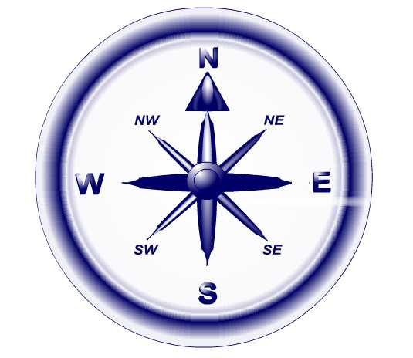
Which direction is your map?
Where is north? What is even meant by ‘north’?

Slide 6
Compass Rose
How can we remember the points of the compass?
‘Never Eat Squishy Watermelon’
TASK: Copy out the compass rose and the above slogan.
Extension: Think of your own slogan!

Slide 7
Finding your direction… move to the right compass point around the room
The direction of:
6 from 1
2 from 7
1 to 5
8 from 12
9 to 3
11 from 8
Let’s play ‘box the compass!’

Slide 8
Which direction is your map?
Can you add a compass point to your map?

Slide 9
How do you know what your map is showing?
E.g. how can you tell what this map is showing?
Did your map have a title? Could you add one if you didn’t?

Slide 10
How big is your map?
How can you tell when a map is 1cm; 1m; 1km or 100km in real life?
By the scale! This tells you the distance on a map
Did your map have a scale? Could you add one?

Slide 11
STACK
Scale
Title
Accuracy
Compass
Key
Now double check that your map has all of these!

