Slide 1
Measuring Height and Gradient on Maps
Map Skills

Slide 2
Key terms
Height & Altitude: Both these terms can be used interchangeably in Geography and they mean the height of an object or point in relation to sea level.
Relief: The difference between the highest and lowest elevations in an area. This is often comparative and will often appear on map skills questions that are asking you to ’describe the relief’

Slide 3
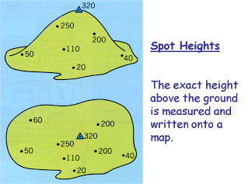
How do we show height on a map?

Slide 4
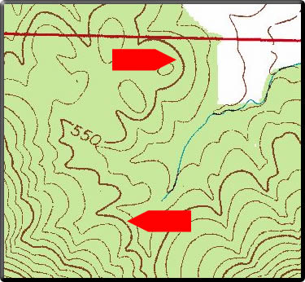
Index Intervals
Make the map less cluttered and easier to read
Thicker and Bolder

Slide 5
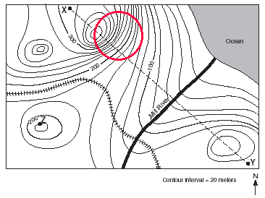
Contour Intervals
Close lines contour = steep slope.

Slide 6
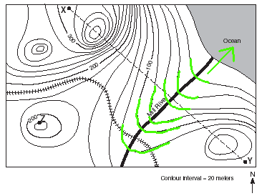
Rivers and Streams
When contour lines cross a stream or river, they bend upward toward higher elevations.
The “V” points upstream.

Slide 8
GRADIENT
THE RATE OF CHANGE OF A SLOPE

Slide 9
GRADIENT
THE MATHEMATICIAN VS GEOGRAPHER
They are interpreted the same way BUT we are studying Geography so use the correct one!
Mathematician | Geographer
As a Fraction | As a Ratio
1/20 | 1:20

Slide 10
GRADIENT
Always ensure that you covert all units into the same scale.
All units should be in meters

Slide 11
GRADIENT
RISE
SLOPE
1M
20M RUN
What does this mean?
-The ratio would be 1:20
-For every 20m we walk there will be an elevation in height of 1 meter. This in other words would be a small slope.

Slide 12
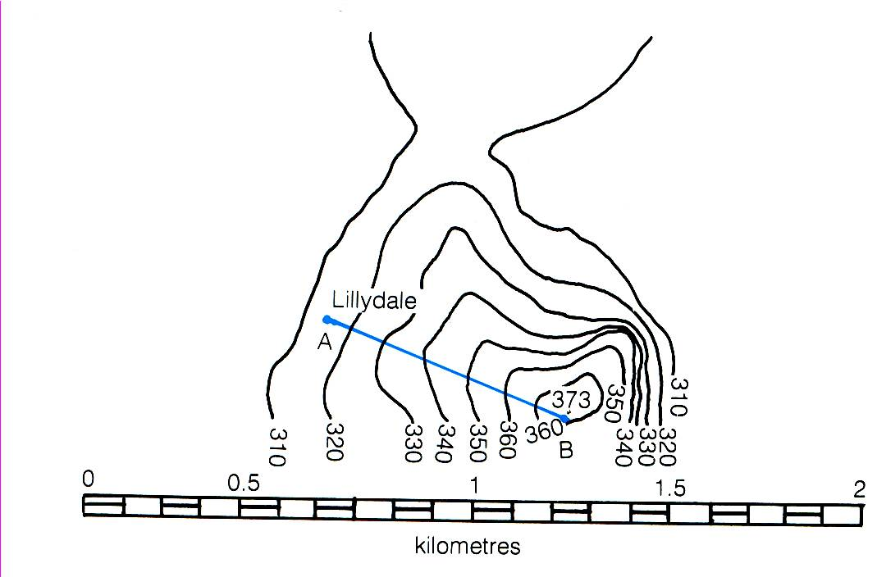
Gradient
Difference in the Vertical Height between two points DIVIDED by the actual distance along the ground as measured on the scale of the map
Gradient = 373 - 315m 700m = 58/700 = 1: 12

Slide 13
What does the Gradient number mean?

Slide 14
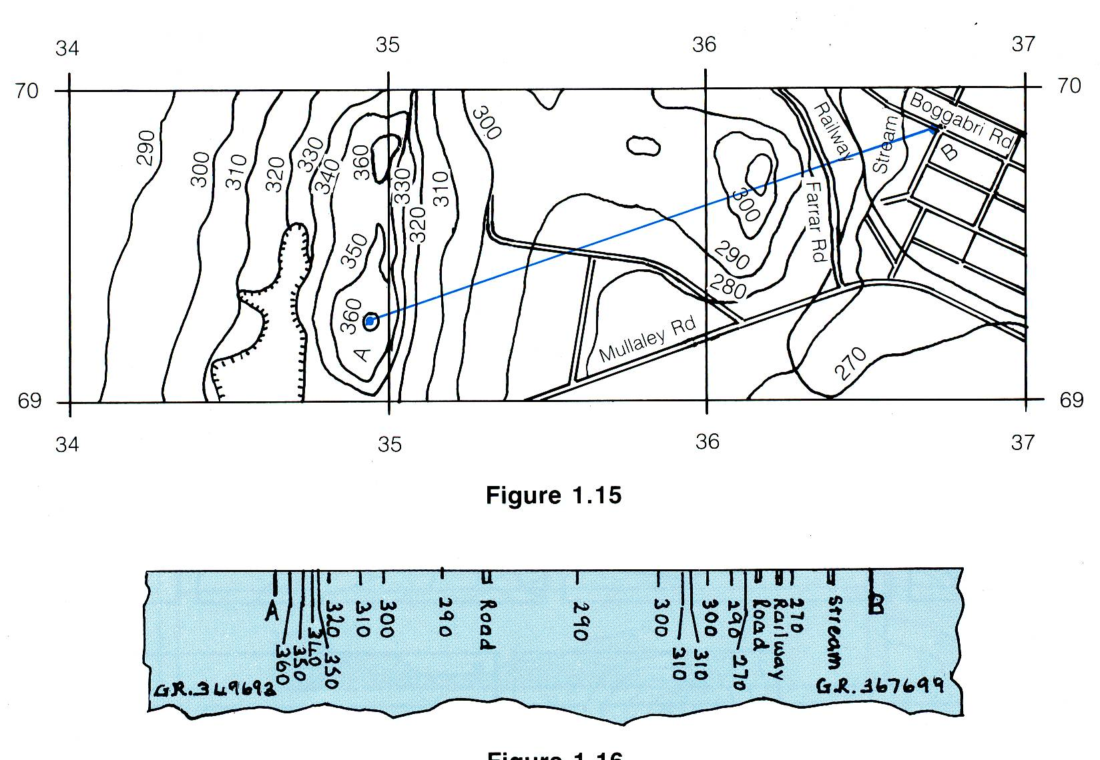
Cross-sections

Slide 15
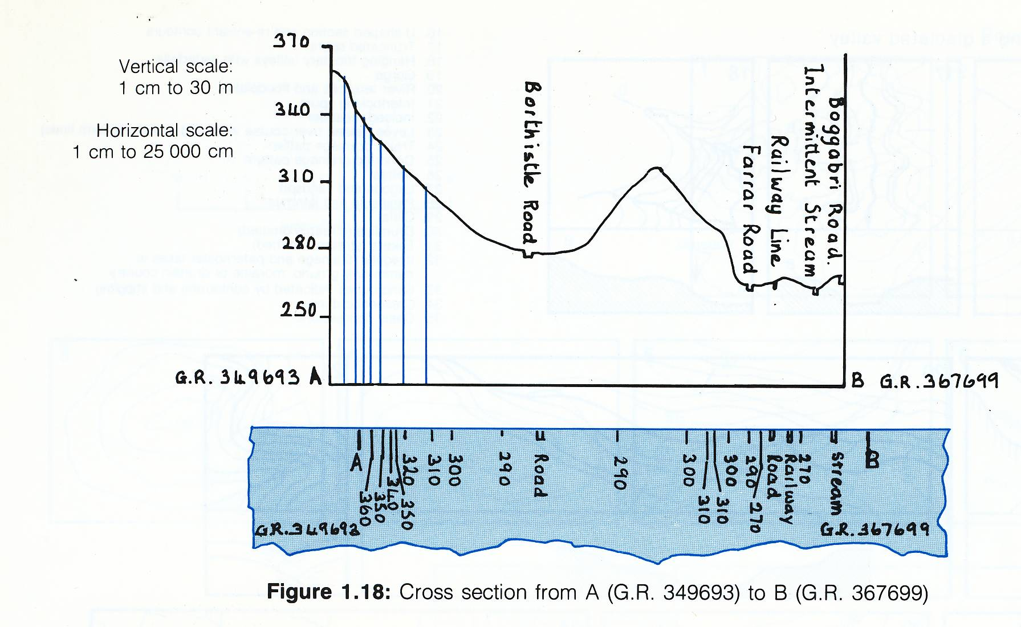
Drawing the cross-section - draw lines up from the base to make a dot at the correct height then a smooth line joining the dots…

