Slide 1
Economic Interactions and flows
Why do they make the world go round?

Slide 2
Key words
Capital: Capital can take many forms but for the purpose of this section we will refer to capital as money.Core Areas: These are economically important and attract investment, capital and people. For the purpose of this section we will consider MEDCs like the US, Canada, Western Europe and Japan to be the core areas.Periphery Areas: These areas are poorer and may experience exploitation, economic leakage and out migration. For the purpose of this section we will consider LEDCs in Africa, Central Asia and parts of Latin America to be the periphery. For further details on why areas become core or periphery and a list of some of their characteristics visit: Global core and peripheryLoans: Money that is borrowed from someone.Debt Repayment: The paying back of money that you have borrowed.

Slide 3
Key words
Aid: To provide support or help. Aid can take many different forms ranging from giving money and loans to providing technology and expertise to providing food and rescue teams.Remittances: Money sent home to friends and family by migrants living in a different location (often abroad).Foreign Direct Investment (FDI): Investment made by overseas governments, businesses or individuals in foreign enterprises.Repatriation of Profits: TNCs operating in foreign countries will normally send any profits made back to the TNC headquarters. This repatriation of profits is sometimes known as economic leakage. By their very nature core areas attract capital, investment, resources and people through things like FDI, debt repayment and repatriation of profits. However, flows of capital can also go from core areas to peripheral areas in the forms of FDI, loans, aid and remittances.

Slide 4
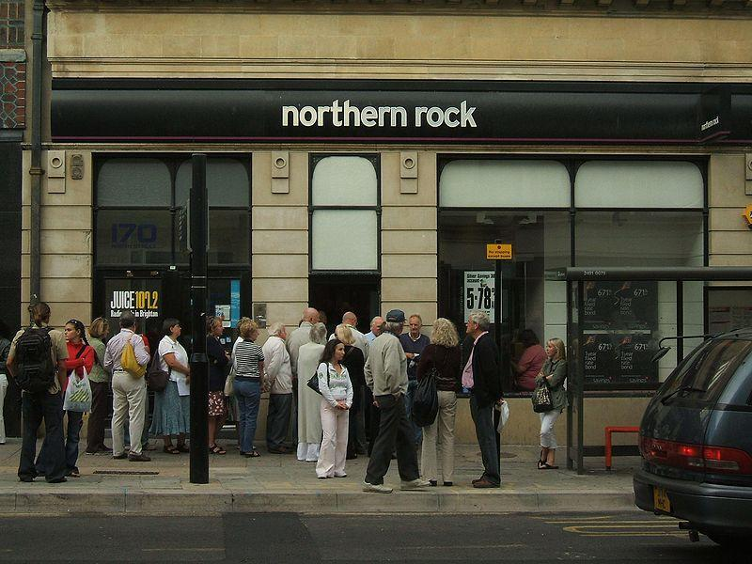
Why are global economic flows important?

Slide 5
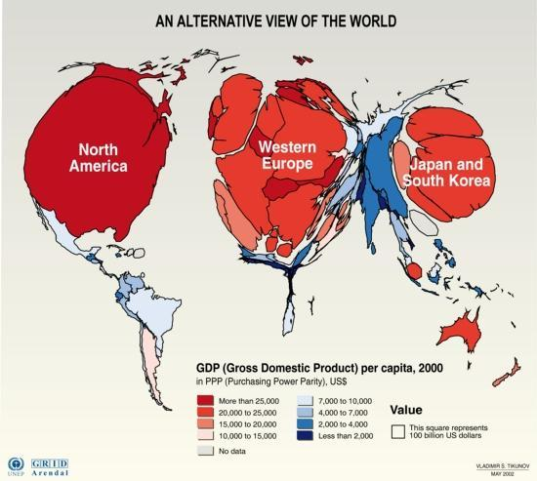

Slide 6
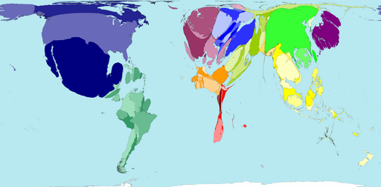
Finance and Insurance Importers

Slide 7
Of the 200 territories in the world, 83.5% are net importers of insurance and finance services. Insurance can be taken against risks to many things, ranging from freight insurance to life insurance. Financial services are those services provided by banks, stock exchanges, credit card enterprises, and similar institutions.
Mexico, the United States and China import the highest values of insurance and finance services (US$ net). Canada imports the fourth highest value of these services. That three of the four biggest importers are North American territories explains why the region of North America is also a net importer.

Slide 8
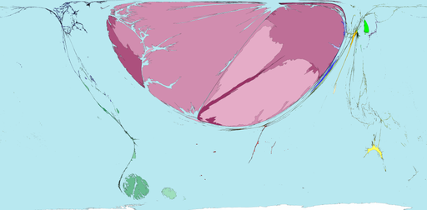
Financial and insurance Exporters

Slide 9
Of all the net finance and insurance services exports in the world, 99% of the profit flows to territories in Western Europe. Despite this, almost half of the 24 territories in Western Europe have no net finance and insurance services exports. The main exporting territories for these services are the United Kingdom, Switzerland, Germany and Luxembourg. The Malvinas (or Falkland Islands) are large on this map because they are resized according to the United Kingdom data.

Slide 10
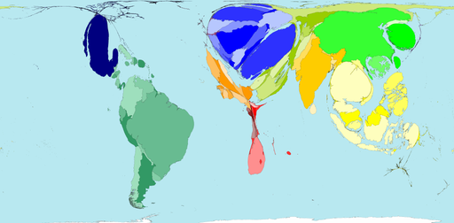
Debt Service 2002

Slide 11
Payments of debts (and the interest that is accrued) in 2002 were US$1158 billion when adjusted for purchasing power parity. This was 8.9% of the value of worldwide exports of goods and services that year.
Only 30 out of 200 territories did not have public debts to pay off. These territories were in Western Europe and North America, plus Australia, New Zealand and Zimbabwe.
Brazil paid the highest proportion of its income from exports, at 69%. Leaving only 31% to spend on services within the territory and to bring in imports from abroad. The largest total payments of debts in 2002 were by Brazil, China, Thailand and India.

Slide 12
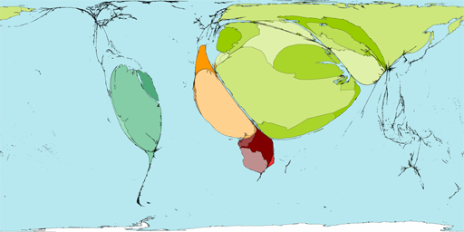
Spending vs Resources larger = negative spending

Slide 13
This map shows negative adjusted savings, which is when spending is greater than resources available.
Here the World Bank has measured savings by adjusting for educational spending as an investment in the future.
Pollution and environmental damage are counted as costs. Long term negative adjusted savings suggest an economy is on an unsustainable path. Poor territories are visible only if they are getting very much poorer.
75% of negative savings in 2003 were recorded in Middle Eastern territories; followed by 10% in South American territories; and 9% in Northern Africa. The largest negative savings were built up in the Russian Federation, Saudi Arabia, and Venezuela.

Slide 14
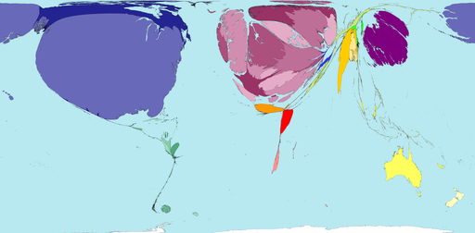
International food aid

Slide 15
Wars, droughts, economic collapse and other disasters disrupt access to basic necessities. This map shows sources of international financial donations intended to provide food for people whose normal way of getting food has failed.
In 2005 governments contributed about US$ 2.5 billion to food aid programmes. Half of this came from the United States; a third was from territories in Western Europe. These are some of the richest territories. A further US$ 0.5 billion was contributed by international organisations, individuals and charities. Food aid is a temporary measure dealing only with the immediate problem.

Slide 16
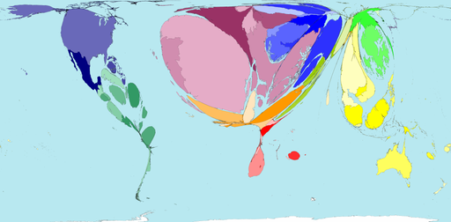
Tourism

Slide 17
This map shows tourist profits, gained when foreign tourists spend more in a territory than its residents spend abroad (as tourists themselves). Those territories that do not make a profit are not shown on this map.
The seven highest earning territories (per person) are islands: Bahamas, Palau, Barbados, Seychelles, Cyprus, Malta and Hong Kong. The highest net earnings are made in Spain where a profit of US$33 billion was made in 2003 which is more than twice the profit made by the second highest tourist earner: the United States.

Slide 18
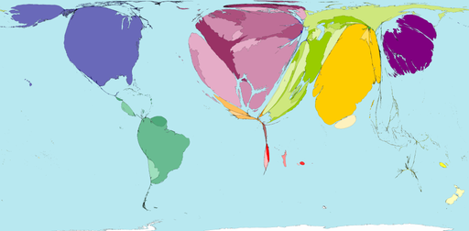
1980-2001 improved import vs export earnings – are these countries benefiting from a globalised economy?

Slide 19
Improving terms of trade means earning increasing amounts for exports whilst paying less for imports. This map shows the financial gain resulting from such changes.
The territories with no area on this map are experiencing the declining terms of trade necessary for others to have the improvements shown here.
The United States has gained the most from these changes, by 2001 US$ 202 billion extra per year was earned there than would have been at 1980s terms of trade.
India experienced a higher proportionate rise (but less actual money) even when adjusted for purchasing power parity: US$ 161 billion per year by 2001.

Slide 20
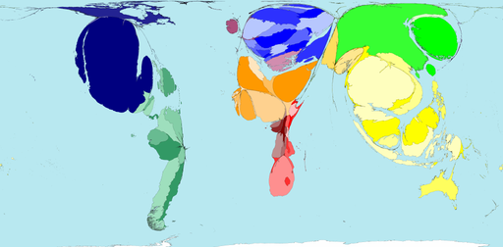
1980-2001 declining import vs export earnings- are these countries benefiting from a globalised economy?

Slide 21
"A tractor which cost five tons of Tanzanian tea in 1973 cost double that 10 years later. The less developed countries were (and still are) running just to stand still." Graham Young, 1990
Of the 200 territories mapped, 126 experienced declining terms of trade.
The territories with the largest relative falls in terms of trade were Burundi, Mexico, Chile and Peru.
In Mexico, by 2001 terms of trade had fallen to 33% of the 1980 figure; resulting in the largest absolute decline of US$ 176 billion less per year.
This means that in the territories shown here there needs to be increasing spending by local people to maintain living standards.

Slide 22
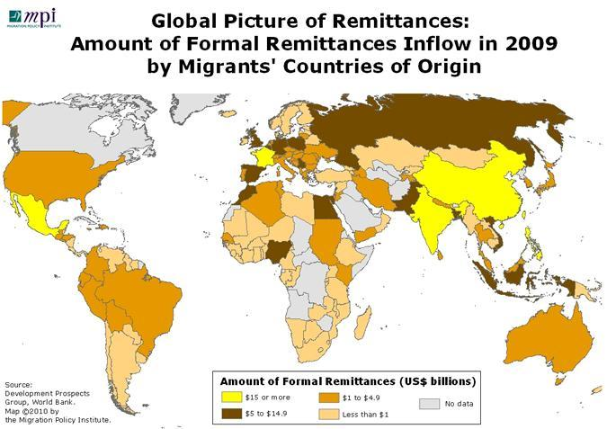

Slide 23
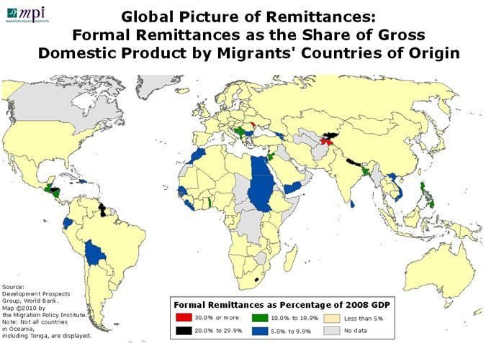

Slide 24
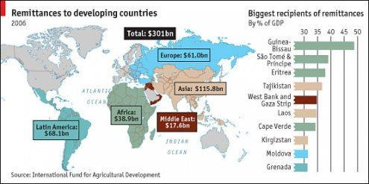

Slide 25
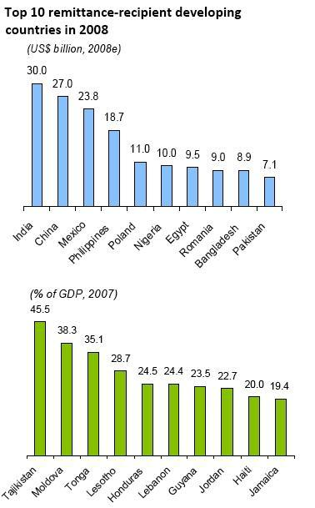

Slide 26
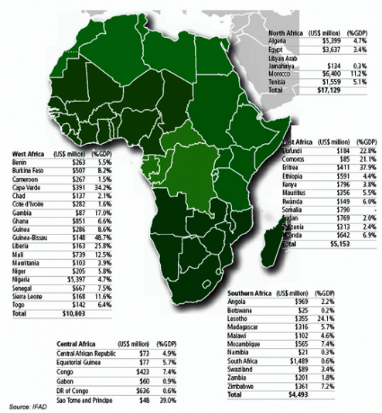

Slide 27
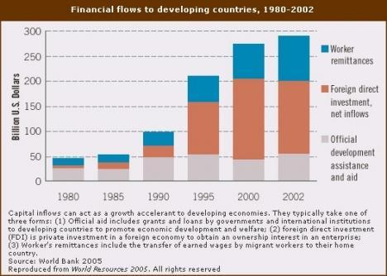

Slide 28
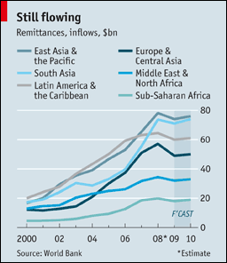

Slide 29
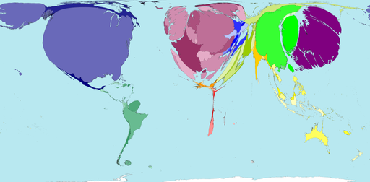
Research and Development Expenditure

Slide 30
Some Economic History – create a timeline…
Prior to WW1 – Gold Standard, fluid transfer of money was based on quantities of gold owned by Countries. This was exchanged for Currency of other nations when needed.
World War 1- Gold Standard abandoned, many countries stop trading foreign currencies and investing abroad due to suspicion of spying.
POST WW2 – Allied countries plan out future of economic structure for the world. Origin of the World Bank, World Trade Organisation and the international monetary fund.
Finish this timeline with the following labels, add some details
Floating exchange rates
Stock Exchanges
Stocks and Shares
Developments in technology
Liberalisation of money markets and deregulation e.g.?
Promotion of free trade

Slide 31
Why are global economic flows important? What? How? Why?

Slide 32
Subprime securities
The subprime crisis came about in large part because of financial instruments such as securitization
banks would pool their various loans into sellable assets, thus off-loading risky loans onto others.
For banks, millions can be made in money-earning loans, but they are tied up for decades. So they were turned into securities.
The security buyer gets regular payments from all those mortgages; the banker off loads the risk. Securitization was seen as perhaps the greatest financial innovation in the 20th century.

Slide 33
Starting in Wall Street, others followed quickly. With soaring profits, all wanted in, even if it went beyond their area of expertise. For example,
Banks borrowed even more money to lend out so they could create more securitization. Some banks didn’t need to rely on savers as much then, as long as they could borrow from other banks and sell those loans on as securities; bad loans would be the problem of whoever bought the securities.

Slide 34
Some investment banks like Lehman Brothers got into mortgages, buying them in order to securitize them and then sell them on.
Some banks loaned even more to have an excuse to securitize those loans.
Running out of who to loan to, banks turned to the poor; the subprime, the riskier loans. Rising house prices led lenders to think it wasn’t too risky; bad loans meant repossessing high-valued property. Subprime and “self-certified” loans (sometimes dubbed “liar’s loans”) became popular, especially in the US.

Slide 35
Some banks evens started to buy securities from others.
Collateralized Debt Obligations, or CDOs, (even more complex forms of securitization) spread the risk but were very complicated and often hid the bad loans. While things were good, no-one wanted bad news.

Slide 36
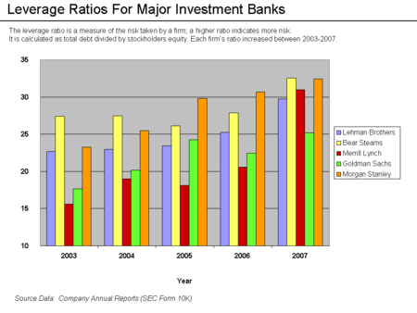
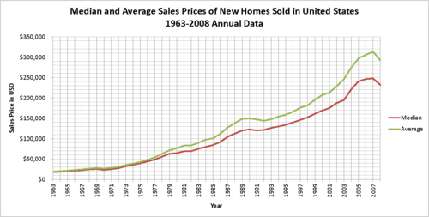
House Prices and risk takers

Slide 37
AND THEN….
When people did eventually start to see problems, confidence fell quickly. Lending slowed, in some cases ceased for a while and even now, there is a crisis of confidence.
Assets were plummeting in value so lenders wanted to take their money back. But some investment banks had little in deposits; no secure retail funding, so some collapsed quickly and dramatically.
The problem was so large, banks even with large capital reserves ran out, so they had to turn to governments for bail out
Shrinking banks suck money out of the economy as they try to build their capital and are nervous about loaning. Meanwhile businesses and individuals that rely on credit find it harder to get. A spiral of problems result.

Slide 38
The International Monetary Fund estimated that large U.S. and European banks lost more than $1 trillion on toxic assets and from bad loans from January 2007 to September 2009.
These losses are expected to top $2.8 trillion from 2007-10.
U.S. banks losses were forecast to hit $1 trillion and European bank losses will reach $1.6 trillion.
The IMF estimated that U.S. banks were about 60 percent through their losses, but British and eurozone banks only 40 percent.

