Slide 1
River profile

Slide 2
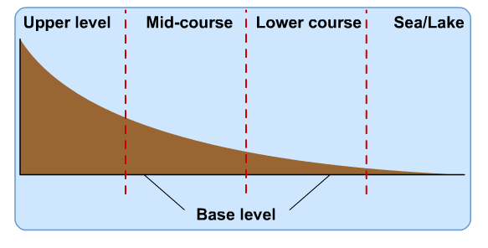
Longitudinal profile

Slide 3
Fluvial/River- Areas
The path the river follows from its source to mouth is known as the river's course.
When studying rivers we often divide it into 3 main sections, the upper course; middle course and lower course.
Each part of the river has distinctive features which form and the characteristics of the river and its surrounding valley change downstream.

Slide 4
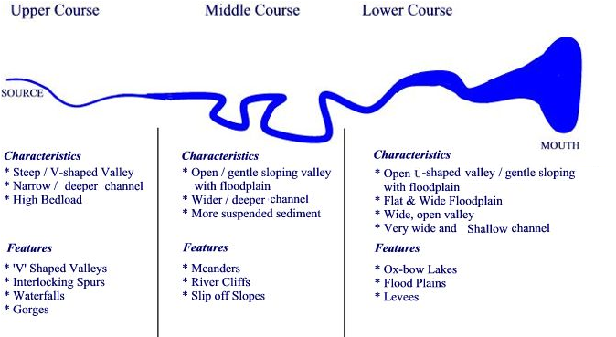
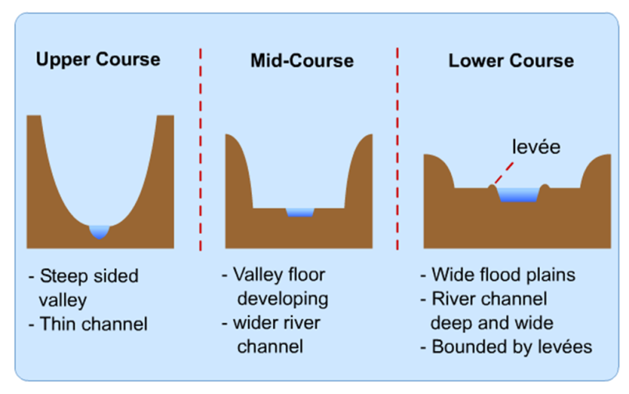

Slide 5
River Processes
As a river flows along its course it undertakes 3 main processes which together help to shape the river channel and the surrounding valley.
These processes are erosion, transport and deposition.

Slide 6
RIVER EROSION
River erosion is the wearing away of the land as the water flows past the bed and banks. There are four main types of river erosion. These are:
Attrition - occurs as rocks bang against each other gradually breaking each other down (rocks become smaller and less angular as attrition occurs)
Abrasion - this is the scraping away of the bed and banks by material transported by the river
Solution - chemicals in the river dissolve minerals in the rocks in the bed and bank, carrying them away in solution.
Hydraulic Action - this is where the water in the river compresses air in cracks in the bed and banks. This results in increased pressure caused by the compression of air, mini 'explosions' are caused as the pressure is then released gradually forcing apart parts of the bed and banks.

Slide 7
RIVER TRANSPORT
Material may be transported by a river in four main ways: solution; suspension; saltation and traction.
The type of transport taking place depends on...
(i) the size of the sediment and
(ii) the amount of energy that is available to undertake the transport.
The chemical composition of the parent rock from which sediments originate.
In the upper course of the river there is more traction and saltation going on due to the large size of the bed-load, as a river enters its middle and lower course there is a lot of finer material eroded from further upstream which will be carried in suspension.

Slide 8
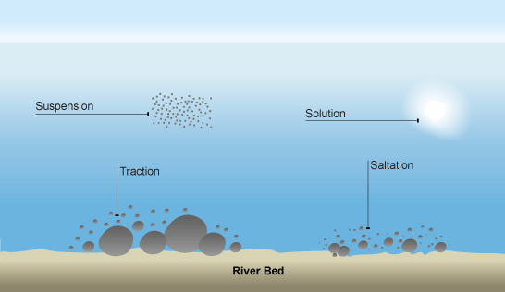

Slide 9
DEPOSITION
is where material carried by the river is dropped.
occur when there is no longer sufficient energy to transport material.
May result in the formation of features such as slip off slopes (on the inner bends of meanders); levees (raised banks) alluvial fans; meanders; braided streams and the floodplain.
Remember - it is the largest material that will be dropped first as it requires the most energy to be transported. Eroded material carried in suspension and solution will be dropped last.

Slide 10
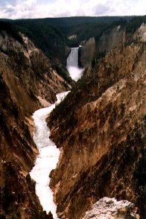
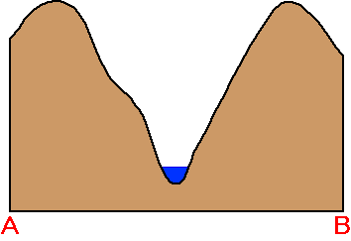
Cross Profile-Upper course

Slide 11
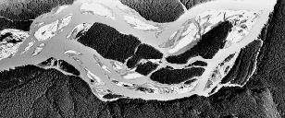
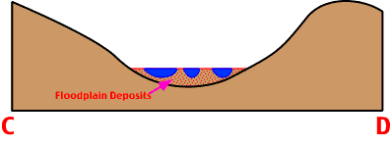
Cross Profile Middle course

Slide 12
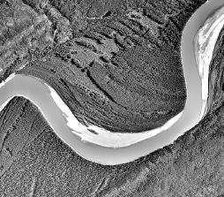
Cross Profile Lower course

