Slide 1
Channel Efficiency
Channel Roughness

Slide 2
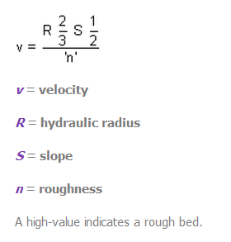
Channel Roughness
It is often thought that the velocity of a river is greatest near its start. This is not the case, as large angular boulders create a rough channel shape and therefore, a large amount of its bed friction. This creates more resistance to flow than a river with smooth clays and silt forming its banks. The roughness coefficient is measured using Manning's 'n', which shows the relationship between channel roughness and velocity.
The equation is as follows:

Slide 3
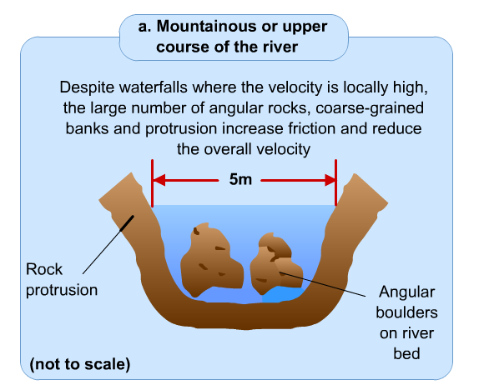

Slide 4
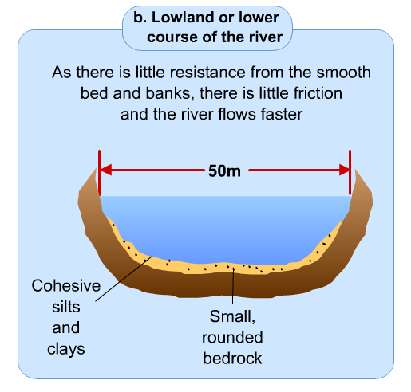

Slide 5
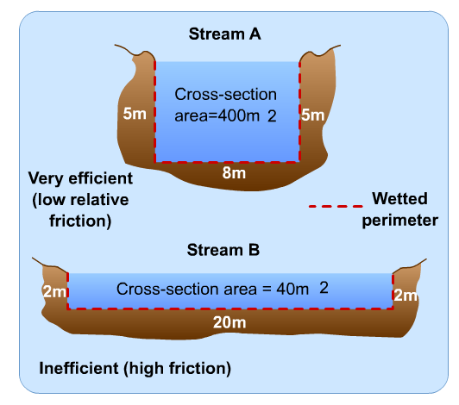
Channel Shape
The efficiency of a rivers channel is measured by finding its Hydraulic radius. It is the ratio between the length of wetted perimeter and cross section of a river channel.
Wetted perimeter: the entire length of the riverbed bank and sides in contact with water.

