Slide 1
The Amazon

Slide 2
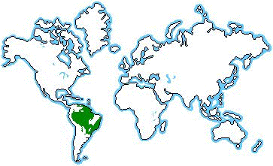
The amazon forest is located in the upper section of Brazil south of the Equator. It is also found in different other countries including, Peru, Boliva, Equador and French Guinea. It covers averagely 40 percent of South America

Slide 3
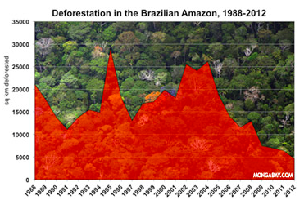
Deforestation rates have been reducing while areas of conserved land have been increasing over the last 10 years. In both 2005 and 2010 the Amazon rainforest suffered severe droughts that killed off large amounts of vegetation in the worst affected areas. Scientist suggests that a 3-degree rise in the world temperatures by the year 2010 would destroy around 75% of the Amazon.

Slide 4
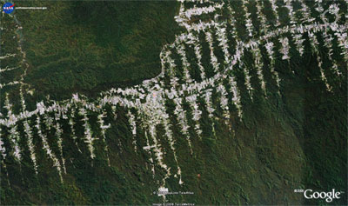
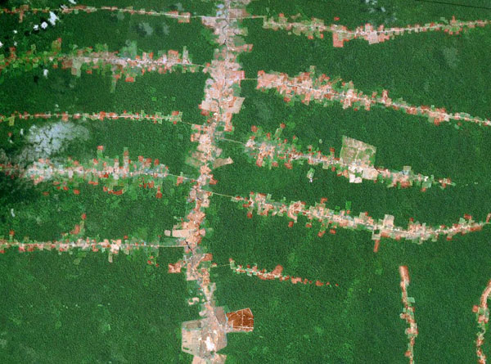
Example of railway road

Slide 5
Value of the rainforest, globally and to the country
GLOBALLY
Medicinal plants = medical remedies
Ecotourism (Avoid people to damaged the environment)
Biodiversity (The largest amount of living organisms in the world e.g. we found half of the world's species of plants, animals and microorganisms approximatively 10 million different species )
Financial (e.g. making of paper = trade around the world, farming and food production at least 80% of the developed world's diet )
Photosynthesis produce oxygen for the world (20% of the oxygen of the world is coming from the Amazon)
COUNTRY
Home to Indigenous (tribes are living there since generations) Ameridians.

Slide 6
Why and how are we damaging it ?
Why?
People are deforesting the amazon for various reasons. Some are cutting trees for woodcarving, coal, manufacturing papers, export and import. Some people are also cutting trees for getting more land to build house or buildings. The population is increasing but not the land so people wants to take place in forests. Brazilians wants to cut down the amazon because they need more land for agriculture and the profit made from logging industry is apparently more important than preserving natural beauty.

Slide 7
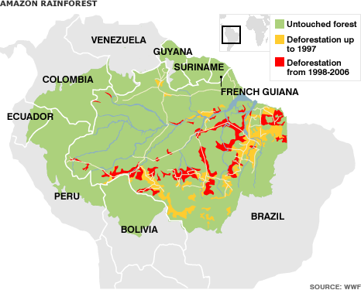

Slide 8
How?
The east cost of Brazil is starting to overpopulate so the government asks the people to move more in central Brazil, which is the amazon and where the yellow part are found on this map are next to the roads because it has an easier access for people to live there.

Slide 9
Conservation efforts
Amazon education, make aware people of the importance of the forest ( from school)
Replant trees
Ecotourism
Sustainable rainforest product. The real solution to saving the rainforest is to make its inhabitants see the forest and the trees by creating a consumer demand and consumer markets for these sustainable rainforest products.
Organizations

Slide 10
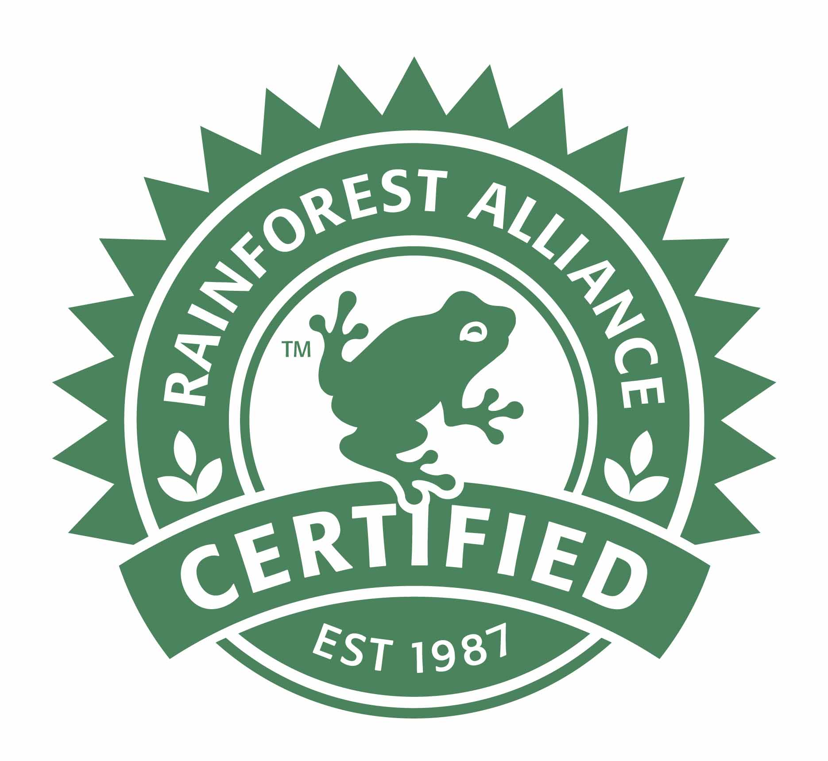
Sustainable agriculture Rainforest Alliance Certified, NGO ( Number of certified farms: 875,091) The goals of this organization are :
Wildlife habitat is protected
Less water pollution and Reduced threats to the environment and human health = controlled of sources of contamination (pesticides, fertilizers)
Less soil erosion= soil conservation: planting on contours and maintaining ground cover.
Less waste, banana stems, coffee pulp, orange peels and un-marketable foliage are composted .Other wastes are recycled.
Less water used, as water conservation measures are applied in washing and packing stations, housing areas and irrigation systems.
More efficient farm management, organize, plan, schedule improvements in farms.
More collaboration between farmers and conservationists.

Slide 11
WWF
The single biggest threat to the Brazil nut trees is deforestation, the only way to eradicate the threat to the species is to take care of the forests.
Brazil nut producers organize themselves into cooperatives, obtain certification for their product and gain access to new purchasing markets.
The aim of the project is to increase the income of Brazilian communities that depend on Brazil nut production and in that way contribute towards maintaining the standing forests by means of the sustainable use of forest resources.
The project provides training for Brazil nut producers in best harvesting practices, storage, drying and transportation of Brazil nuts.
This project is successful because innovations have introduced in the way in which the product is commercialized. It has led to significant improvements in the quality of the product stemming from the training that was given and the organization of producers in cooperatives. The producers themselves have been able to exercise greater control over the commercialization process and obtain better prices.

